Slide 1
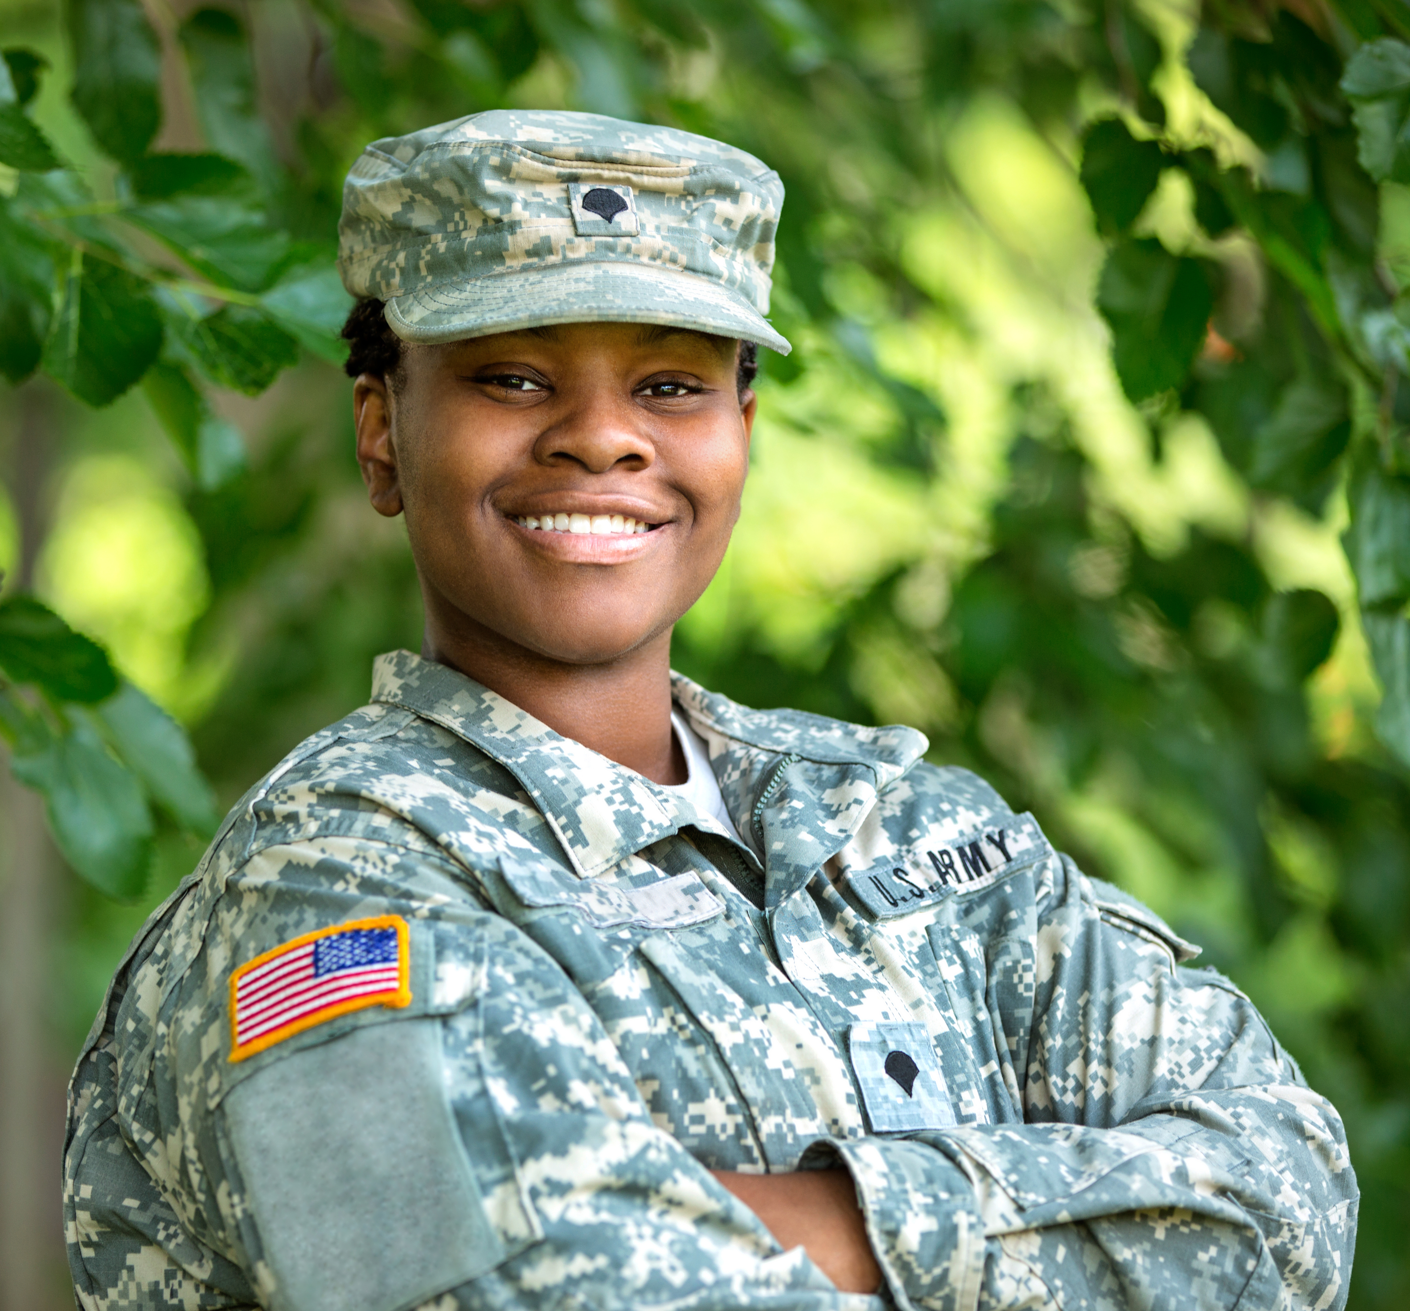
The National Quantum Literacy Network is not a future network, it is a now network that will impact the future.
Addressing Hyper-Disparities in Quantum Literacy Education and Training of Historically Underrepresented Groups through an Artificial Intelligence-Powered Micro-Credential Certification Program

Slide 2
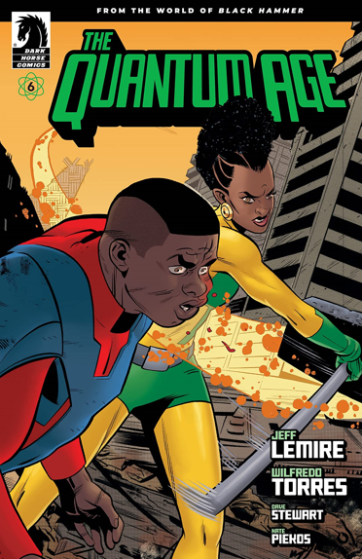
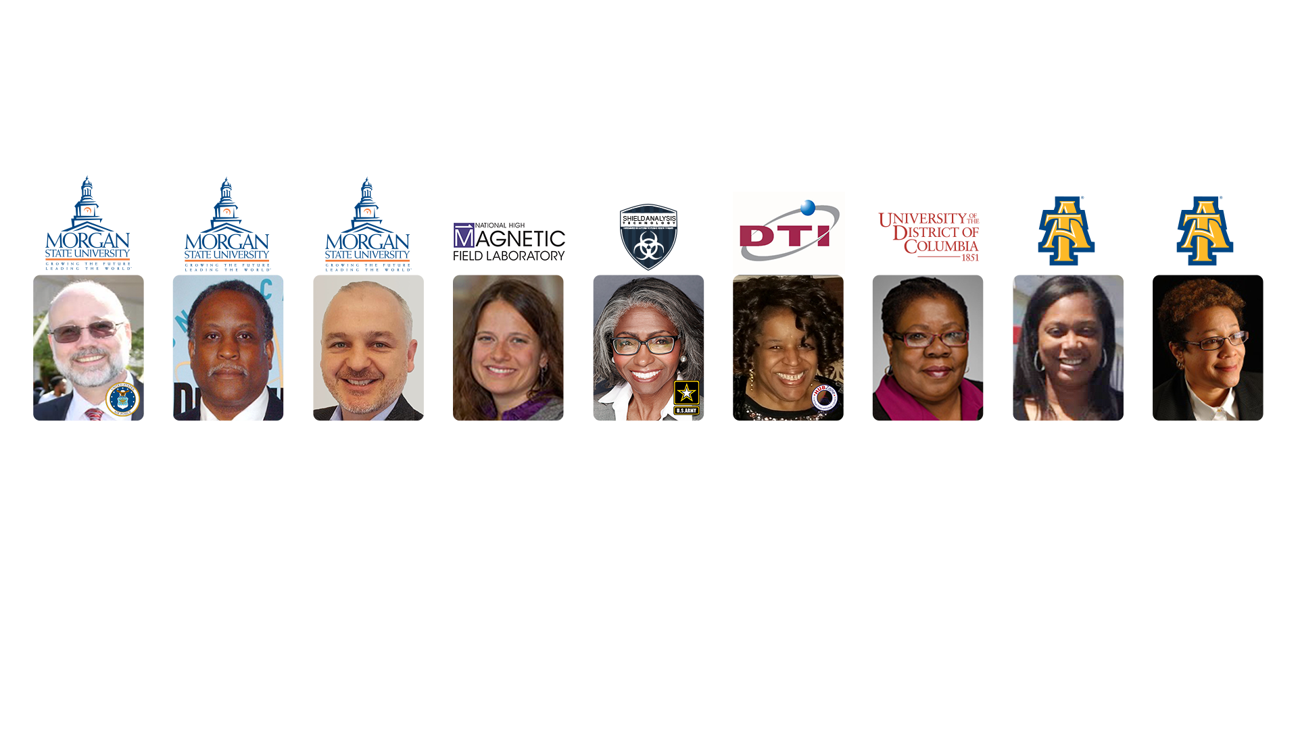
Dr. Timothy Akers
Lead-PI and Member,
National Quantum Initiative Advisory Committee
Dr. Kevin Peters
Co-PI
Dr. Birol Ozturk
Co-PI
Dr. Roxanne Hughes
Co-PI
Dr. Denise Baken
Co-PI
Ms. Lily Milliner
Co-PI
Dr. Marilyn Hamilton
Team Lead
Dr. Evelyn Sowells-Boone
Team Lead
Dr. Tonya Smith-Jackson
Team Lead
quantumliteracy.com

Slide 3
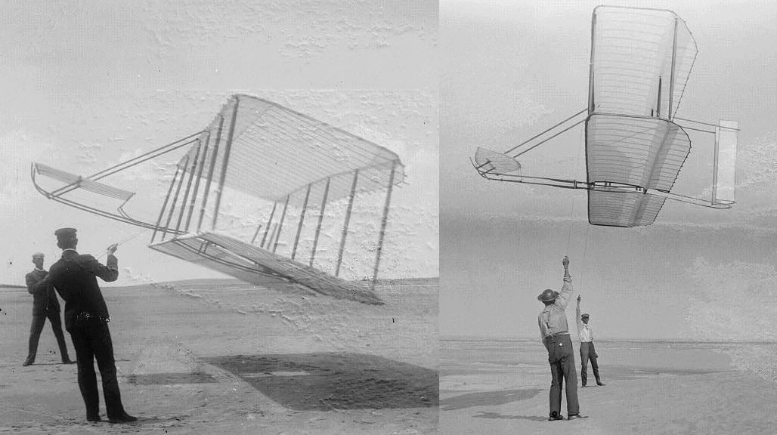
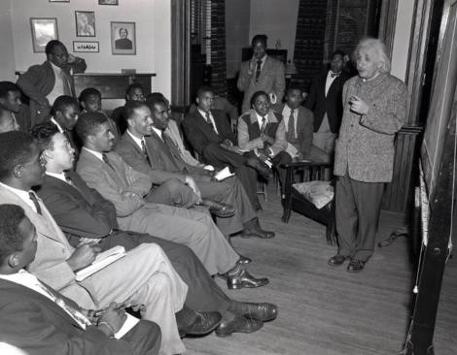
DIVERSITY AND INCLUSION IN QUANTUM LITERACY EDUCATION
“Conceived by genius.
Achieved by dauntless resolution
and unconquerable faith.”
Inscription on the Wright Memorial at Kitty Hawk, 1903.
Albert Einstein Physics Lecture, Lincoln University, 1946.

Slide 4
Phase I

Slide 5
Phase I

Slide 6
Phase I - Pathway

Slide 7
Phase I

Slide 8
MAJOR QUANTUM LITERATE WORKFORCE IMPACT
Quantum Project Objectives
Increase Gen-Z Q-Literacy
Develop Skilled QL-Workforce (Deep Learning)
Mitigate Historical Bias
Provide Position- and Application-Based Training
Deliver Diverse Learning Styles
Create Scalable QL-Defense Systems
Design Targeted QL-Learning (Quantum Applications)
“There’s a supply-chain problem brewing in the long range when things become more commercial. It’s not just the same rack that a telecom technician can install and forget about. The future will require much more specific components targeting a wide range of quantum applications.”
Celia Merzbacher, Ph.D.
Executive Director
Quantum Economic Development Consortium
Accessed from “Plan for Quantum Supply Chains and Supply-Chain Management” (White Paper)
By Carolyn Mathas

Slide 9
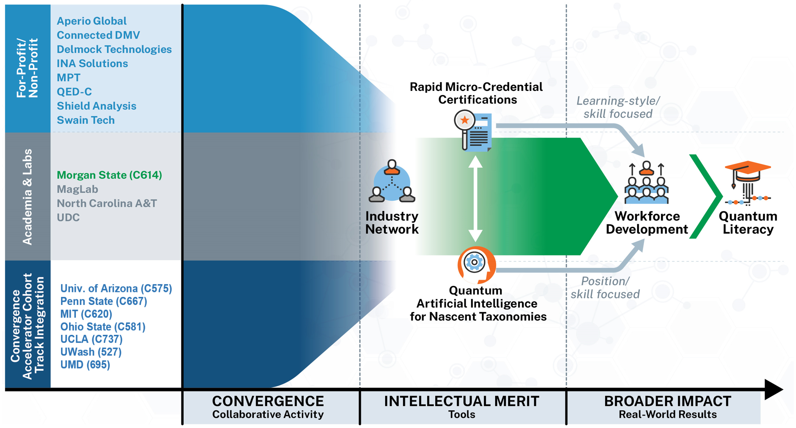
QUANTUM APPLICATIONS THROUGH PLANNED, COLLABORATIVE APPROACHES TO SUCCESS

Slide 10
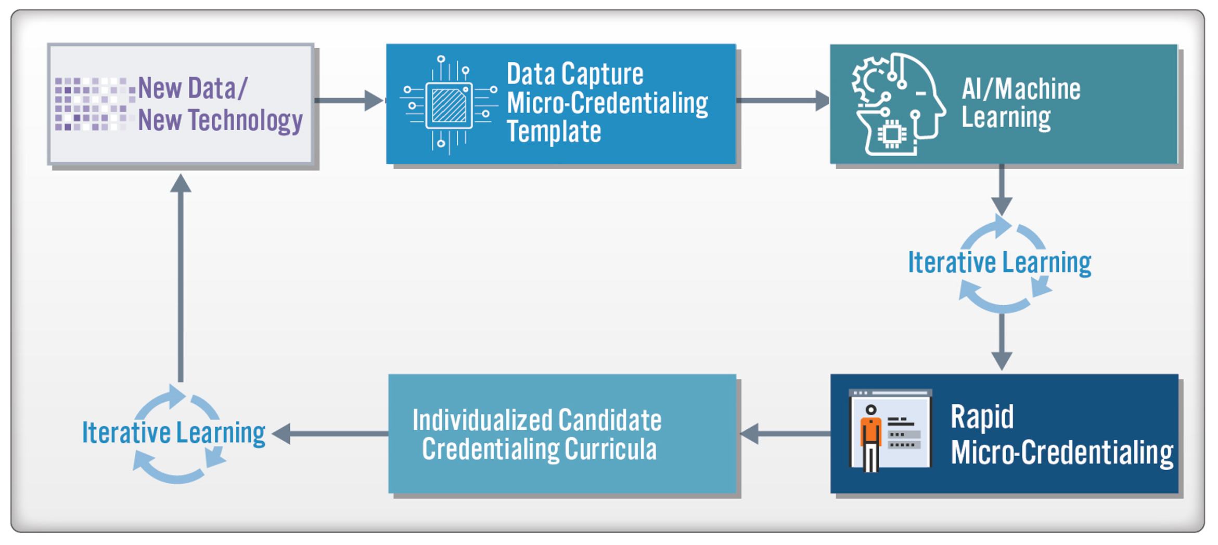
QUANTUM LITERACY WORKFORCE PROTOTYPES

Slide 11
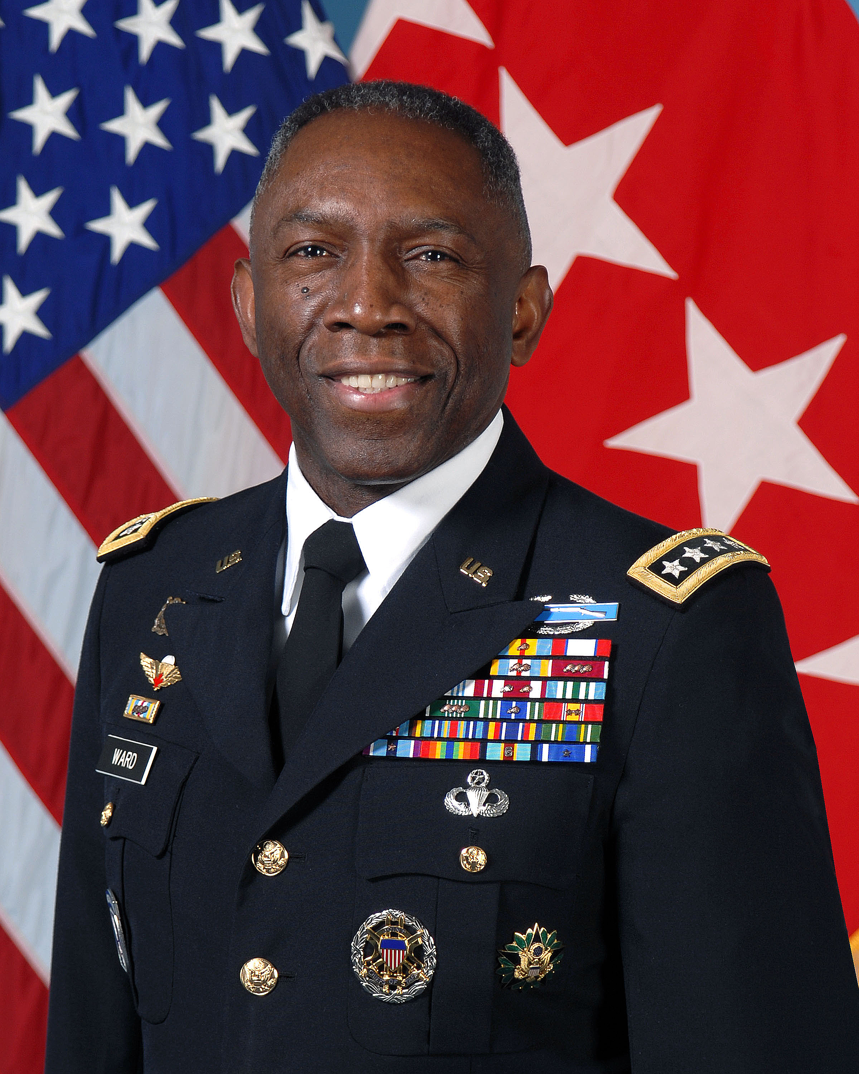
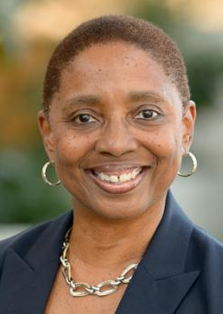
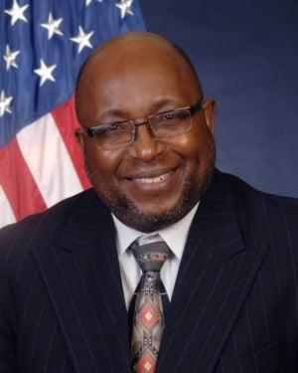
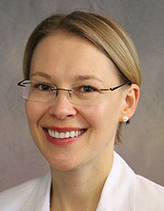
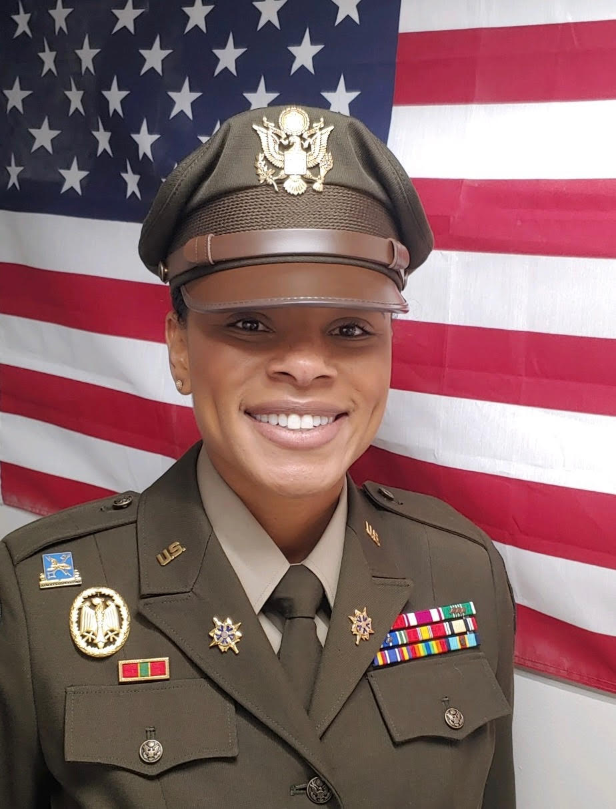
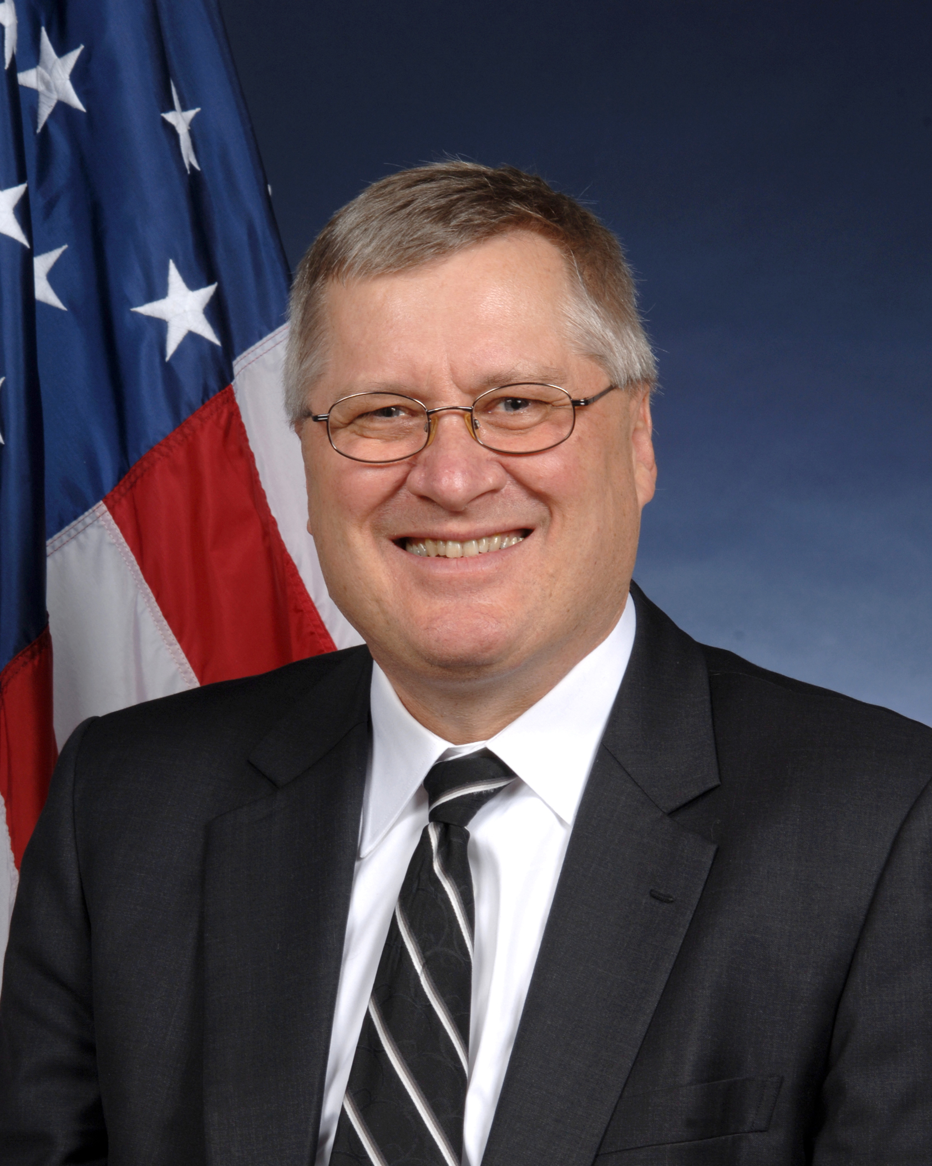
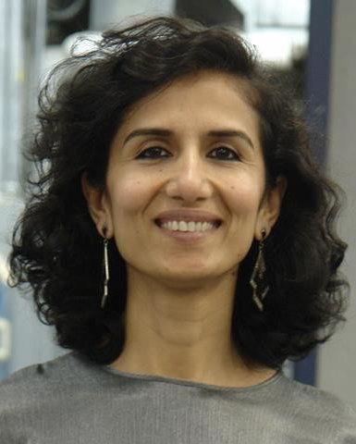
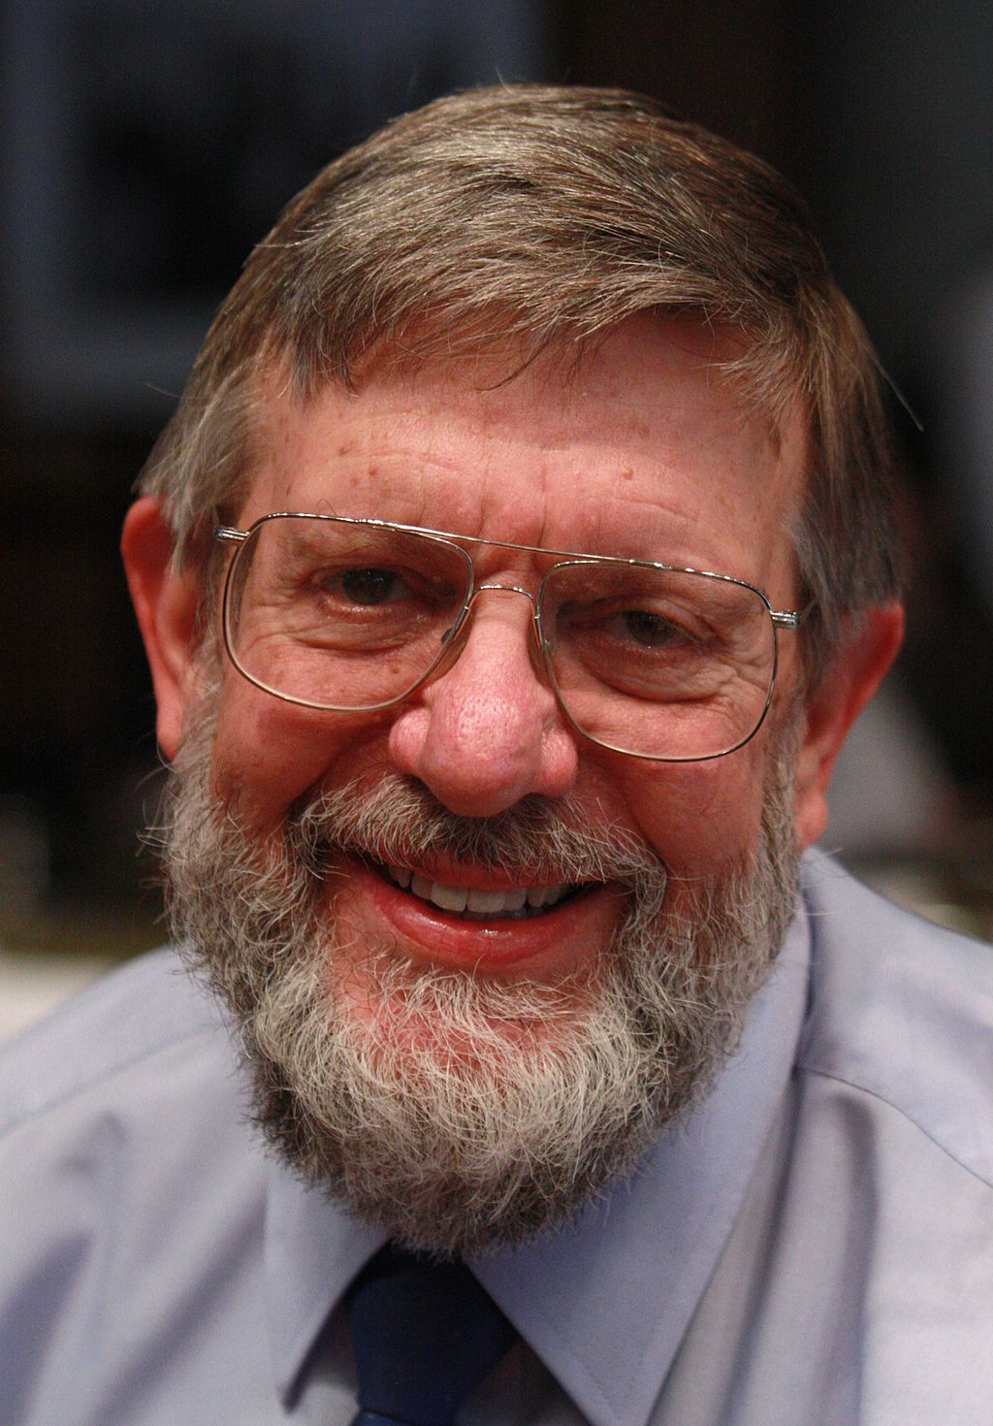
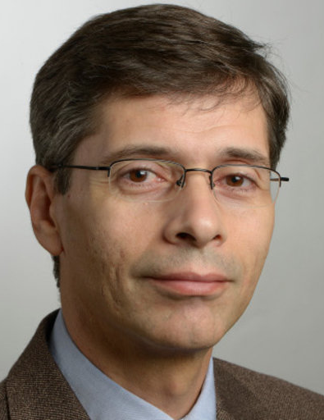
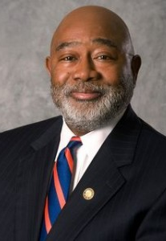
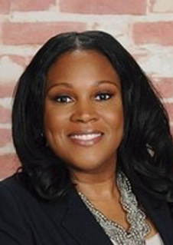
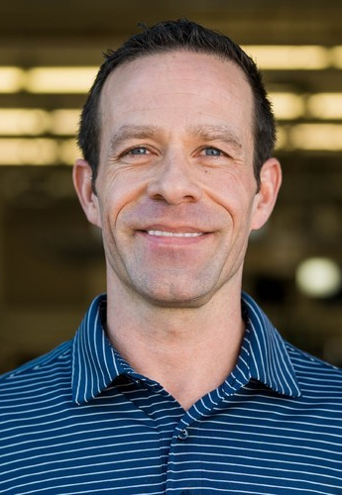
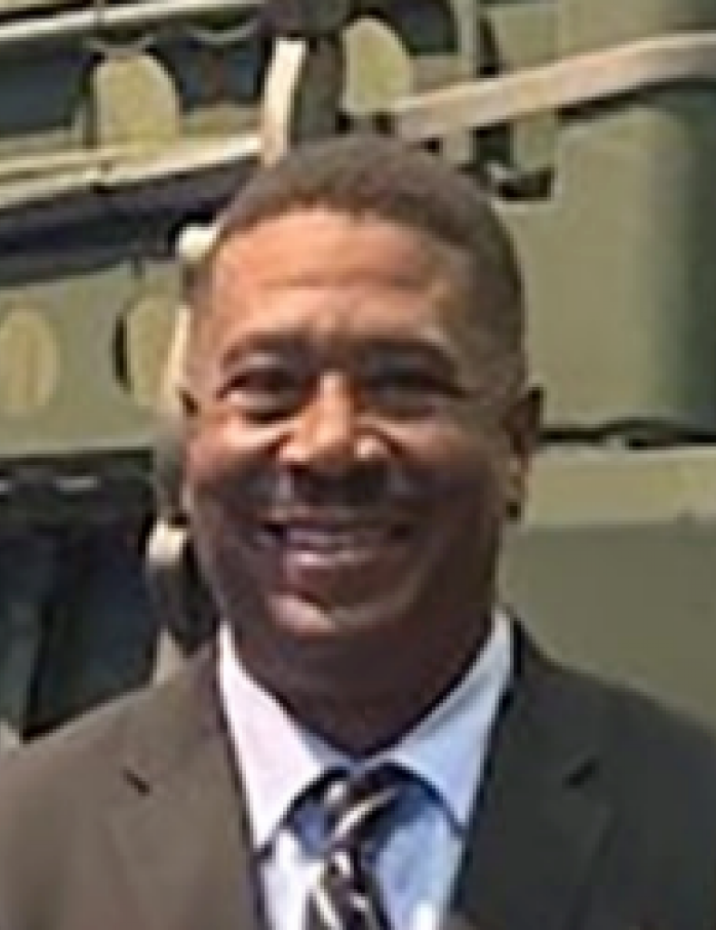
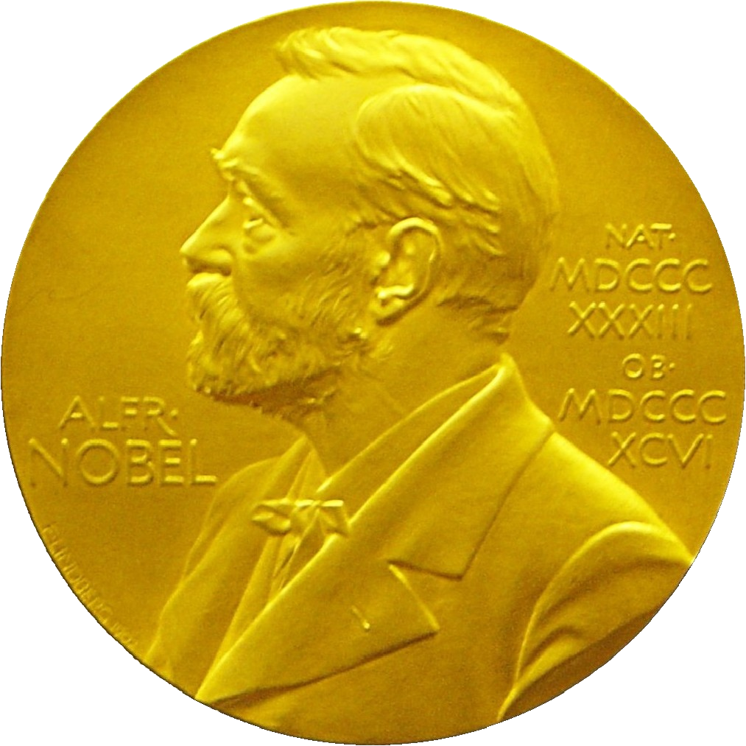
NATIONAL ADVISORY BOARD

Slide 12
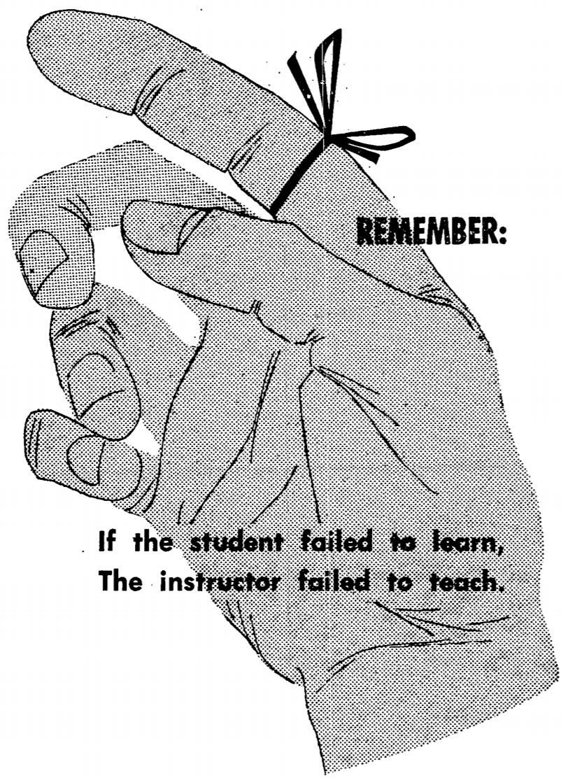
WHY WE
PRESS ON . . .
Thank you!
Where convergence begins,
learning accelerates.
DEPARTMENT OF THE ARMY Techniques of Military Instruction, FM 21-6
May 1954
NATIONAL QUANTUM LITERACY NETWORK May 2021

Slide 13
Contact Information:
Timothy A. Akers
Morgan State University
Timothy.akers@morgan.edu
Also, go to:
quantumliteracy.com
&
NQLweek.com

