Slide 1

Quantum for ALL
Preparing Secondary Teachers to Teach Quantum Information Science #2009351
Developing and Testing Innovations (DTI): Preparing Secondary Teachers and Students #2048691 DRL
Dr. Karen Jo Matsler (Principal Investigator)
kmatsler@uta.edu
817-723-1132
Notes:
https://www.nsf.gov/awardsearch/showAward?AWD_ID=2048691&HistoricalAwards=false
https://www.nsf.gov/awardsearch/showAward?AWD_ID=2048691&HistoricalAwards=false

Slide 2
Quantum for All Goals
Promote quantum information science (QIS) through STEM integration in the HS
Increase awareness of quantum-smart and diverse career opportunities related to QIS
Increase confidence (students and educators) with regard to understanding quantum concepts
Prepare students for future careers in industries related to quantum
QED-C Goals https://quantumconsortium.org/goals/
Identify applications of quantum based technologies
Workforce with skills in diverse applications
Work with stakeholders in industry, academia…
Notes:
Show how our goals are similar

Slide 3
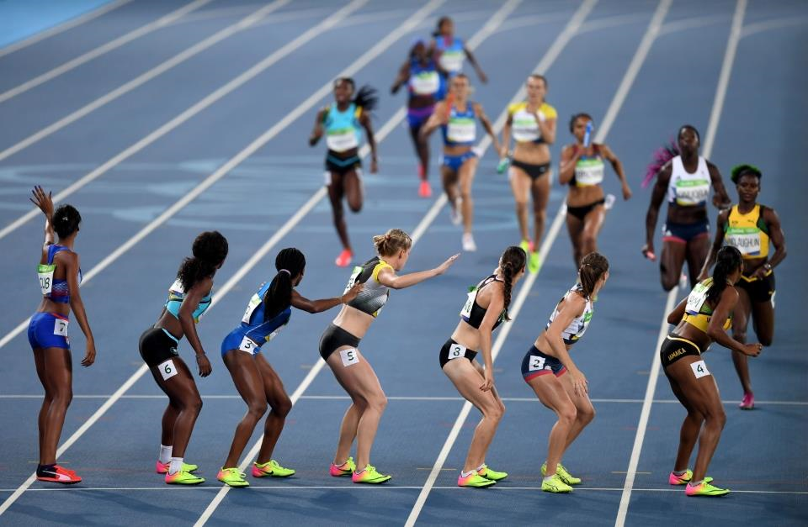
History and the competition…..
2013 UK appropriated 270 million dollars for quantum program [UKQT, 2015]
2016 Canada implements pre college awareness
Dec. 2018 U.S. Congress passed National Quantum Initiative Act to advance quantum technology and computing
Jan. 2019 National Quantum Initiative Program signed into law https://www.quantum.gov/
Aug. 2020 NSF, OSTP initiative to expand to HS and MS
Dec. 2020 National Q-12 Partnership kickoff
Presently developing key concepts for HS QISE https://q12education.org/
Notes:
Show how our goals are similar

Slide 4
What is QfA doing?
What we do best…teach, but we need your knowledge to ensure relevance, accuracy, and real world examples
Goal 2: Increase awareness of quantum-smart and diverse career opportunities related to QIS

Slide 5
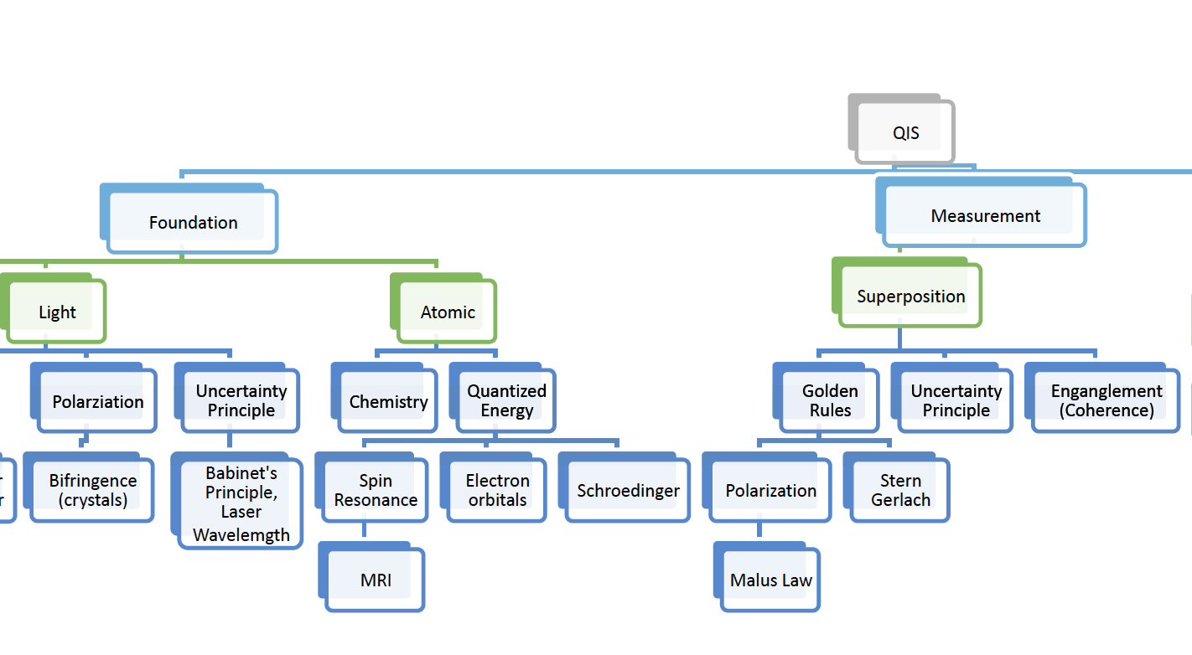
QfA is providing
Content support for educators
Real world applications
Tailored curriculum that aligns with QIS and their current standards
Extensions to address and introduce quantum connections
Integration into multiple subjects (STEM)
Opportunities for students to learn quantum based concepts
Notes:
Not adding more to what they do, but extending and increasing relevance.

Slide 6
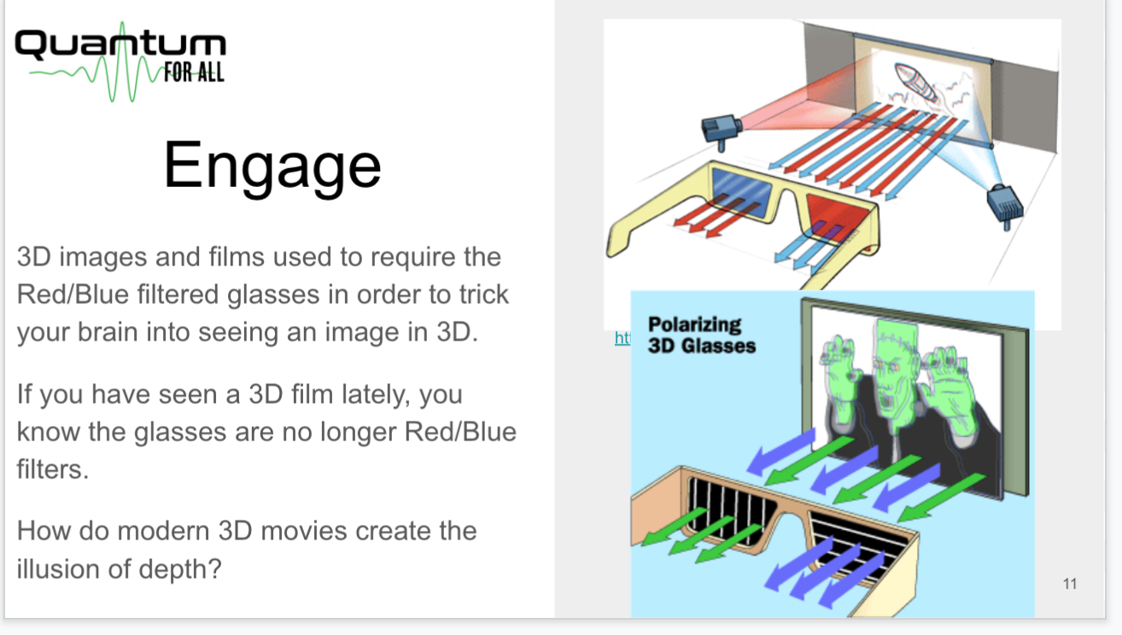
2021 Sample Lesson Topics
Quantum Connections
Bohr to Quantum
Golden Rules
Wave Particle Duality
Mach Zehnder
Heisenberg Uncertainty
Polarization, Malus’ Law
Quantum Cryptography
Start with the familiar and build lessons that integrate quantum concepts

Slide 7
Identifying and addressing challenges

Slide 8


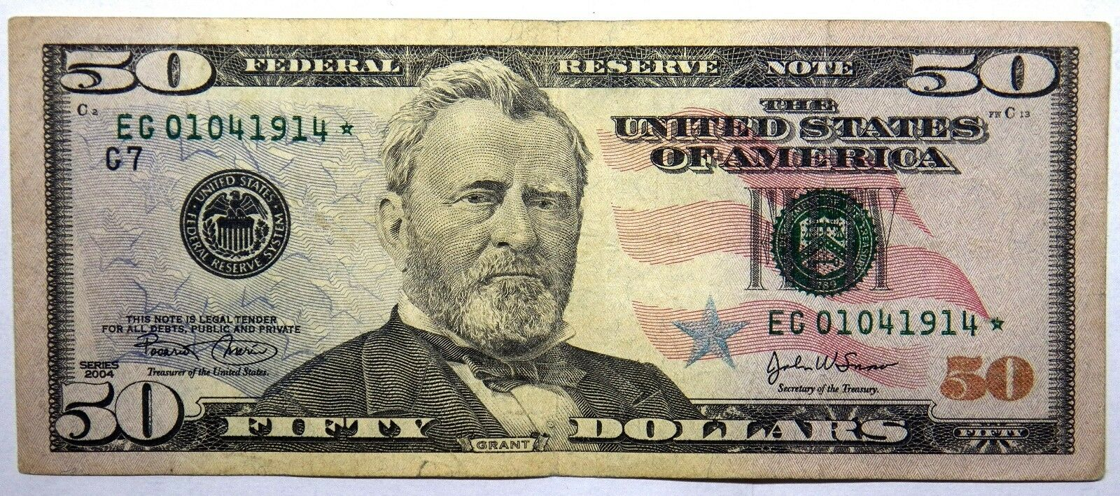

Challenges of teaching quantum K-12
Teachers do not have background for content or context of job opportunities
Appropriate resources are inadequate for K-12
Limited accountability in standards
Lack of awareness as to importance in workforce
Scalability to reach critical mass
TIME to learn, internalize, and build confidence in educators

Slide 9
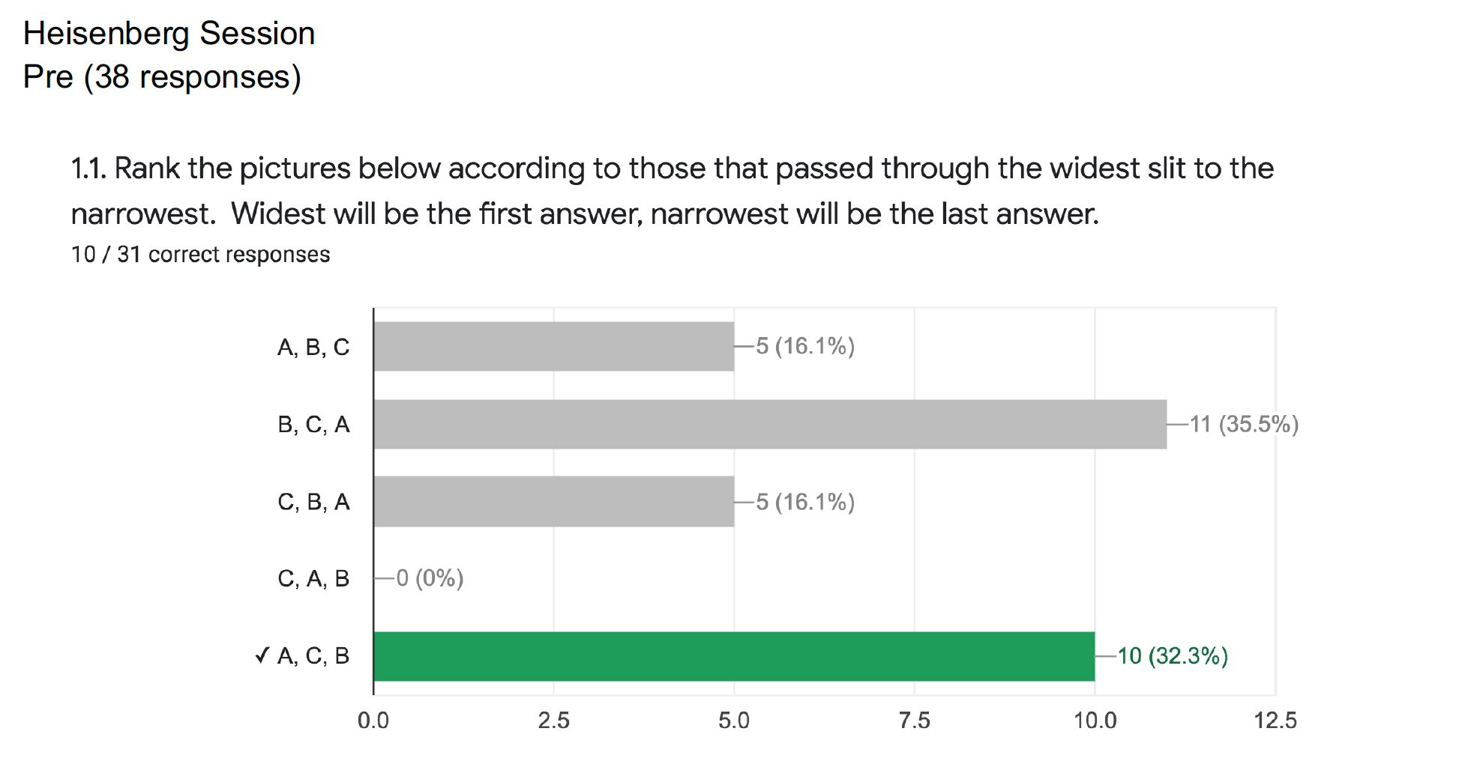
Need to Increase Understanding of Content
Heisenberg (Pre)

Slide 10
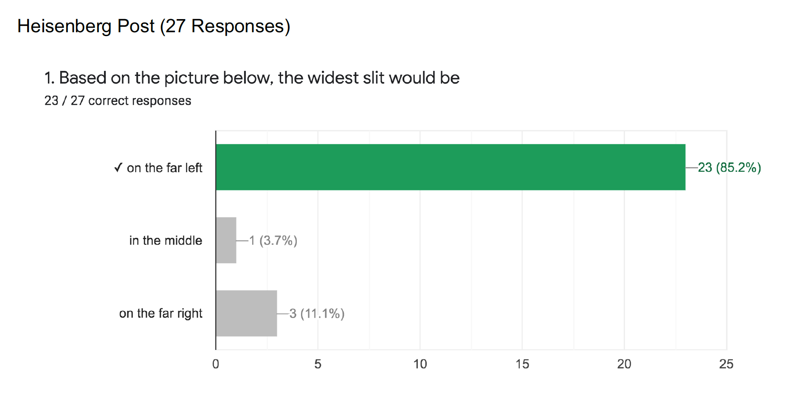
Heisenberg (Post)

Slide 11
Addressing the Challenges
Teachers do not have background for content or context
Project provides opportunities for educators to learn quantum concepts. They attend workshops then teach concepts at student camps. Had to close registration (had the interest but limited funding)
Lack of resources appropriate for K-12
Quantum for All is writing lessons embedding concepts in current curriculum (learning cycles, PER, etc.)
Most available resources are written for undergraduate and graduate students, not HS.
Connections in curriculum must be explicit to support novice teachers
Limited accountability in standards
Industry can influence lobbyists to emphasize QIS is really important for the future workforce. QIS needs to be in state and national standards. Currently working on key concepts for HS students. Larger concepts were done in May 2020, Quantum Key Concepts https://qis-learners.research.illinois.edu/
Limited awareness of importance of quantum in future workforce
Developing modules to help teachers see relevance.
We need partnerships with industry and research professionals to give relevance and help engage both teachers and students.
Time to reach critical mass, internalize content, build confidence
We need to quickly reach hundreds of students and teachers.
Teachers should be compensated for learning QIS content
Notes:
Typically written by university faculty with limited K-12 experience

Slide 12
We are making progress, but there is still much to do
(Participants)
July 6-9, 2020 (74-77)
November 14, 2020 (12)
December 12, 2020 (14)
January 16, 2021 (25)
(July-January =117 unique individuals with average of 6.3 hrs)
April 10, 2021 (25)
July 17-19, 2021 (Leadership conference, 22 for 25 hrs)
July 20-23, 2021 (Online Workshop, sent supplies, 55 participants, 14 leaders for avg. 15 hrs)
Research indicates a minimum of 80 hours of content exposure is needed before it will be successfully implemented in the classroom!

Slide 13

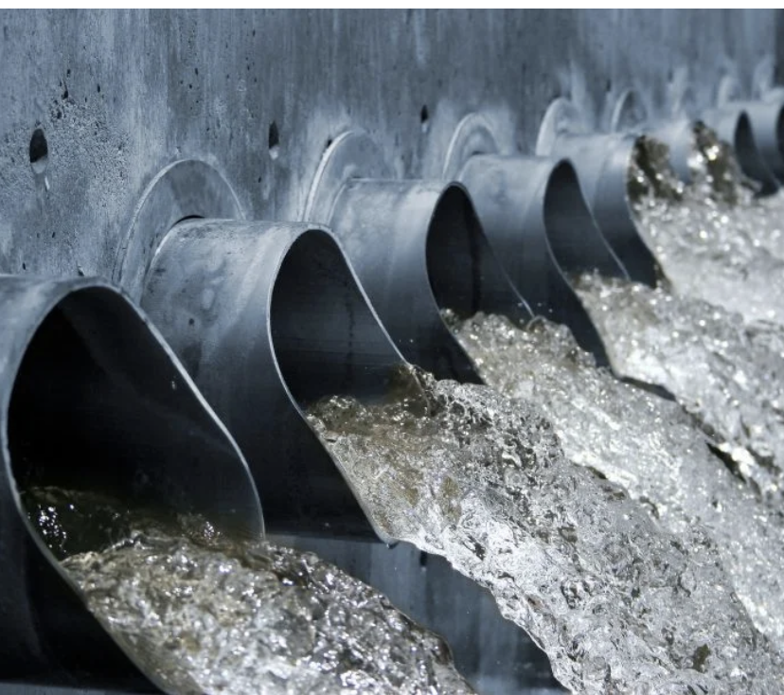
How can we help each other?
Connecting the Pipelines
Notes:
https://www.wspynews.com/news/local/city-of-joliet-agrees-to-lake-michigan-water-pipeline/article_9da946f4-648b-11eb-a6bb-9b904db7fffa.html

Slide 14
What Needs to Happen
Partnerships between educators, students, government, and industry are critical
Content and contextual support
Mentors, internships (students and teachers)
Recruit educators in your area
Help us identify industrial applications and
Identify future job market opportunities
Conversations with government officials
Lobbyists
Support for K-12 efforts
Financial support
Equipment for classrooms
Teacher scholarships
Support student camps for more sites
Student scholarships

Slide 15
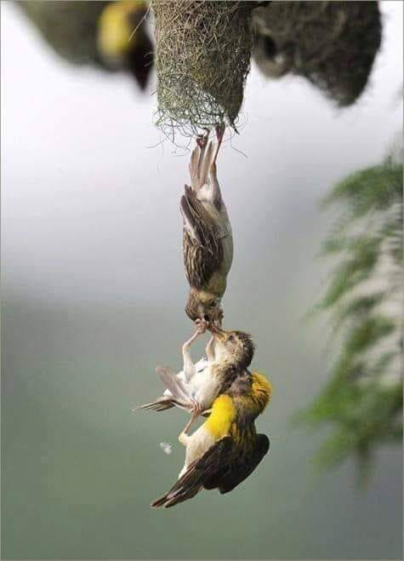
How can you help?
Share a quantum application used in your industry
Identify and share skills or job requirements students will need to be successful
Join our team of mentors to further share your expertise
Spread the word so we can reach more teachers! (email, social media, PR)
Provide camp/workshop scholarship(s) for a student, teacher, or an entire school district
Contribute equipment for use in the classroom
Create a 2-3 minute highlight video for us to share with students and teachers showing quantum applications in your business
Put your name, contact information, and company in chat along with what you would like to offer

Slide 16

Moving forward

Slide 17
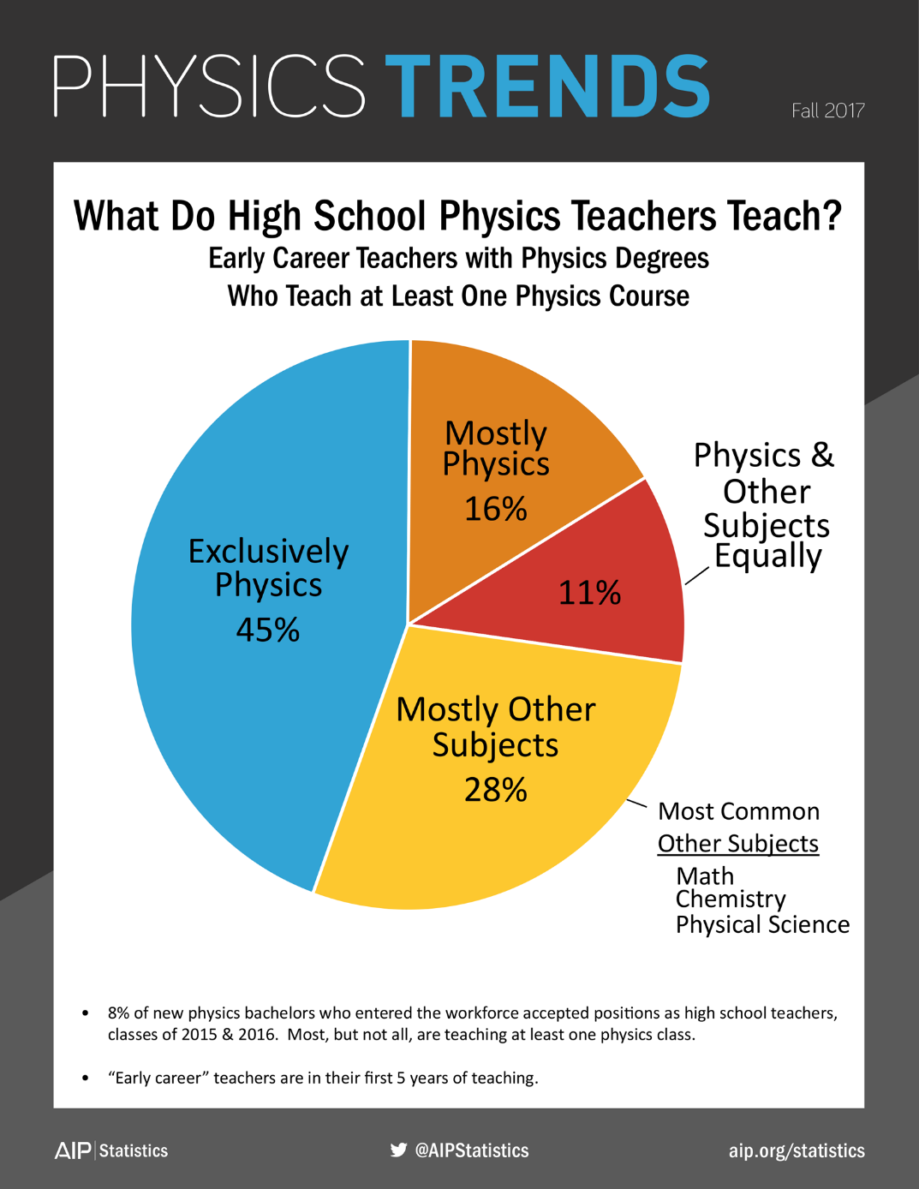
One logical venue for exposure to quantum is a physics course. However, according to the American Institute of Physics (AIP), nearly 100,000 students attended schools where physics was not even offered.
Quantum for All Students is providing opportunities for students to learn about quantum, regardless of whether they take a physics class by developing online resources and providing camps.
Notes:
2012

Slide 18
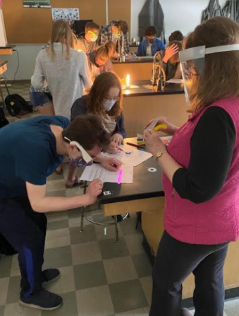
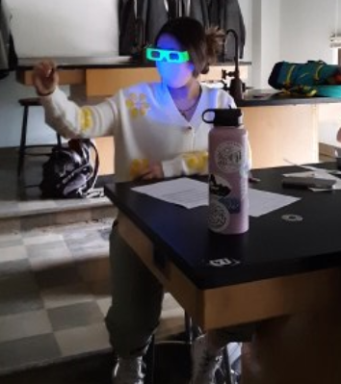
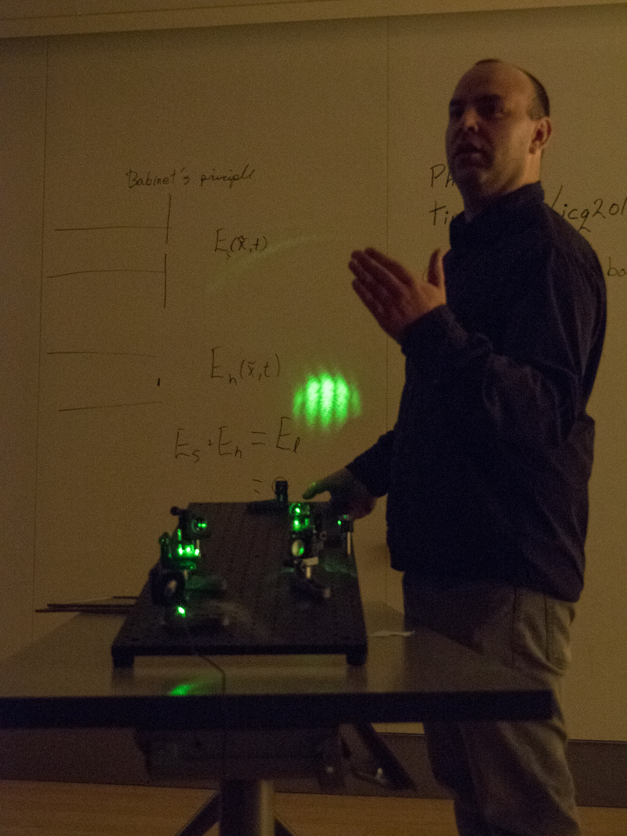
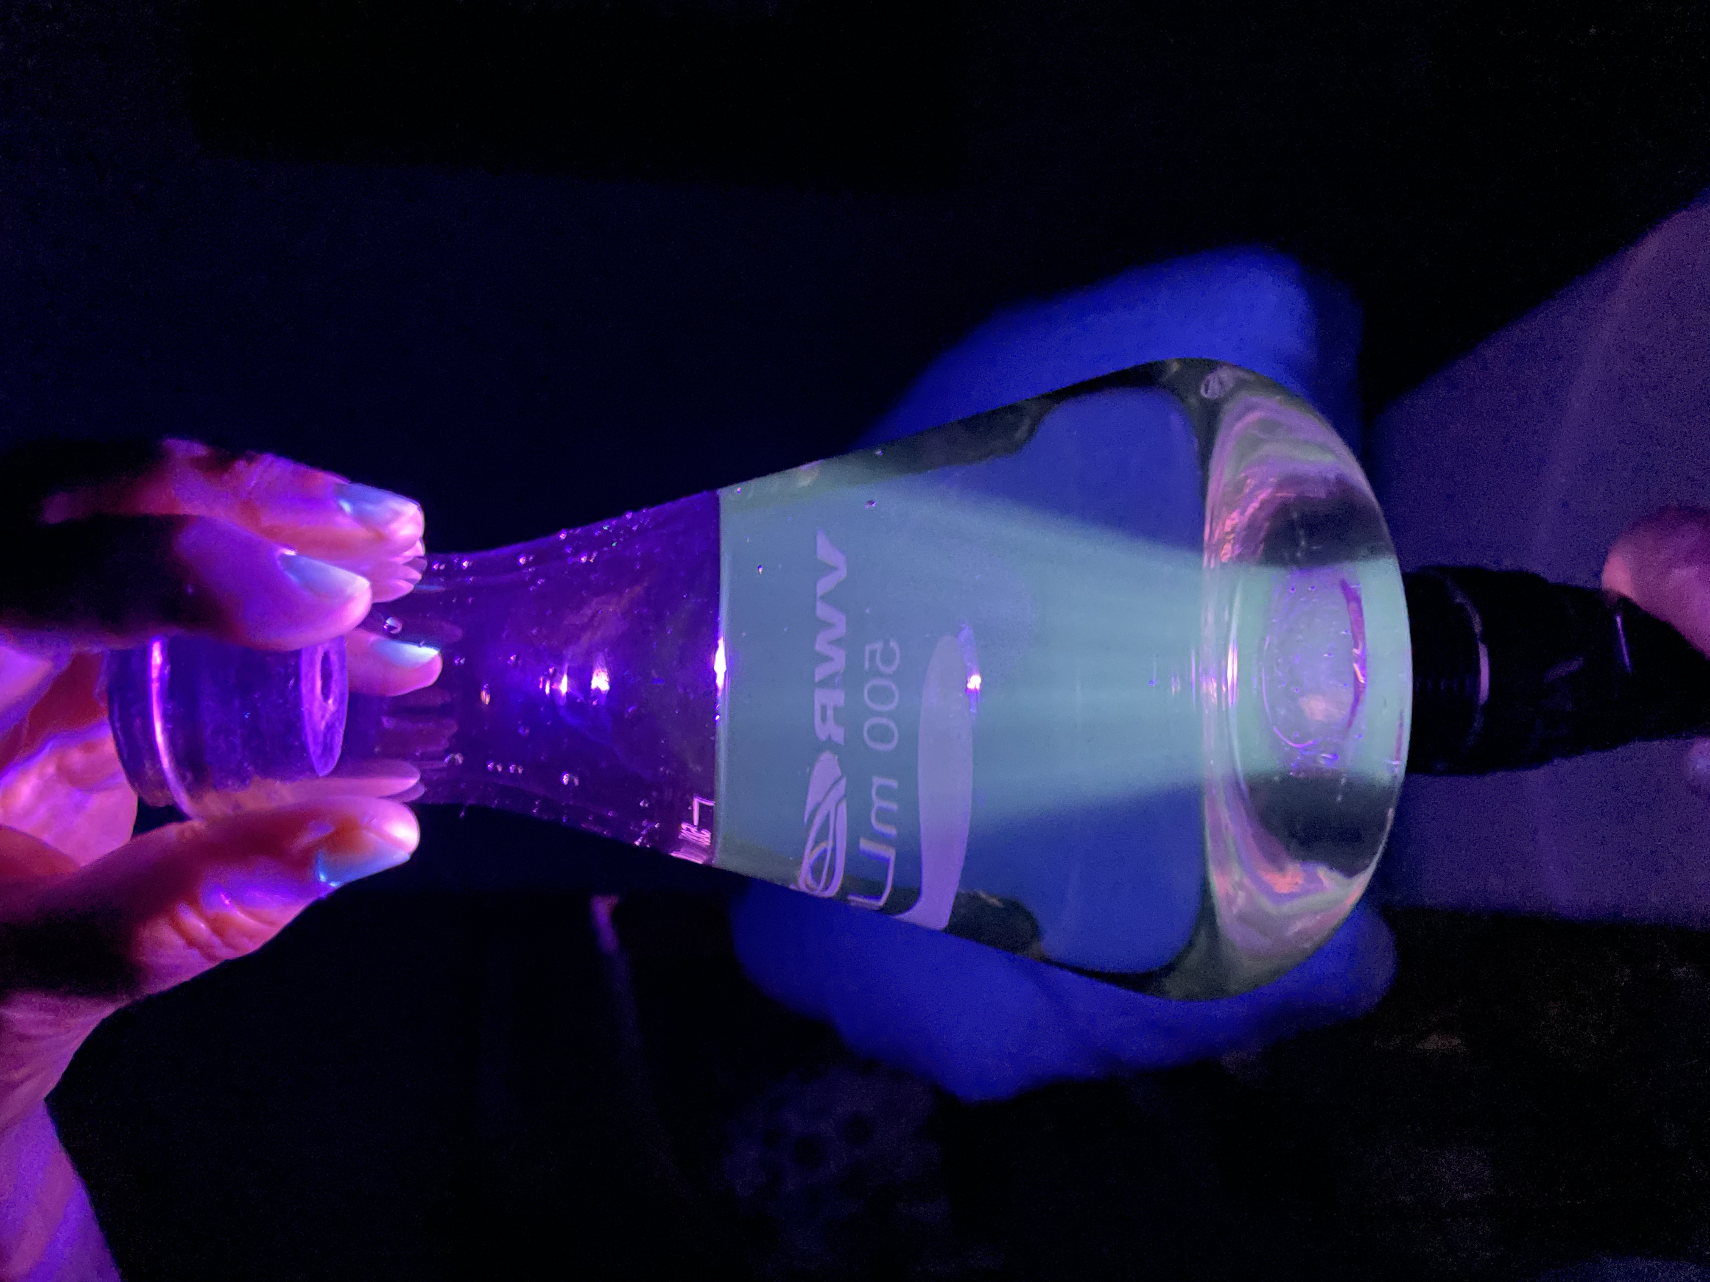
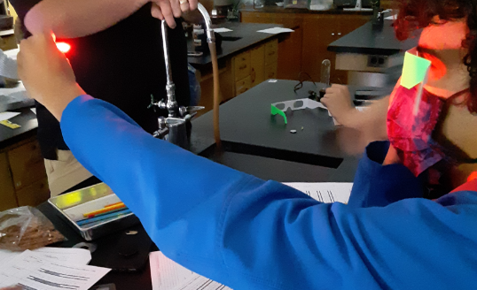
What does it look like in the classroom?
Blue LED
Pictures if possible
Glow stick incandescent light source
Interferometer
Homemade quantum dots
Red LED

Slide 19

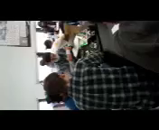
Student Understanding Relevance of Wavelength

Slide 20



Thank you
@Quantumforall
@quantumforall
Quantum Education
We look forward to working with you!
Dr. Karen Jo Matsler
kmatsler@uta.edu or info@quantumforall.org
817-723-1132
https://quantumforall.org/

