Slide 1
What does Quantum Information Look like in the High School Classroom?
Alice Flarend, PhD, NBCT

Slide 2
Who am I?
BS Nuclear Engineering University of Illinois
MS Nuclear Engineering University of Michigan
Passed candidacy exam and then became interested in:
WHY ARE PEOPLE SO MISINFORMED ABOUT NUCLEAR POWER??
Teacher for 25+ years, currently at small rural school in PA
National Board Certified Teacher
PhD Curriculum & Instruction Penn State University

Slide 3
Samples of lessons
Focus on incorporating quantum into current physics curriculum

Slide 4
Quantum in my classroom
Interference – Deutsch Jozsa Algorithm via Mach Zehnder Interferometer
Polarization – Quantum Cryptography (QKD)
Atomic Structure: Electron orbitals
Wave Particle Duality
Notes:
QKD most extensive use of quantum

Slide 5
Deutsch Jozsa with mach- Zehnder INterferometer
T

Slide 6
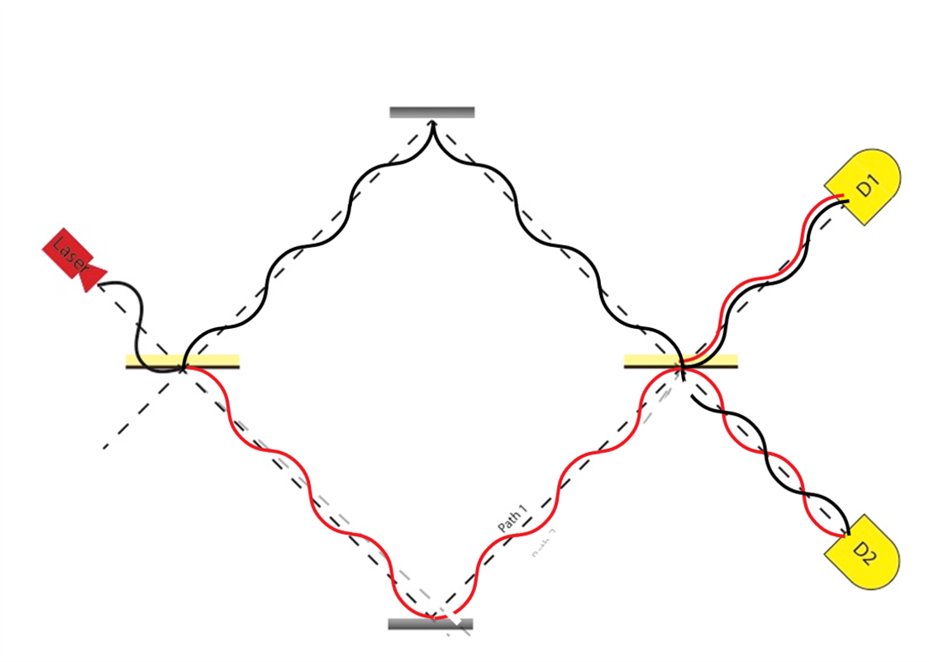
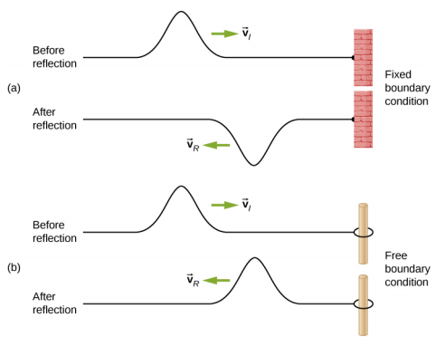
Deutsch Jozsa with mach-Zehnder Institute for Quantum Computing, WAterloo
Which detector records light?
Beam Splitter: Phase shifts upon reflection dependent on boundary condition
Constructive Interference
Wave interference
This Photo by Unknown Author is licensed under CC BY-SA-NC
Destructive Interference
Notes:
Ask which detector fires?
A LOT of PHYSICS- at QfA we break it down
Use as example for wave interference
Beam splitter – phase shifts relating to reflection conditions

Slide 7
Phase shifts for functions in Algorithm
If f(0) = 1, top path phase shift
If f(1) = 1, bottom path phase shift
= phase shift
Will there be any phase shifts introduced?
Will there be any phase shifts introduced?
Will there be any phase shifts introduced?
Will there be any phase shifts introduced?
Notes:
Ask participants to predict the location (top or bottom) of the phase shift glass; the answers will appear after each table with 2 clicks
Notice that there are equivalent phase shifts for the constant functions

Slide 8
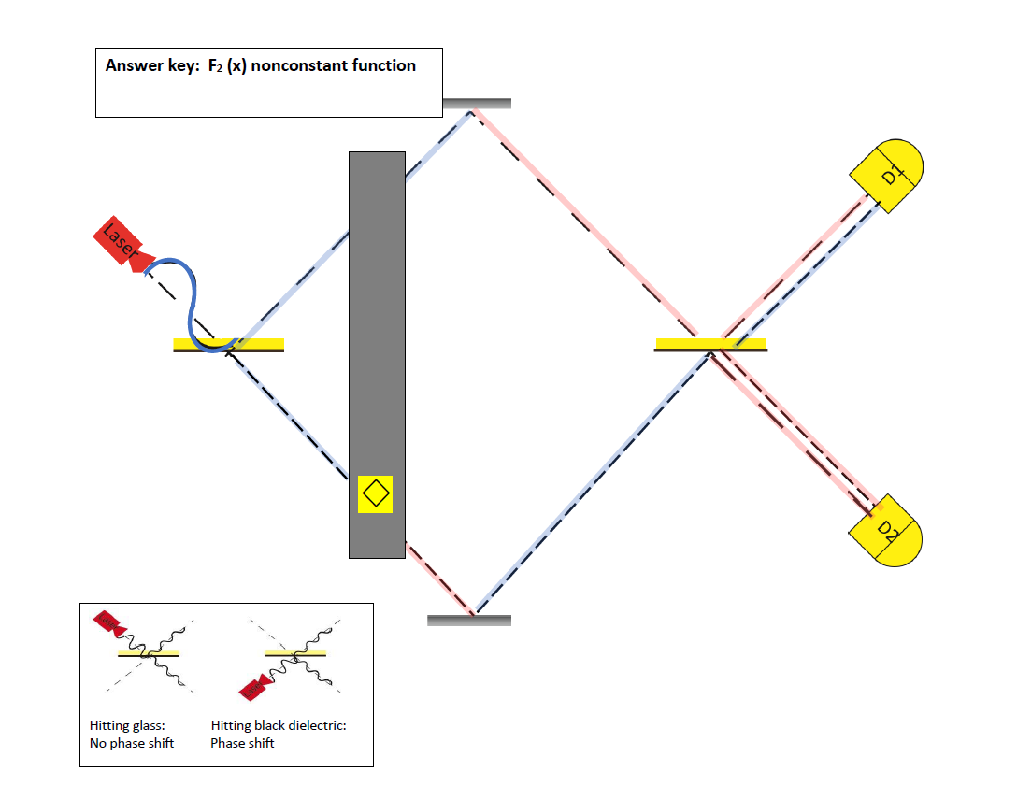
Example: Which detector will fire if Alice holds f3?
Pay attention to the phase of the waves:
BLUE is the original phase change
RED is the wave shifted by 180
D2 fires

Slide 9
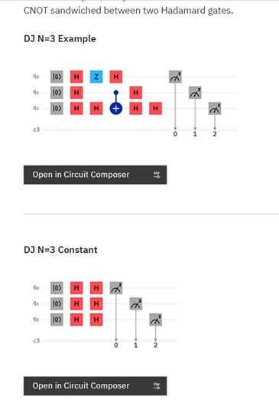
Deutsch-Jozsa algorithm on IBM Quantum simulator
https://quantum-computing.ibm.com/composer/docs/guide/deutsch-jozsa-algorithm
Non Constant or Balanced Function
Constant Function
Notes:
Every square is a gate; 3 qubits are used
Put link in the chat

Slide 10
QKD

Slide 11
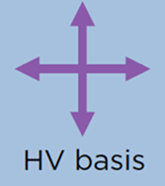
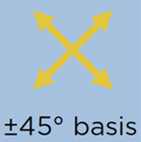
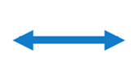
Thinking With Photons and basis using polarization – Malus’ LAw
Polarizer 1
Polarizer 2
Polarizer 3
Basis photon Basis photon Basis photon
If photon does not match polarizer basis, there is superposition
Notes:
Superposition: when basis does not match photon Ex polarizers 2 and 3
Measurement: polarization changes after measurement to match the polarizer

Slide 12
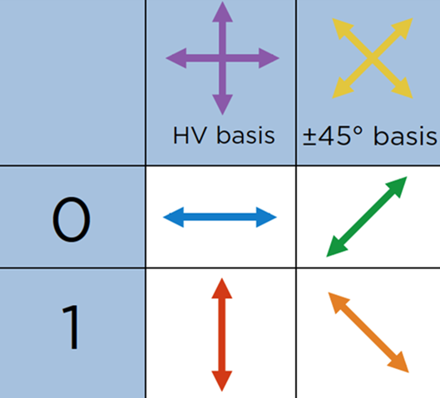
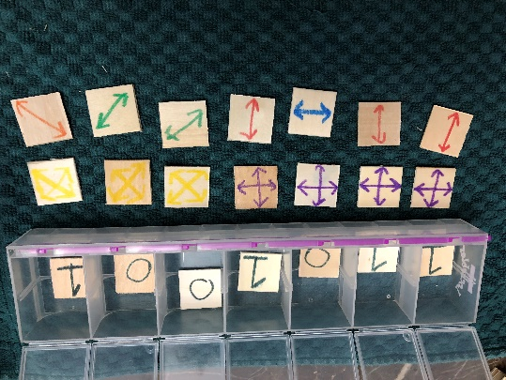
QKD Activity from Institute for Quantum Computing, Waterloo
Overview:
Alice prepares photons for Bob using random basis for each
Bob prepares random basis to measure bits from photons
Alice & Bob openly share basis and use the bits where basis are the same as key
Can add eavesdropper to see how they are detected
Quantum for All improvement:
Made activity more classroom friendly using tiles

Slide 13
Understanding takes more than a single activity
QKD is too complex to begin with

Slide 14
Quantum Coin Toss developed by QfA
How can you do a fair coin toss over the phone (no video) – can you tell if Alice lies?
-based on Physics Girl video
Example Analysis:
Alice claims a basis = HV and sent bit = 1
Bob used basis = HV and measured bit = 0
Did Alice lie about her basis?
Bob used basis = D/A and measured bit = 0
Did Alice lie about her basis?
Developed for use with tiles and remote learning with linked spreadsheets
YES!!
Can’t tell
Notes:
Do this before QKD

Slide 15
Cryptography simulation with and without Eve
https://www.st-andrews.ac.uk/physics/quvis/simulations_html5/sims/BB84_photons/BB84_photons.html
Without Eve
Without Eve
With Eve
Notes:
Next slide has navigation

Slide 16
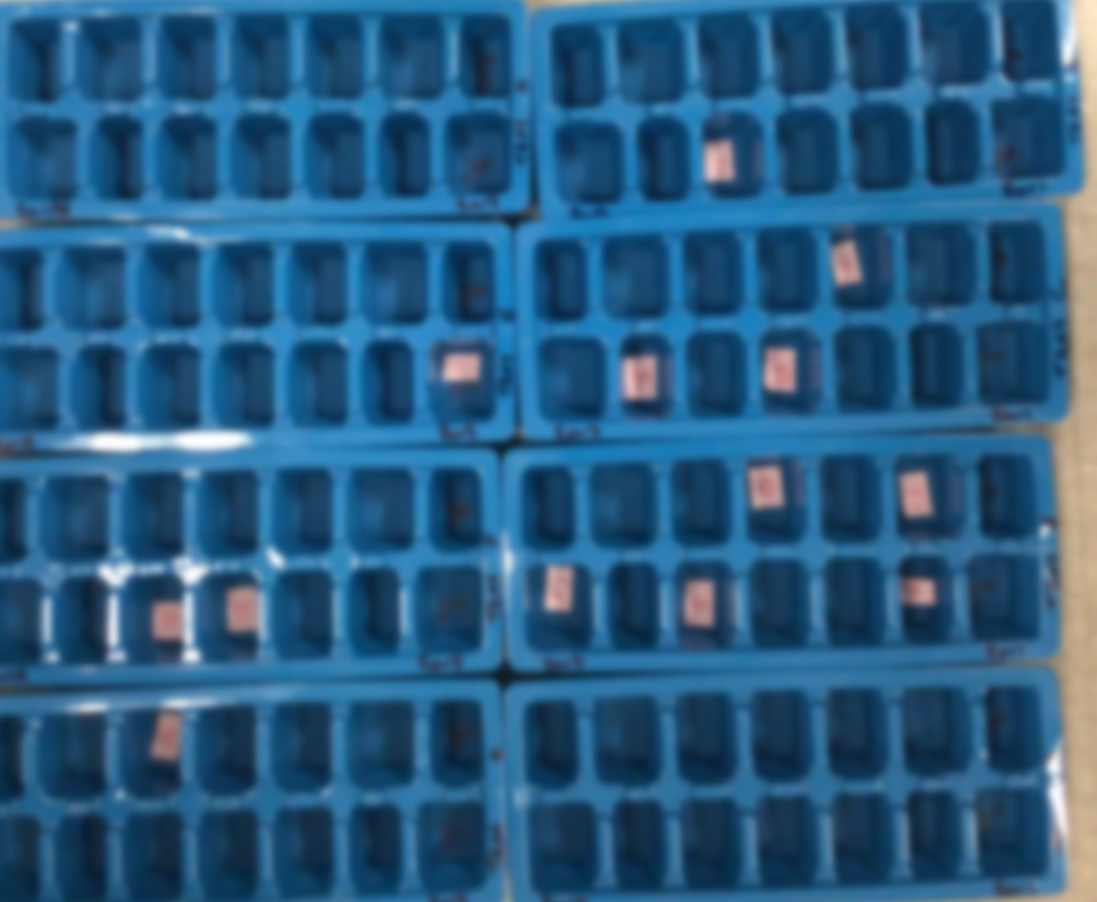
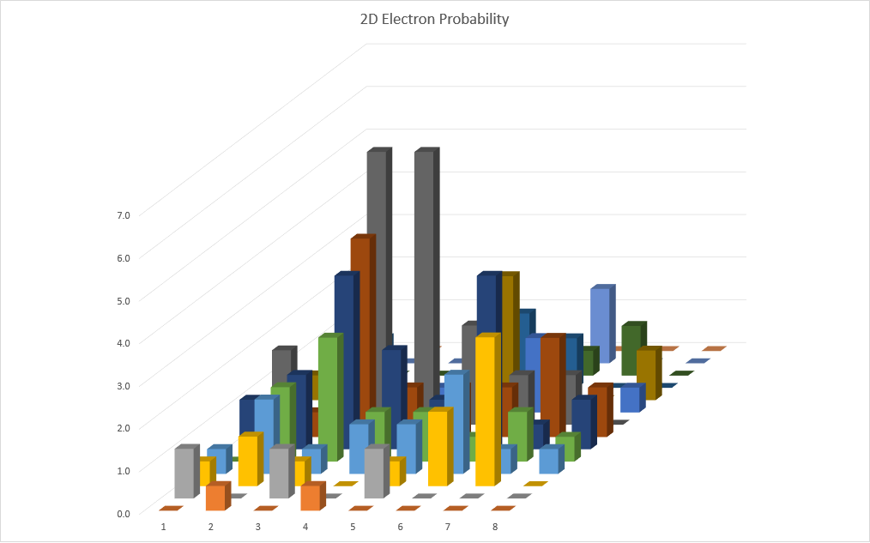
Electron orbitals as probability clouds:
Different wells in ice cube tray = different points (+/-)
Analogous to Coulomb potential
Each student 20 bingo chips, trying to get a max score
Graph chip population in each well
2D probability function of chip location

Slide 17
How do we get quantum into more classrooms?

Slide 18
constraints
Few standardized tests, but AP; no incentive
No room in current curriculum
Fundamental Problem: Teachers are not comfortable with quantum concepts and do not see relevance in their curriculum and in their lives
Teachers need high quality professional development
Notes:
What gets tested gets taught

Slide 19
Teacher Professional development (PD)
Research based fundamental features of PD that work:
Long term
Directly related to classroom
Peer led PD
QfA has experience- over 30 educators (HS & university)
Each with 10-40+ years experience
https://quantumforall.org/meet-the-team/

Slide 20
Teacher Professional development (PD)
High Quality PD this takes TIME and $$ and Information
PD Development
Activities & ancillary support materials
Teacher attendance
Advertise to teachers
Travel outside of district for extended time
Stipend for time
Project Discovery – Ohio
NSF funded
6 weeks
5 days / week
6-8 hour days
5 Follow up meetings
2 Classroom visits
Stipend (thousand +)
$$ for Supplies

Slide 21
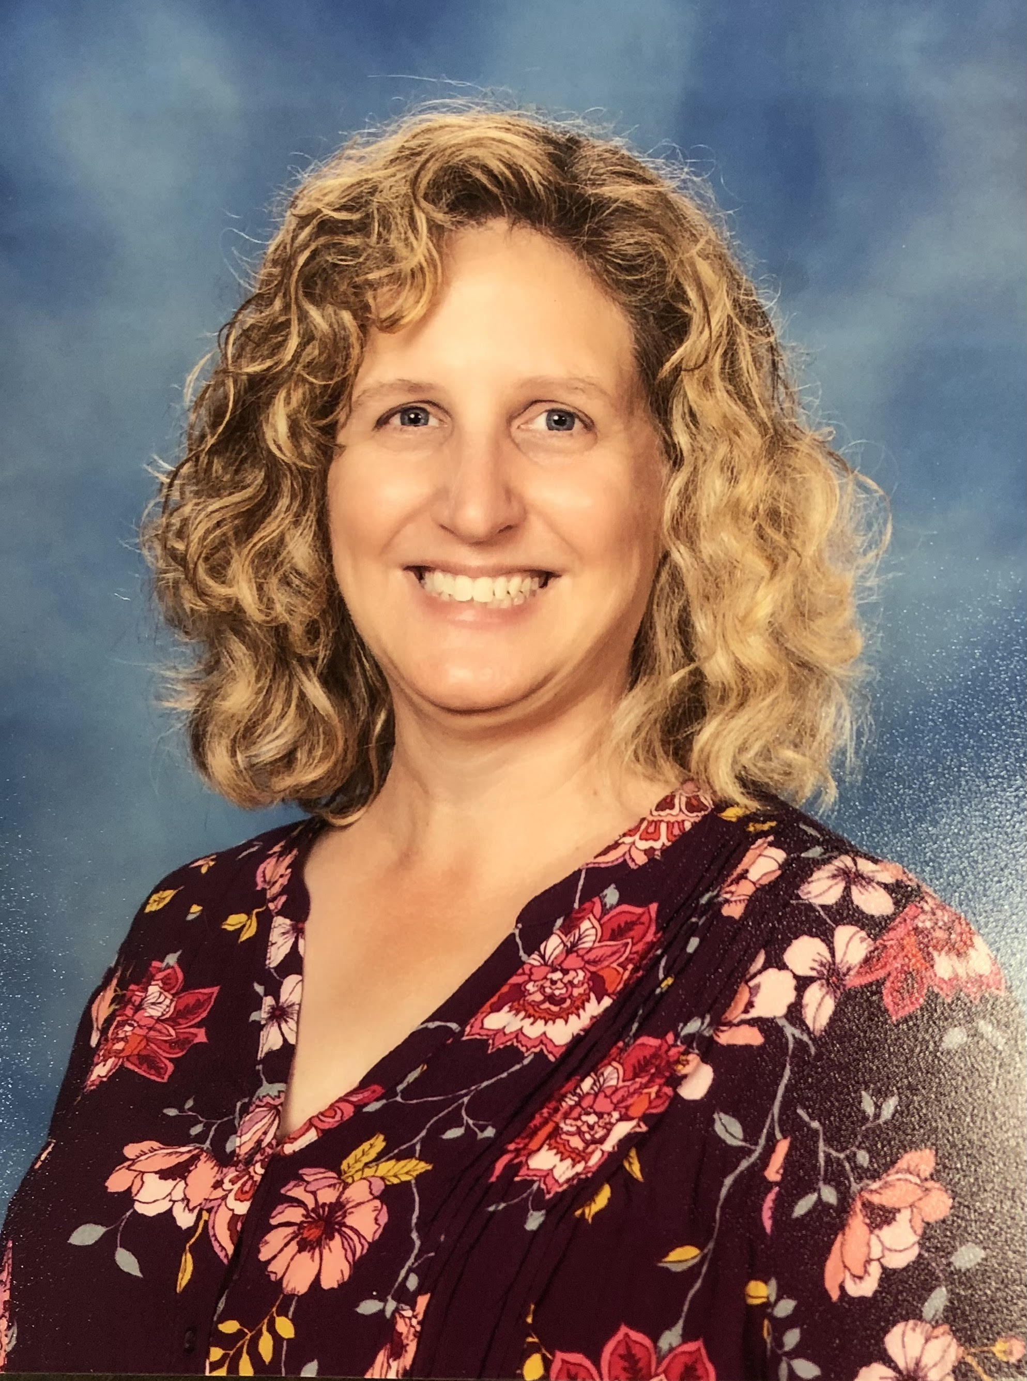
Contact INformation
Alice Flarend
amf@blwd.k12.pa.us
Bellwood-Antis HS
400 Martin St
Bellwood PA 16617

