Slide 1
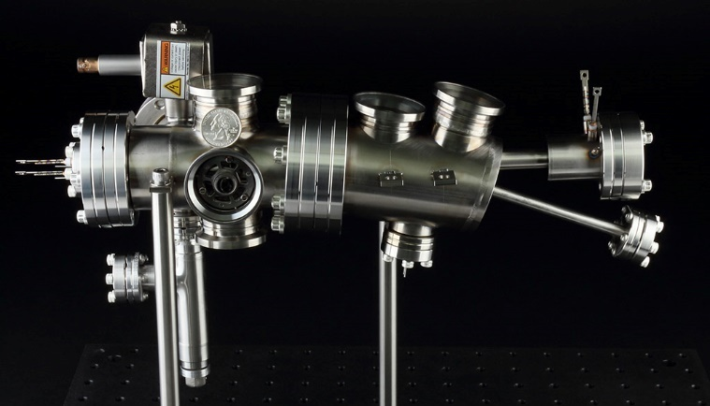
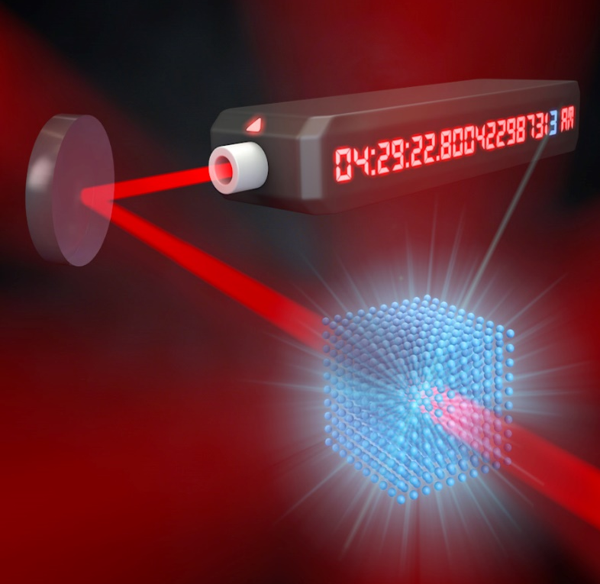
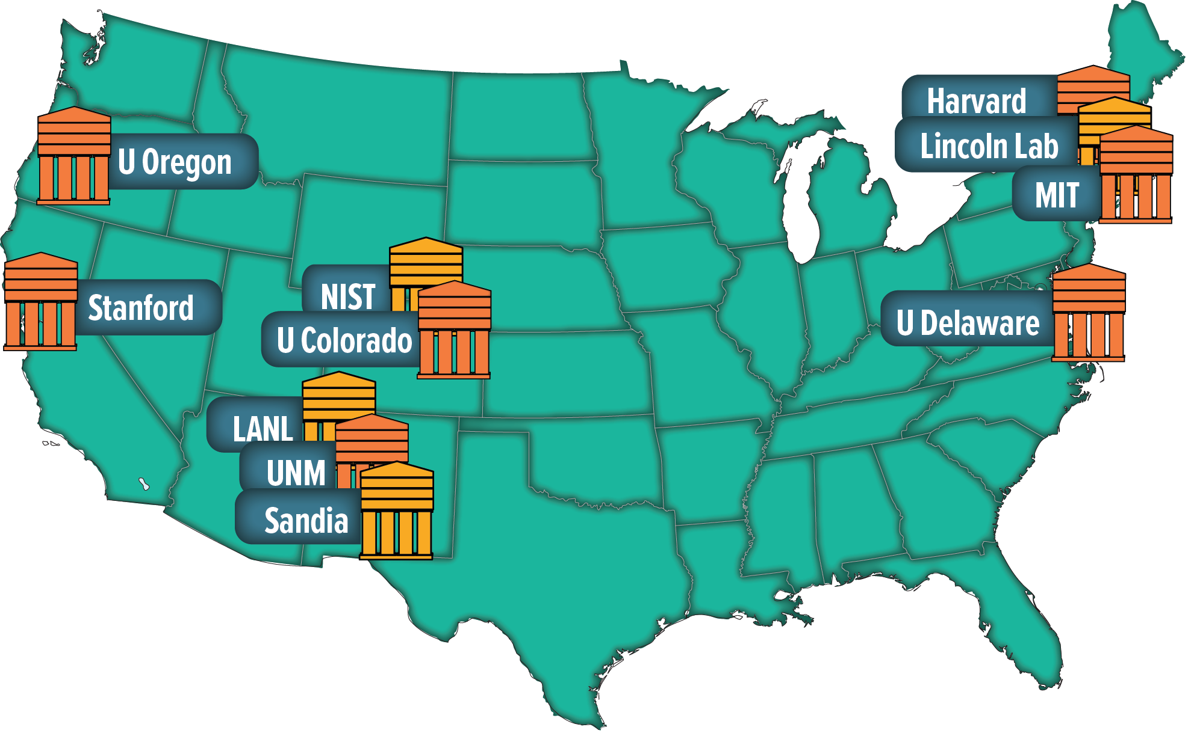
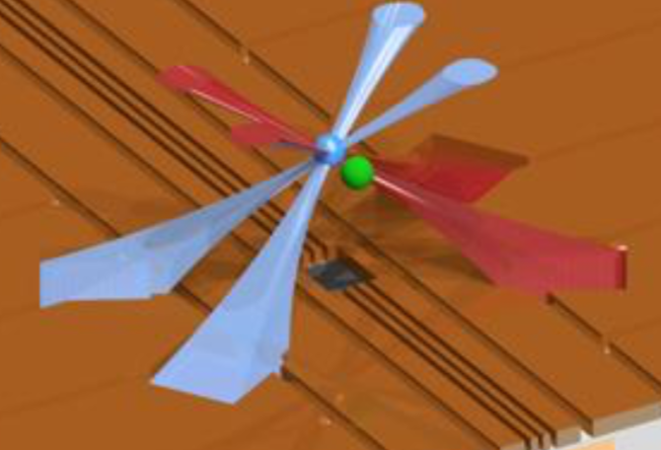
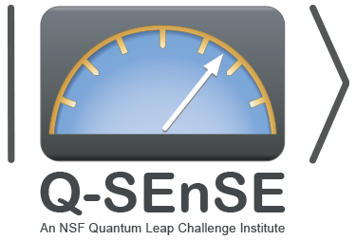
Q-SEnSE: An NSF Quantum Leap Challenge Institute
Q-SEnSE: Quantum Systems through Entangled Science and Engineering
Deliver quantum advantage in sensing
Cindy Regal, CU Boulder Physics, JILA (NIST & CU)
Associate Director for Science CUbit and Q-SEnSE

Slide 2
NSF Quantum Leap Challenge institutes
Quantum Leap Challenge Institutes are large-scale interdisciplinary research projects that aim to advance the frontiers of quantum information science and engineering.
3 institutes that started in 2020:
Institute for Present and Future Quantum Computing
PI: Dan Stamper-Kurn; Co-PIs: Umesh Vazirani, Birgitta Whaley, Eric Hudson, Hartmut Haeffner; University of California-Berkeley
Institute for Hybrid Quantum Architectures and Networks PI: Brian DeMarco; Co-PIs: Mark Saffman, Paul Kwiat, Hannes Bernien;
University of Illinois at Urbana-Champaign
Institute for Enhanced Sensing and Distribution Using Correlated Quantum States
PI: Jun Ye; Co-PIs: Mark Kasevich, Marianna Safronova, Gregory Rieker, Svenja Knappe;
University of Colorado at Boulder

Slide 3
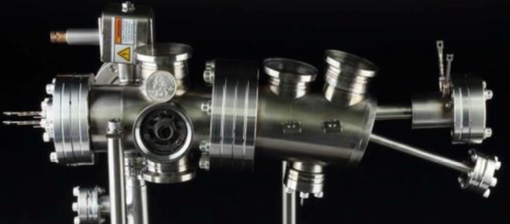
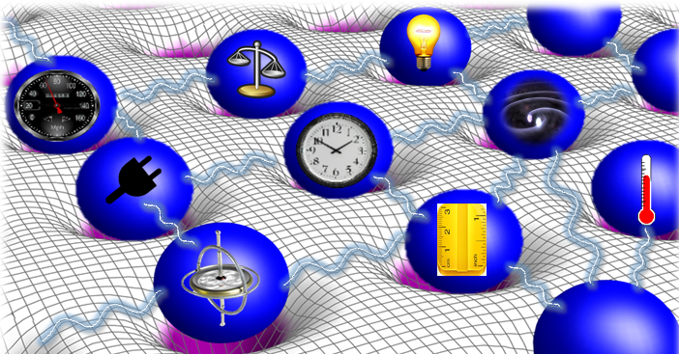
Q-SEnSE science and engineering
https://www.colorado.edu/research/qsense/
deployable sensing and measurement
national quantum
infrastructure:
case study strontium
quantum
sensing
quantum advantage in sensing and measurement, e.g. squeezing

Slide 4
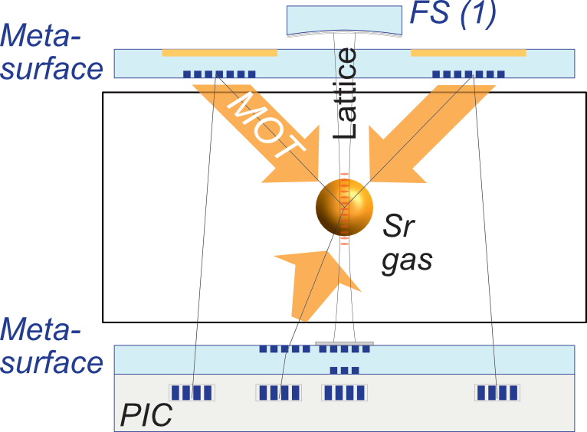
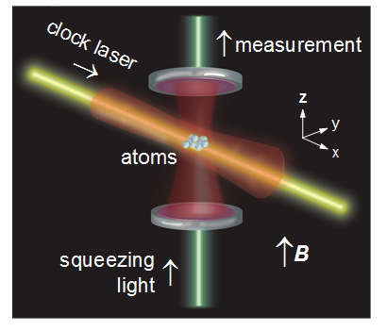
Sample research areas
clocks and atom interferometers
precision microwave measurements
portable and photonic
integrated clocks
microscopic entanglement of alkaline earth atoms
spin squeezing concepts

Slide 5
Q-SEnSE workforce development components
Quantum Forge
Community College Partnerships
Industry and National Lab Internships
Interdisciplinary Graduate Training
PhET (interactive educational module)
Undergraduate Minor in Quantum Science and Engineering
Professional Masters & Stackable Credits in Quantum Engineering
Quantum Track in Physics PhD

Slide 6
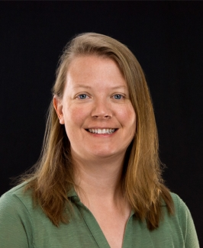
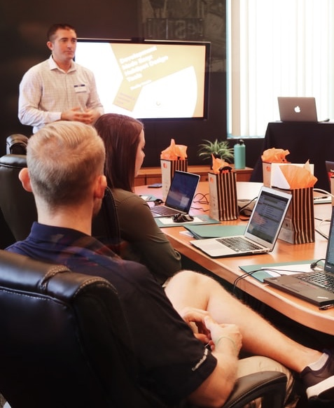
Q-SEnSE workforce development
QED-C Workforce TAC participation
Student research exchange marketplace
Professional Training
Heather Lewandowski
Internship coordination program connecting students from 16 educational institutions to industry and national lab partners: Summer 2022
Professional masters & stackable credits in quantum engineering

Slide 7
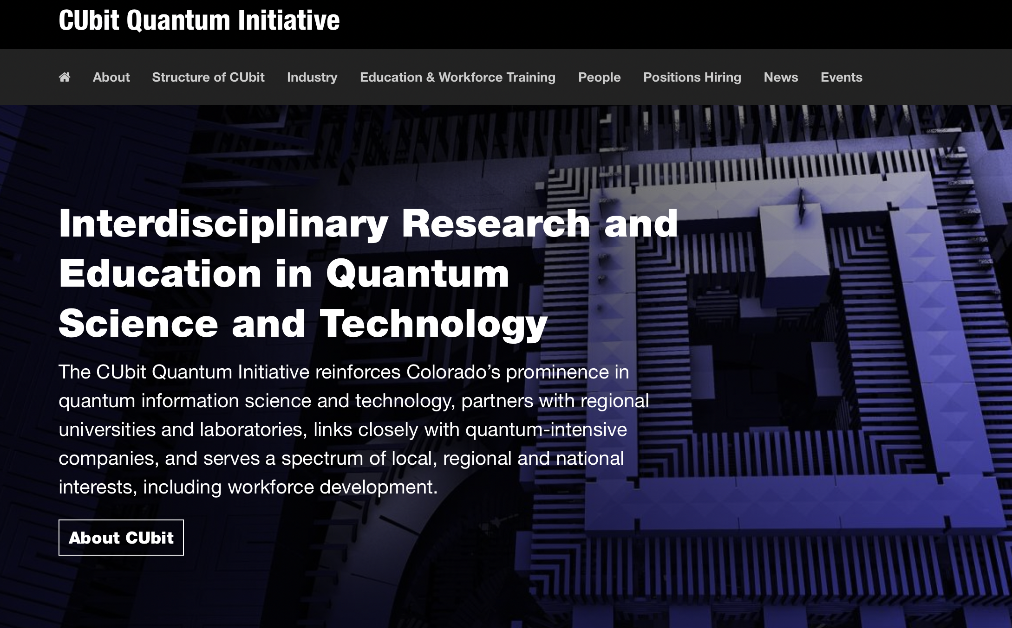
CUBit: CU Boulder quantum umbrella
https://www.colorado.edu/initiative/cubit/

Slide 8
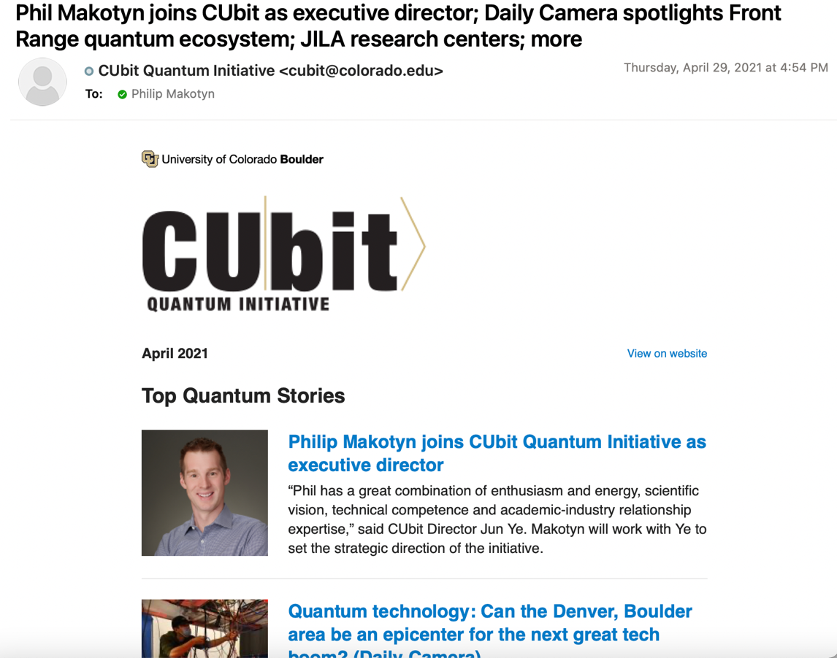
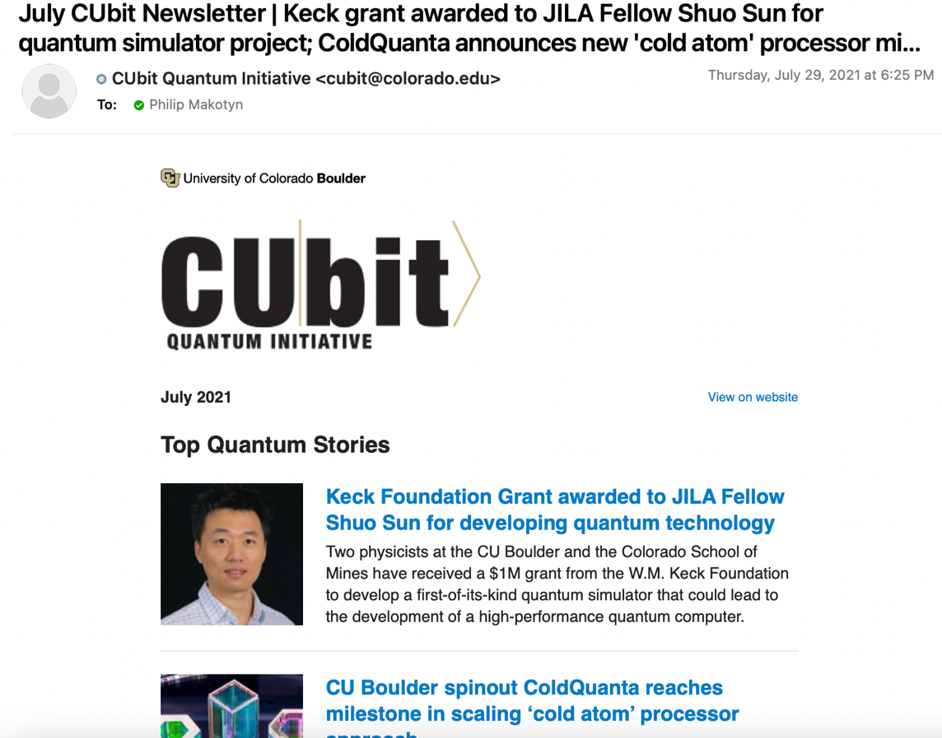
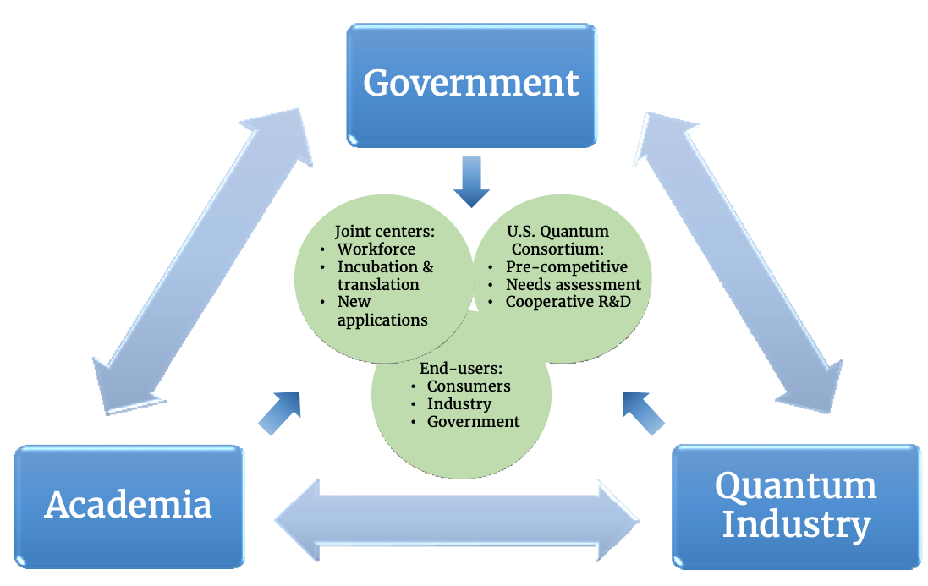
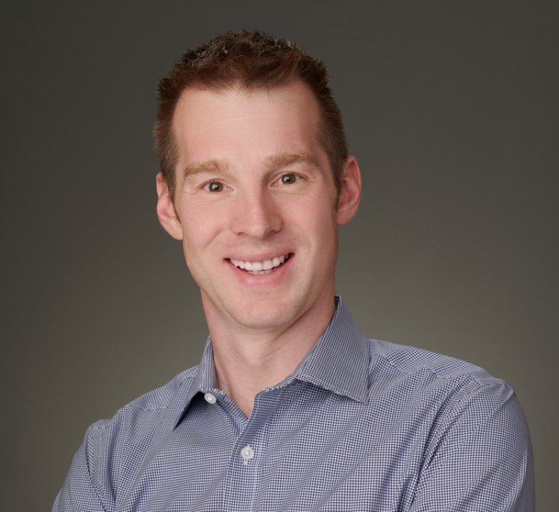
Q-SEnSE engagement opportunities
Information
Q-SEnSE industry engagement contact
Following: National Strategic Overview for Quantum Information Science
CUbit Executive Director
Philip.Makotyn@colorado.edu
CUbit Newsletter
Request subscription - cubit@colorado.edu

Slide 9
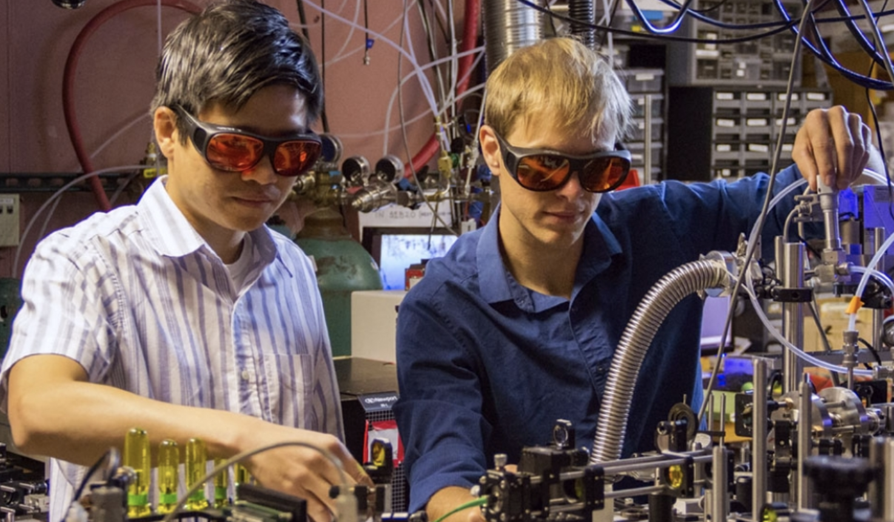
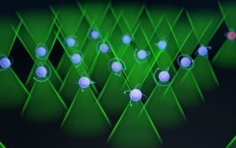
Q-SEnSE goals summary
a broad quantum workforce
diverse sensors with quantum advantage
addressable and programmable quantum systems impacting networking, computing, and simulation
ultra-cold atoms
trapped ions
solid-state

