Slide 1
Quantum computing meets spacetime
Maria Violaris, University of Oxford
Indiana University Bloomington Quantum Summer School
24th July 2024

Slide 2
What’s to come….
Lecture 1, Wednesday 10th July
The Quantum Bomb Tester and Quantum Computing Basics
Lecture 2, Wednesday 17th July
Collapse vs Many-Worlds: Demystifying Schrödinger’s Cat, the Double-Slit, and Quantum Observers
Lecture 3, Wednesday 24th July
Continue “Collapse vs Many-Worlds” from last week.
Quantum computing meets spacetime

Slide 3
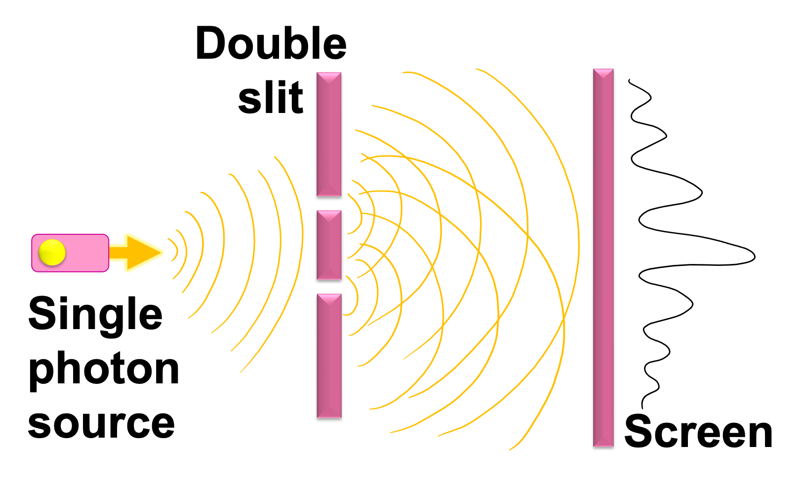
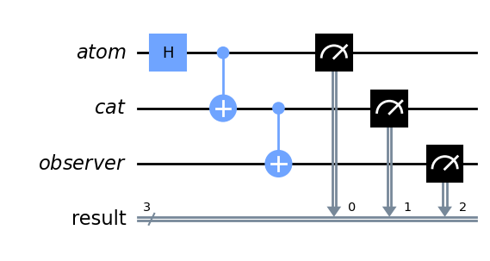
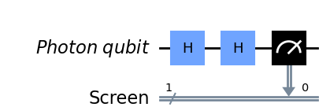
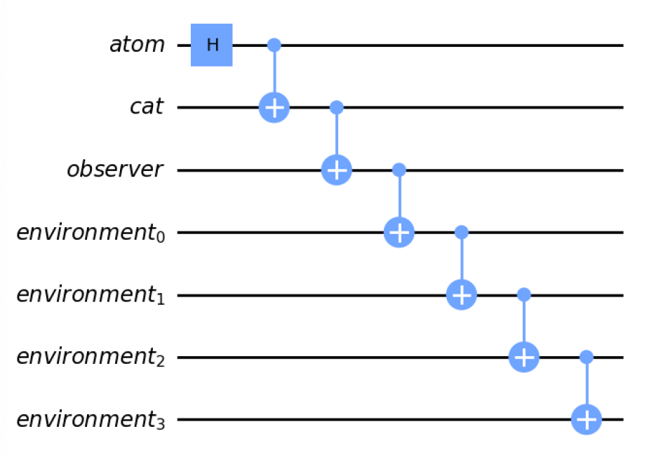
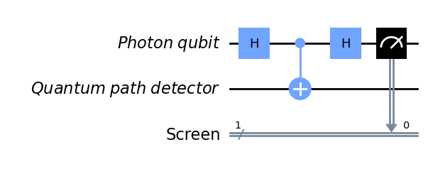
Review from last week
Any questions?
Resources for questions asked in Week 1:
Paper on experimental implementation of bomb tester
Paper on interaction-free imaging
Paper on momentum conservation in beam-splitter
Resources on my project on irreversibility and quantum thermodynamics:
Paper with video abstract; accessible 20-min talk; accessible 3-min talk (also another 3-min talk about entropy & Boltzmann brains). I also made a quantum Maxwell’s Demon Qiskit video, blog and code tutorial in description.

Slide 4
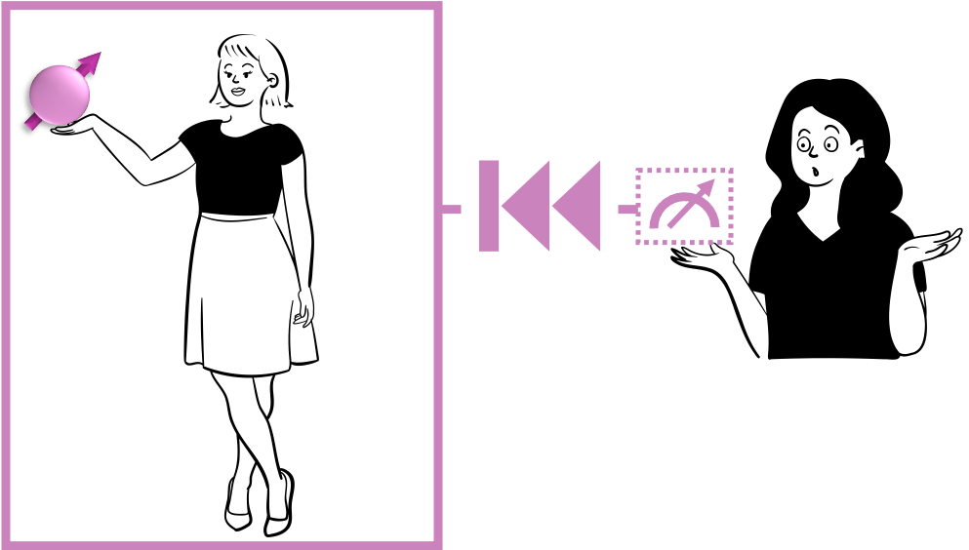
Summary
Experimentally testing many-worlds vs Copenhagen collapse & recipe for resolving paradoxes
EPR paradox: does entanglement imply “faster than light” influences that violate relativity principles?
Time-travel: how to resolve the Grandfather Paradox using quantum computing (and the quantum multiverse)
U
U’
Alice-0
$$U^{′}$$
$$\left.{|ψ}_{0}\right\rangle$$
???
$$ρ_{1}$$
Alice-1
$$ρ_{1}$$
!!!
$$ρ_{1}^{′}$$

Slide 5
Many-worlds vs Copenhagen test
Notes:
Now there is a controversy about whether the observer can really be treated as a quantum system or whether they should be treated as a classical system that causes irreversible collapse. Interestingly, a thought experiment proposed in 1985 by David Deutsch provides a way to experimentally distinguish the two cases where measurement causes irreversible collapse, and where measurement is reversible. I will refer you to my paper and an upcoming Qiskit video for the full explanation, but the overall idea is that we simulate an observer making a measurement, writing down that they definitely made a measurement, then try and reverse it all. Adding an irreversible measurement to collapse the qubit will lead to different outcomes at the end than a reversible measurement.
Another nice aspect of this thought experiment is that it was the first proposal for a universal quantum computer, though it was not called that at the time.
2 min

Slide 6
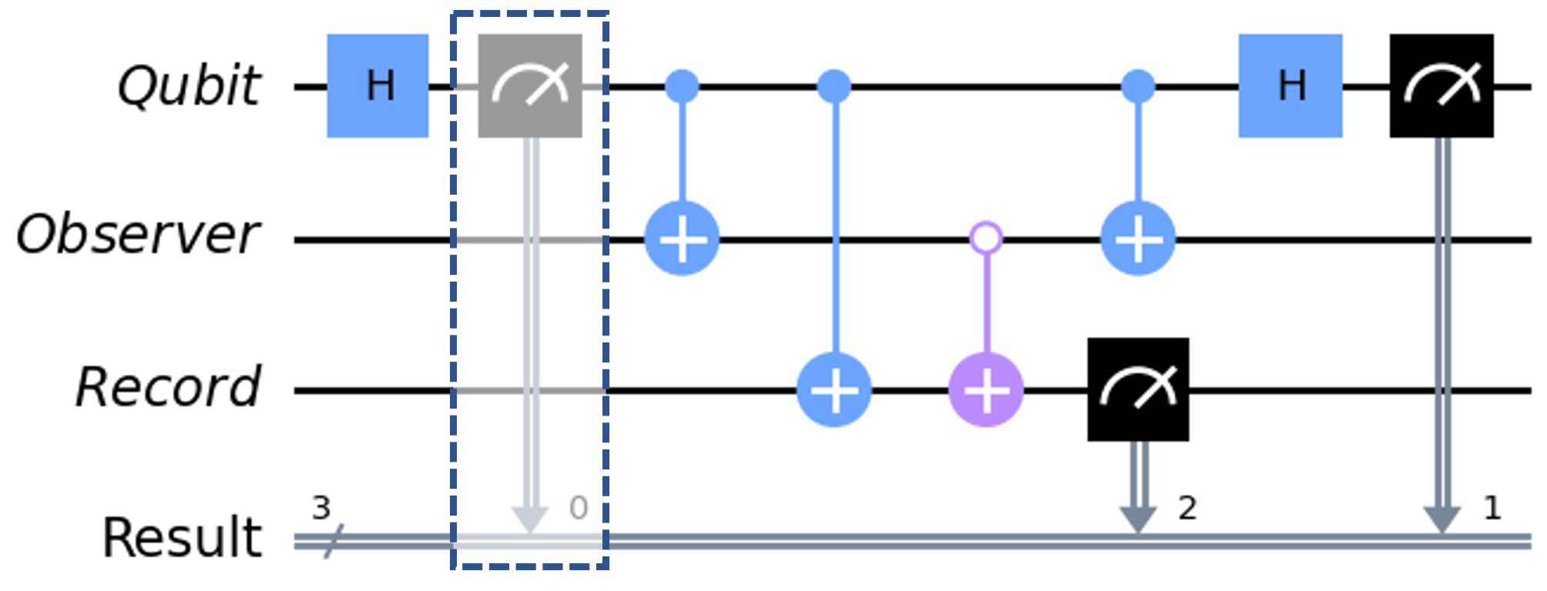
Many-worlds vs Copenhagen test
Notes:
Now there is a controversy about whether the observer can really be treated as a quantum system or whether they should be treated as a classical system that causes irreversible collapse. Interestingly, a thought experiment proposed in 1985 by David Deutsch provides a way to experimentally distinguish the two cases where measurement causes irreversible collapse, and where measurement is reversible. I will refer you to my paper and an upcoming Qiskit video for the full explanation, but the overall idea is that we simulate an observer making a measurement, writing down that they definitely made a measurement, then try and reverse it all. Adding an irreversible measurement to collapse the qubit will lead to different outcomes at the end than a reversible measurement.
Another nice aspect of this thought experiment is that it was the first proposal for a universal quantum computer, though it was not called that at the time.
2 min

Slide 7
Recipe for resolutions
Notes:
Now in all the six thought experiments in my paper there is a common theme for providing circuit representations of the thought experiments and resolutions to apparent paradoxes.
2min
Detectors as quantum systems
Measurements as entangling CNOT gates
Environment as quantum system inducing decoherence
Also works in EPR, quantum teleportation, Hardy, pigeonhole, Frauchinger-Renner, non-classicality in gravity

Slide 8
Recipe for resolutions
1. Detectors / Observers → Quantum systems
Notes:
Detectors as quantum systems
Measurements as entangling CNOT gates
Environment as quantum system inducing decoherence
Also works in EPR, quantum teleportation, Hardy, pigeonhole, Frauchinger-Renner, non-classicality in gravity

Slide 9
Recipe for resolutions
2. Measurements → Entangling CNOT gate
1. Detectors / Observers → Quantum systems
Notes:
Detectors as quantum systems
Measurements as entangling CNOT gates
Environment as quantum system inducing decoherence
Also works in EPR, quantum teleportation, Hardy, pigeonhole, Frauchinger-Renner, non-classicality in gravity

Slide 10
Recipe for resolutions
2. Measurements → Entangling CNOT gate
1. Detectors / Observers → Quantum systems
3. Environment → Quantum system inducing decoherence

Slide 11
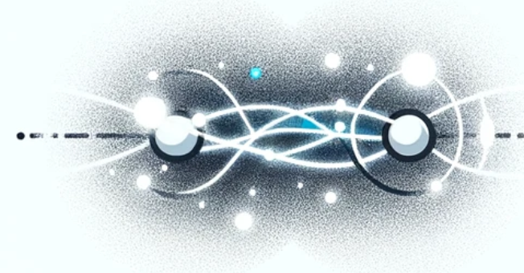
Entanglement & uncertainty principle
$$≠$$
Size & colour incompatible?

Slide 12
Einstein-Podolsky-Rosen paradox & locality
Does entanglement violate the principle that no influence can travel faster than light?
Is quantum theory “incomplete”?
“local realism”

Slide 13
Alice & Bob share an entangled pair
Entangled pair generator
U
U’

Slide 14
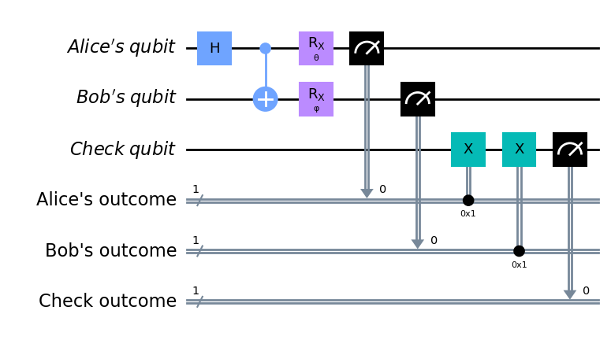
Entangled pair as a quantum circuit:
U
U’

Slide 15
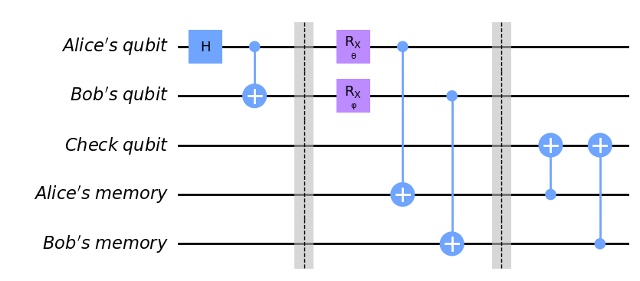
Entangled pair as a quantum circuit:
unitary
$$<$$
U
U’

Slide 16
Local, complete description of quantum theory
Local?
Complete?
$$\left.|ψ\right\rangle$$
$$ρ_{1}$$
$$σ_{1}$$

Slide 17
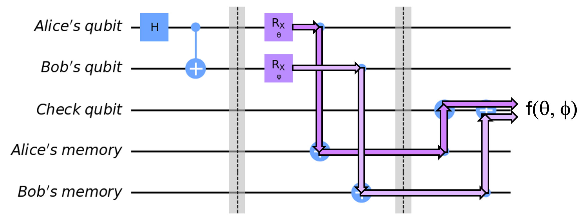
Tracking information flow
$$σ_{3}(θ)$$
$$σ_{3} (θ,φ)$$
U
U’

Slide 18
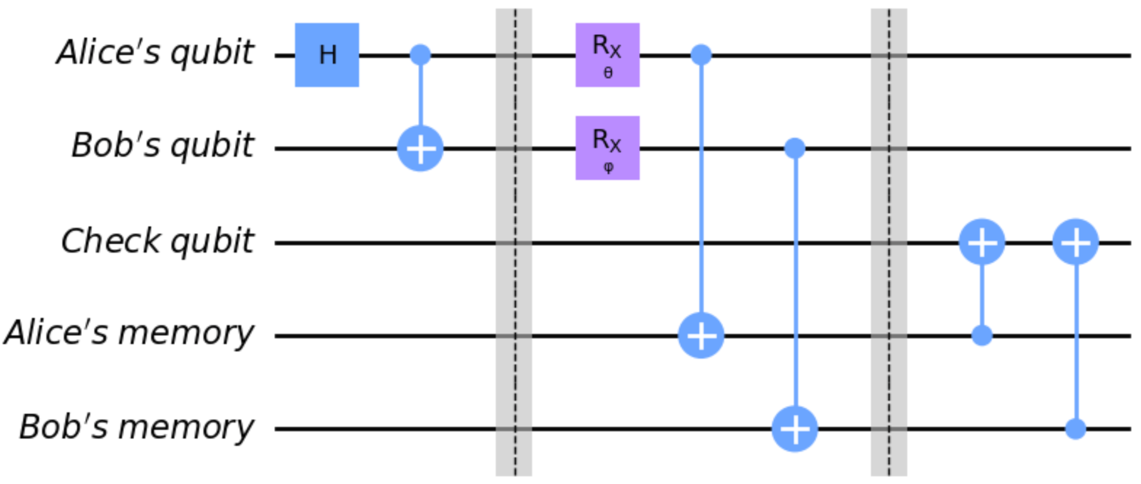
Tracking information flow
$$σ_{1}$$
$$σ_{1}(θ)$$
$$σ_{2}$$
$$σ_{2}(φ)$$
$$σ_{3}$$
$$σ_{3}(θ)$$
$$σ_{3} (θ,φ)$$
$$σ_{4}$$
$$σ_{4}(θ)$$
$$σ_{5}$$
$$σ_{5}(φ)$$
U
U’

Slide 19
Is quantum theory local realistic?
Depends on your assumptions for what is the “real” description of a quantum system
If you describe is as a “multiversal” object, described by the matrices
then there is a local realistic description
$$σ_{i}$$
U
U’

Slide 20
Is quantum theory local realistic?
Depends on your assumptions for what is the “real” description of a quantum system
If you describe is as a “multiversal” object, described by the matrices
then there is a local realistic description
$$σ_{i}$$
For more detail see my YouTube podcast:
U
U’

Slide 21
Time-travel paradoxes
Can we resolve the grandfather paradox using quantum computing?

Slide 22
The grandfather paradox
What’s the problem with classical resolutions?

Slide 23
Time travel as a quantum circuit
Alice-0
$$U^{′}$$
$$\left.{|ψ}_{0}\right\rangle$$
$$ρ_{1}$$
???
Alice-1
!!!
$$ρ_{1}$$
$$ρ_{1}^{′}$$
“consistency condition”

Slide 24
Time travel as a quantum circuit
more convenient
$$<$$
Alice-0
$$U$$
$$\left.{|ψ}_{0}\right\rangle$$
$$ρ_{1}^{′}$$
???
Alice-1
$$ρ_{1}$$
!!!
$$ρ_{1}$$
“consistency condition”

Slide 25
Open problems with quantum time-loops
Knowledge paradox
Locality
Alice-0
$$U$$
$$\left.{|ψ}_{0}\right\rangle$$
$$ρ_{1}^{′}$$
???
Alice-1
$$ρ_{1}$$
!!!
$$ρ_{1}$$

Slide 26
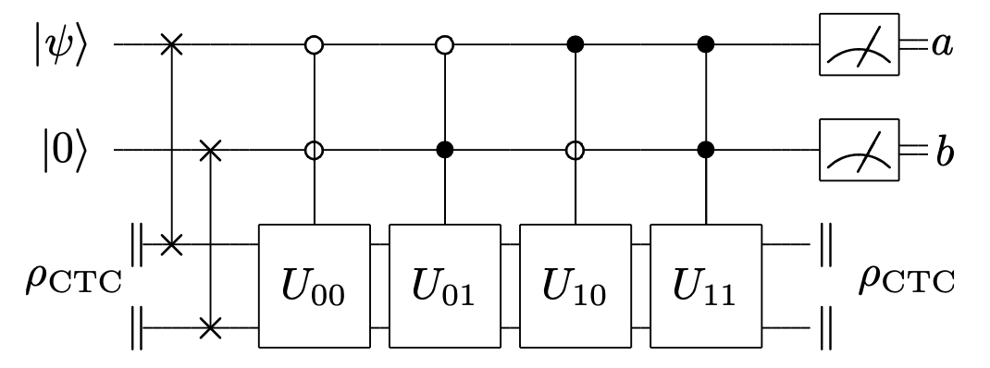
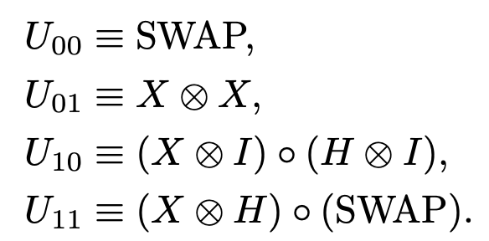
Computational power of time-loops
Distinguish quantum states perfectly (violating uncertainty principle)
Store unbounded classical information in a single qubit

Slide 27
Summary
Many-worlds and Copenhagen are experimentally distinguishable!
Entanglement defies classical description of measurement outcomes; but we can save locality by shifting our assumptions about local realism
The grandfather paradox can be resolved using quantum computing, but there remain open problems

Slide 28
Any questions?
maria@violaris.com
Maria Violaris
@maria__violaris
maria@violaris.com
Maria Violaris
@maria__violaris
mariaviolaris.com
Maria Violaris
Please fill in my feedback form!
It’s anonymous, you can leave your name in the final box if you like.
Fill in as many questions as you like, any are useful! (there’s 6 total)
Maria Violaris
https://forms.gle/3EoU77i6GS6uV5yq7
* For recap of the thought experiments I discussed (& some more), links to Quantum Paradoxes videos, blogs and code tutorials are on my website, mariaviolaris.com/quantum-paradoxes

