Slide 1
Collapse vs Many-Worlds Demystifying Schrödinger’s cat, the double-slit, and observers
Maria Violaris, University of Oxford
Indiana University Bloomington Quantum Summer School
17th July 2024

Slide 2
What’s to come….
Lecture 1, Wednesday 10th July
The Quantum Bomb Tester and Quantum Computing Basics
Lecture 2, Wednesday 17th July
Collapse vs Many-Worlds: Demystifying Schrödinger’s Cat, the Double-Slit, and Quantum Observers
Lecture 3, Wednesday 24th July
Entangling Disciplines: How Quantum Computing meets Relativity, Maxwell’s Demon and Time-Travel

Slide 3
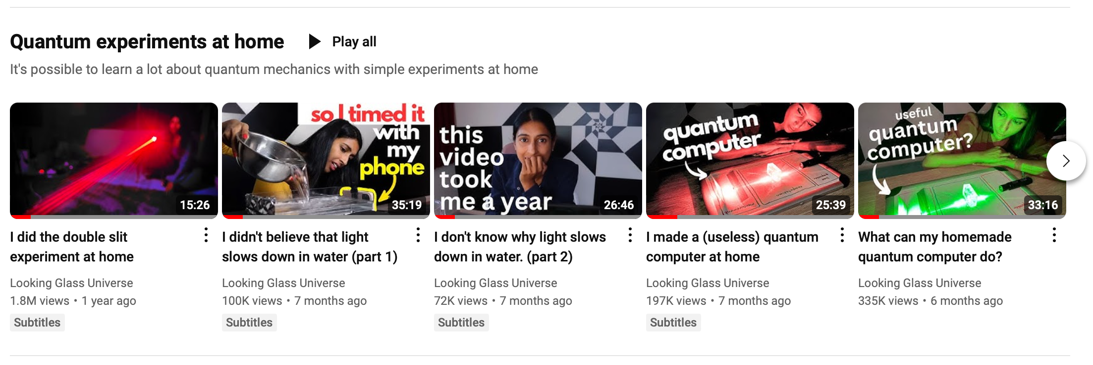
Question: low-cost H and CNOT experiments?
https://www.youtube.com/@LookingGlassUniverse

Slide 4
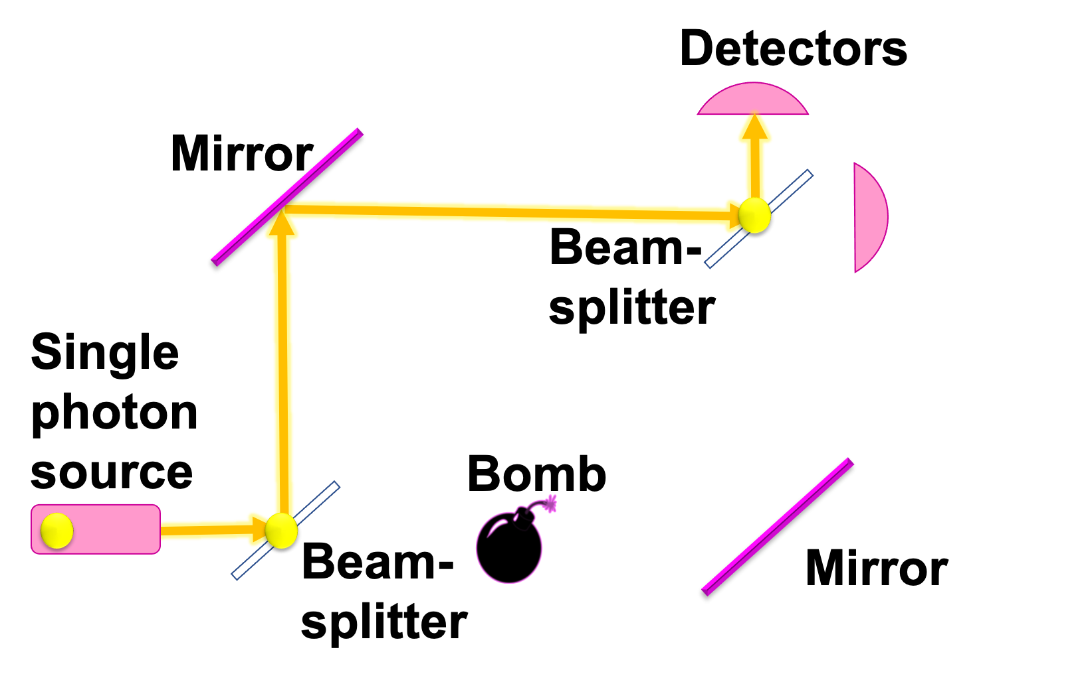
Review from last week
Any questions?
Any feedback from the activities?
Resources for questions asked last week: I will send…
Paper on experimental implementation of bomb tester
Paper on interaction-free imaging
Paper on momentum conservation in beam-splitter
Resources on my project on irreversibility and quantum thermodynamics

Slide 5
Summary
Quantum measurement devices → solves problems!
Schrödinger’s cat, double-slit, quantum observers, and decoherence
Distinguishing many-worlds vs Copenhagen collapse

Slide 6
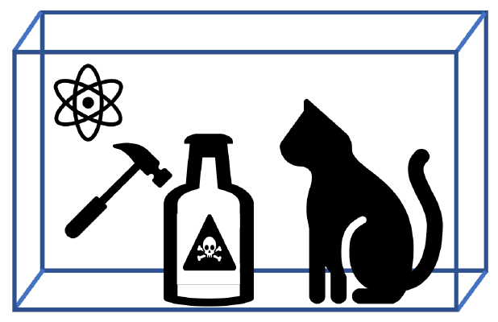
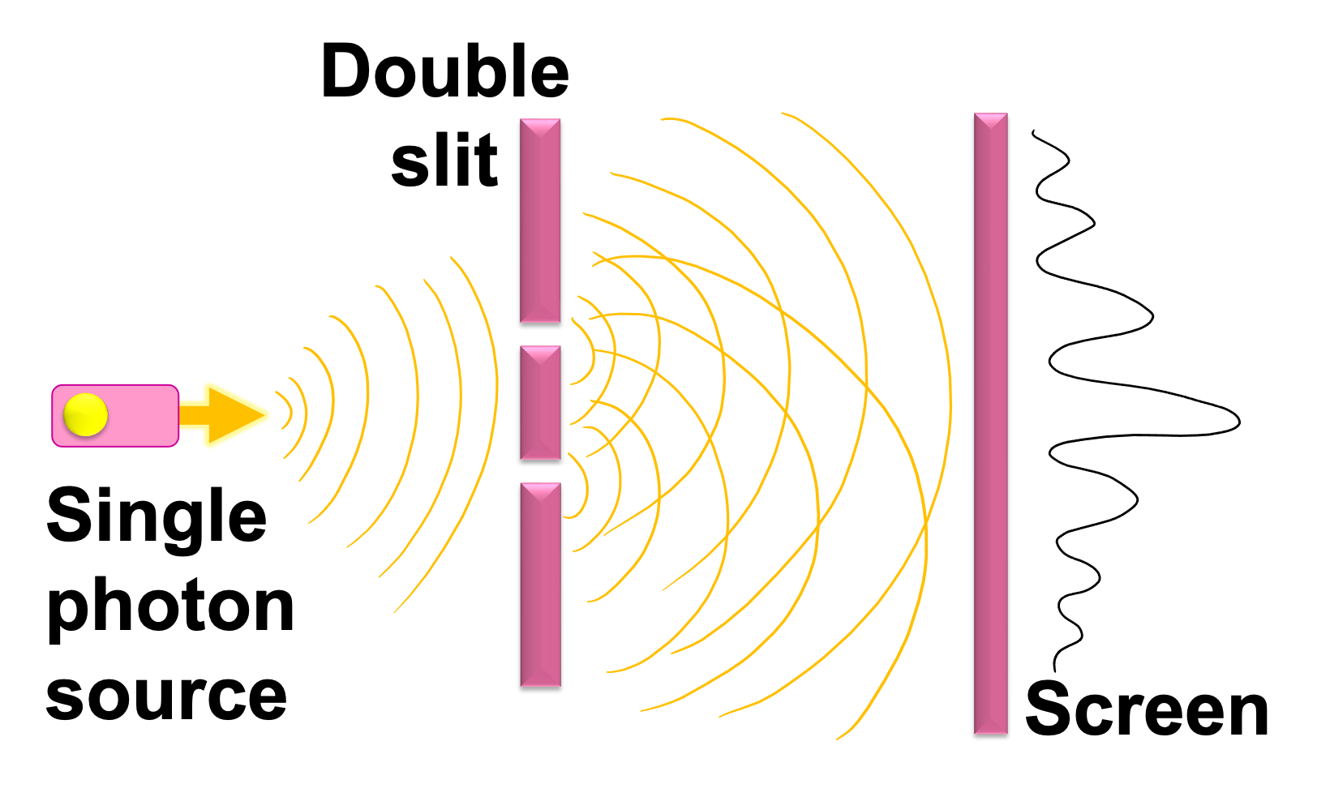
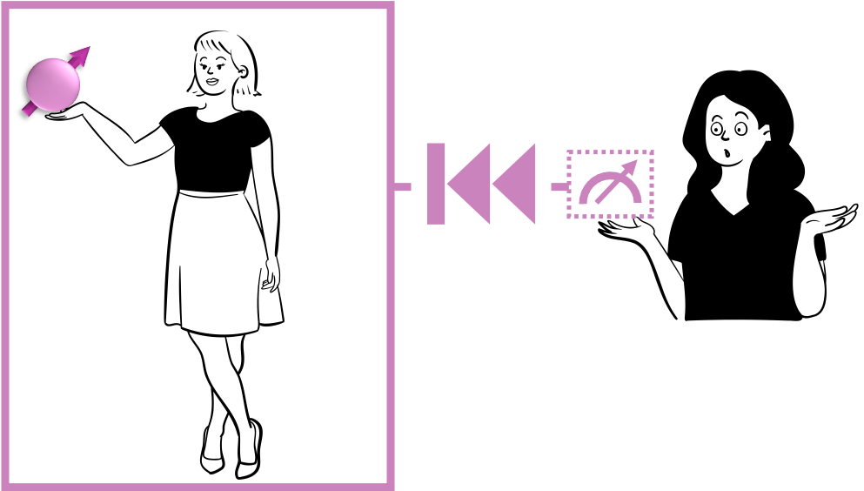
Thought experiments with “observers”
Schrödinger’s cat
Double slit
Many-worlds vs Copenhagen test

Slide 7
Thought experiments with “observers”
Schrödinger’s cat
Double slit
Many-worlds vs Copenhagen test
Macroscopic superpositions
Wave-particle duality
Measurement problem
Notes:
In my paper I go through six quantum thought experiments. These are Schrodinger’s cat, Wigner’s friend, a test of the many-worlds against the Copenhagen interpretation, the double-slit, the delayed-choice quantum eraser, and the quantum bomb tester.
3 min
Schrödinger’s cat → Macroscopic superpositions
Wigner’s friend → measurement problem
Many worlds vs Copenhagen test → Test universality of quantum theory
Double-slit → Wave-particle duality
Delayed-choice quantum eraser → Decoherence and entanglement
Quantum bomb tester → Interaction-free measurement
These are the focus of my paper.

Slide 8
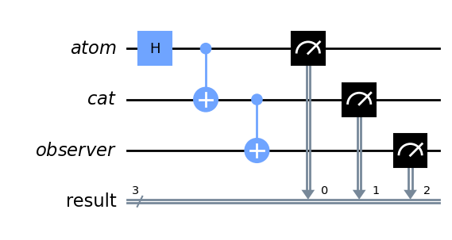
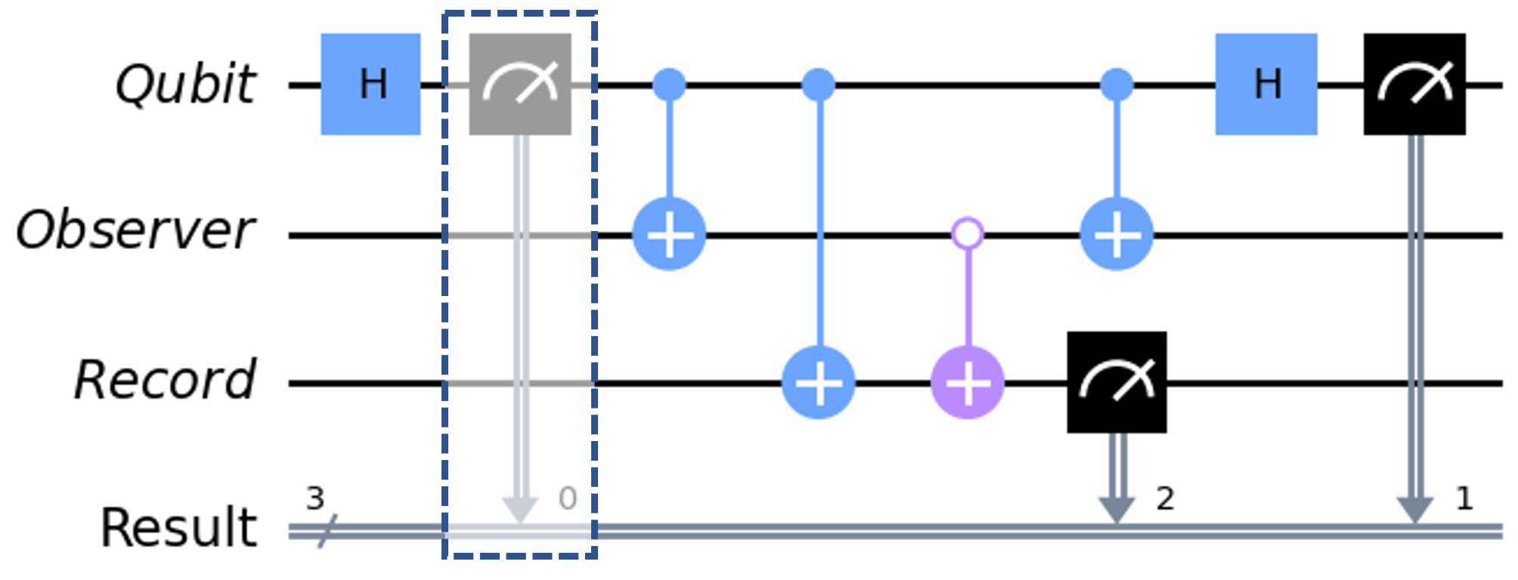
Thought experiments with “observers”
Schrödinger’s cat
Double slit
Many-worlds vs Copenhagen test
Macroscopic superpositions
Wave-particle duality
Measurement problem

Slide 9
Schrödinger’s cat
Notes:
In the famous Schrodinger’s cat thought experiment, we imagine a cat trapped in a box with an atom and a vial of poison. If the atom is in a superposition of decaying and not decaying, then the cat enters an entangled superposition of being alive and dead. Then an observer that looks at the cat will either see it being alive or dead.
To turn this into a quantum circuit, we can model the atom, the cat and the observer as qubits. Then we simply need a Hadamard gate to prepare the initial superposition of having decayed and not decayed. Then we have an entangling CNOT gate to represent the cat’s measurement of the atom, so they enter an entangled superposition. Then if a quantum observer looks inside the box, we represent their observation by aother CNOT gate, which will store an outcome of 0 if the atom ahs not decayed and the cat is alive, or an outcome of 1 if the atom has decayed and the cat is dead.
We add measurements so that when we simulate the circuit we can see what the distribution of outcomes is.
This circuit models how the cat and observer can enter an entangled quantum superposition when they measure the qubit.
3 min

Slide 10
Schrödinger’s cat
Notes:
In the famous Schrodinger’s cat thought experiment, we imagine a cat trapped in a box with an atom and a vial of poison. If the atom is in a superposition of decaying and not decaying, then the cat enters an entangled superposition of being alive and dead. Then an observer that looks at the cat will either see it being alive or dead.
To turn this into a quantum circuit, we can model the atom, the cat and the observer as qubits. Then we simply need a Hadamard gate to prepare the initial superposition of having decayed and not decayed. Then we have an entangling CNOT gate to represent the cat’s measurement of the atom, so they enter an entangled superposition. Then if a quantum observer looks inside the box, we represent their observation by aother CNOT gate, which will store an outcome of 0 if the atom ahs not decayed and the cat is alive, or an outcome of 1 if the atom has decayed and the cat is dead.
We add measurements so that when we simulate the circuit we can see what the distribution of outcomes is.
This circuit models how the cat and observer can enter an entangled quantum superposition when they measure the qubit.
3 min

Slide 11
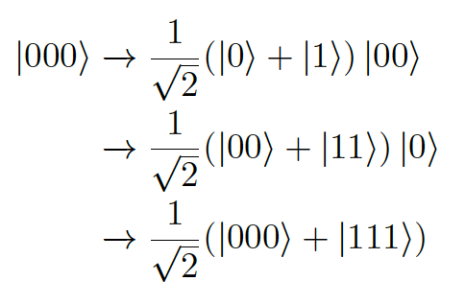
Schrödinger’s cat
Notes:
In the famous Schrodinger’s cat thought experiment, we imagine a cat trapped in a box with an atom and a vial of poison. If the atom is in a superposition of decaying and not decaying, then the cat enters an entangled superposition of being alive and dead. Then an observer that looks at the cat will either see it being alive or dead.
To turn this into a quantum circuit, we can model the atom, the cat and the observer as qubits. Then we simply need a Hadamard gate to prepare the initial superposition of having decayed and not decayed. Then we have an entangling CNOT gate to represent the cat’s measurement of the atom, so they enter an entangled superposition. Then if a quantum observer looks inside the box, we represent their observation by aother CNOT gate, which will store an outcome of 0 if the atom ahs not decayed and the cat is alive, or an outcome of 1 if the atom has decayed and the cat is dead.
We add measurements so that when we simulate the circuit we can see what the distribution of outcomes is.
This circuit models how the cat and observer can enter an entangled quantum superposition when they measure the qubit.
3 min

Slide 12
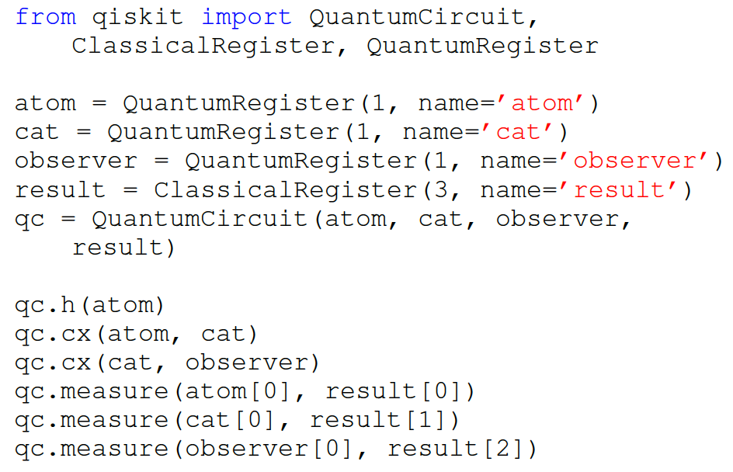
Schrödinger’s cat
Notes:
The qiskit code for this circuit is very simple to implement, and uses the basic functions needed to code a quantum circuit.

Slide 13
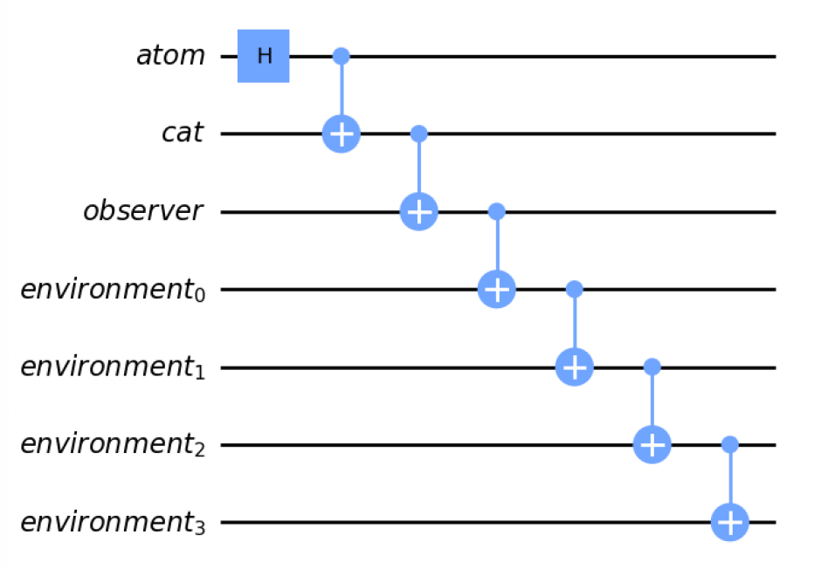
Schrödinger’s cat
Notes:
Now the apparent absurdity of Schrodinger’s cat is that a cat can be dead and alive simultaneously, yet we never see cats dead and alive in everyday life. This can be understood in terms of decoherence. If the cat and observer interact with a large environment, then they are essentially irreversibly projected into either the cat being dead or being alive. We can model the decoherence process by treating the environment as a large collection of qubits, and adding them to the circuit with additional CNOT gates that model the chain reaction as the cat interacts with more and more of its surroundings.

Slide 14
Schrödinger’s cat
Decoherence as dominoes
Notes:
Now the apparent absurdity of Schrodinger’s cat is that a cat can be dead and alive simultaneously, yet we never see cats dead and alive in everyday life. This can be understood in terms of decoherence. If the cat and observer interact with a large environment, then they are essentially irreversibly projected into either the cat being dead or being alive. We can model the decoherence process by treating the environment as a large collection of qubits, and adding them to the circuit with additional CNOT gates that model the chain reaction as the cat interacts with more and more of its surroundings.

Slide 15
Schrödinger’s cat
Decoherence as dominoes
Notes:
Now the apparent absurdity of Schrodinger’s cat is that a cat can be dead and alive simultaneously, yet we never see cats dead and alive in everyday life. This can be understood in terms of decoherence. If the cat and observer interact with a large environment, then they are essentially irreversibly projected into either the cat being dead or being alive. We can model the decoherence process by treating the environment as a large collection of qubits, and adding them to the circuit with additional CNOT gates that model the chain reaction as the cat interacts with more and more of its surroundings.

Slide 16
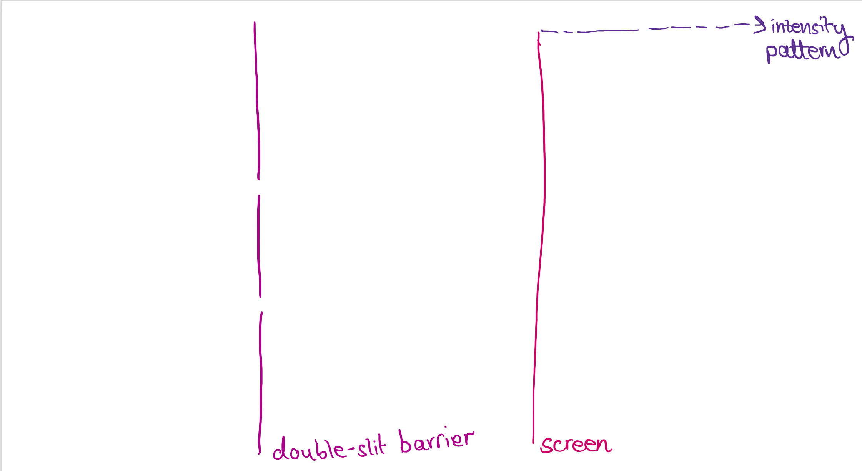
Double-slit

Slide 17
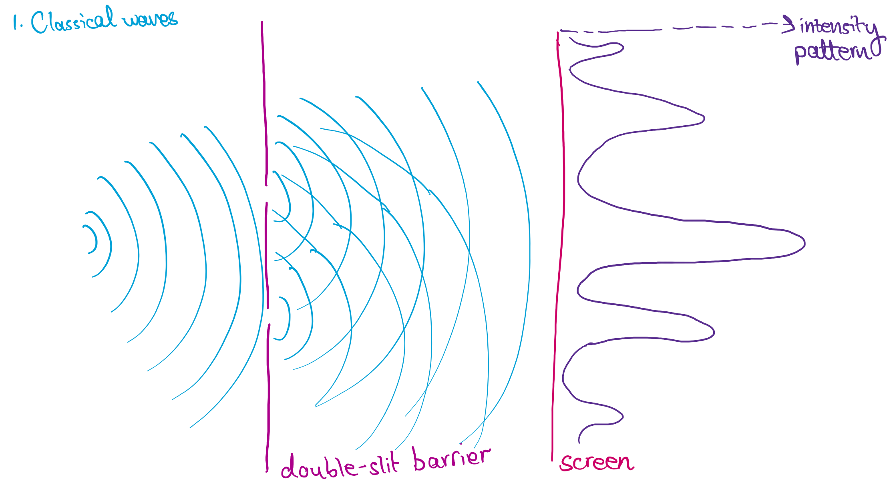
Waves

Slide 18
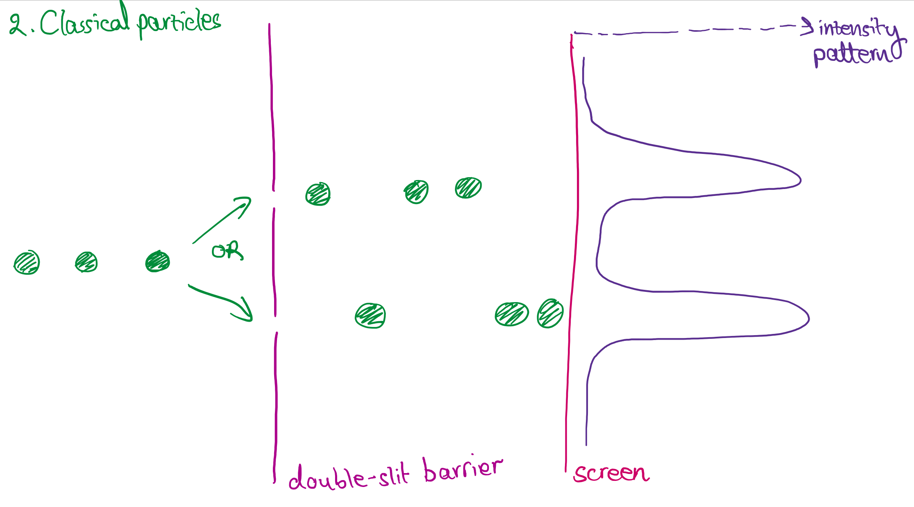
Particles

Slide 19
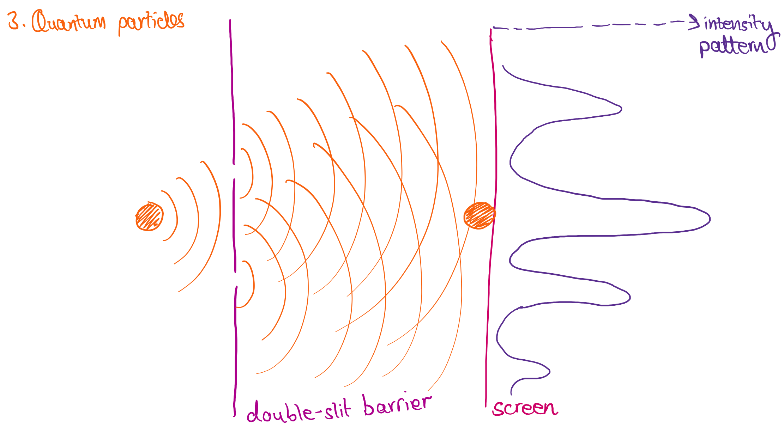
Quantum particles

Slide 20
What if we add a detector???

Slide 21
Double slit
Screen

Slide 22
Double slit
Screen

Slide 23
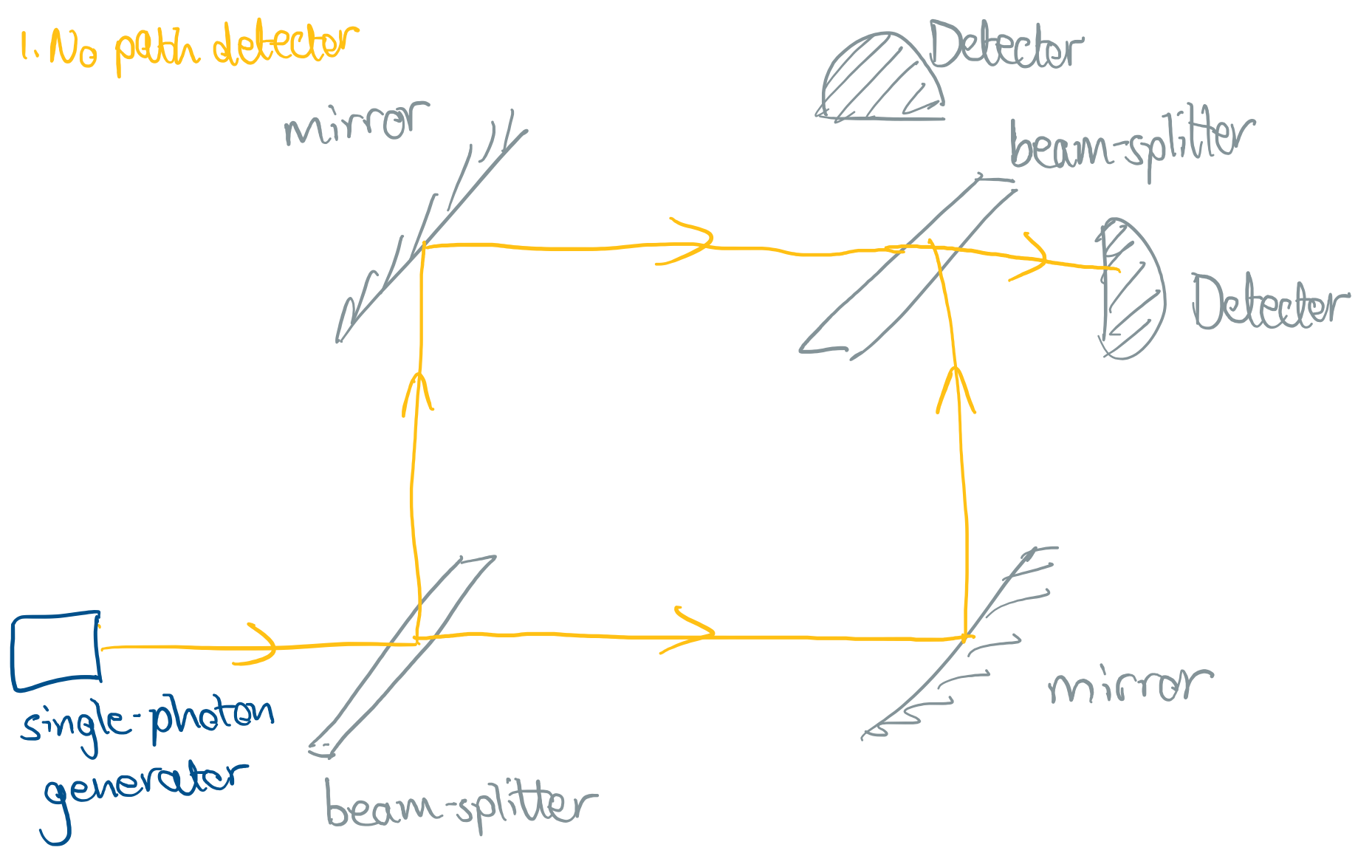
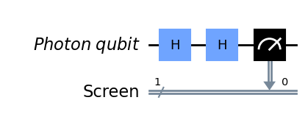
Map to interferometer

Slide 24
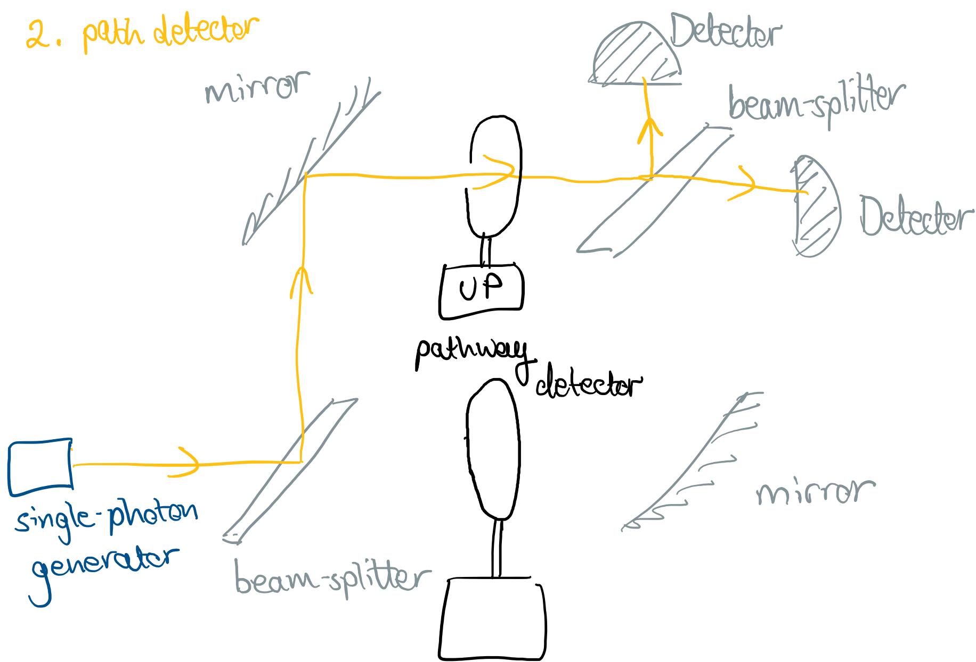
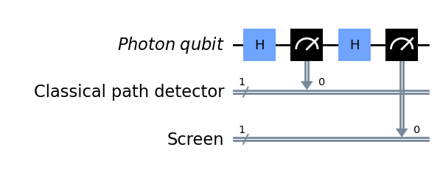
Add a detector

Slide 25
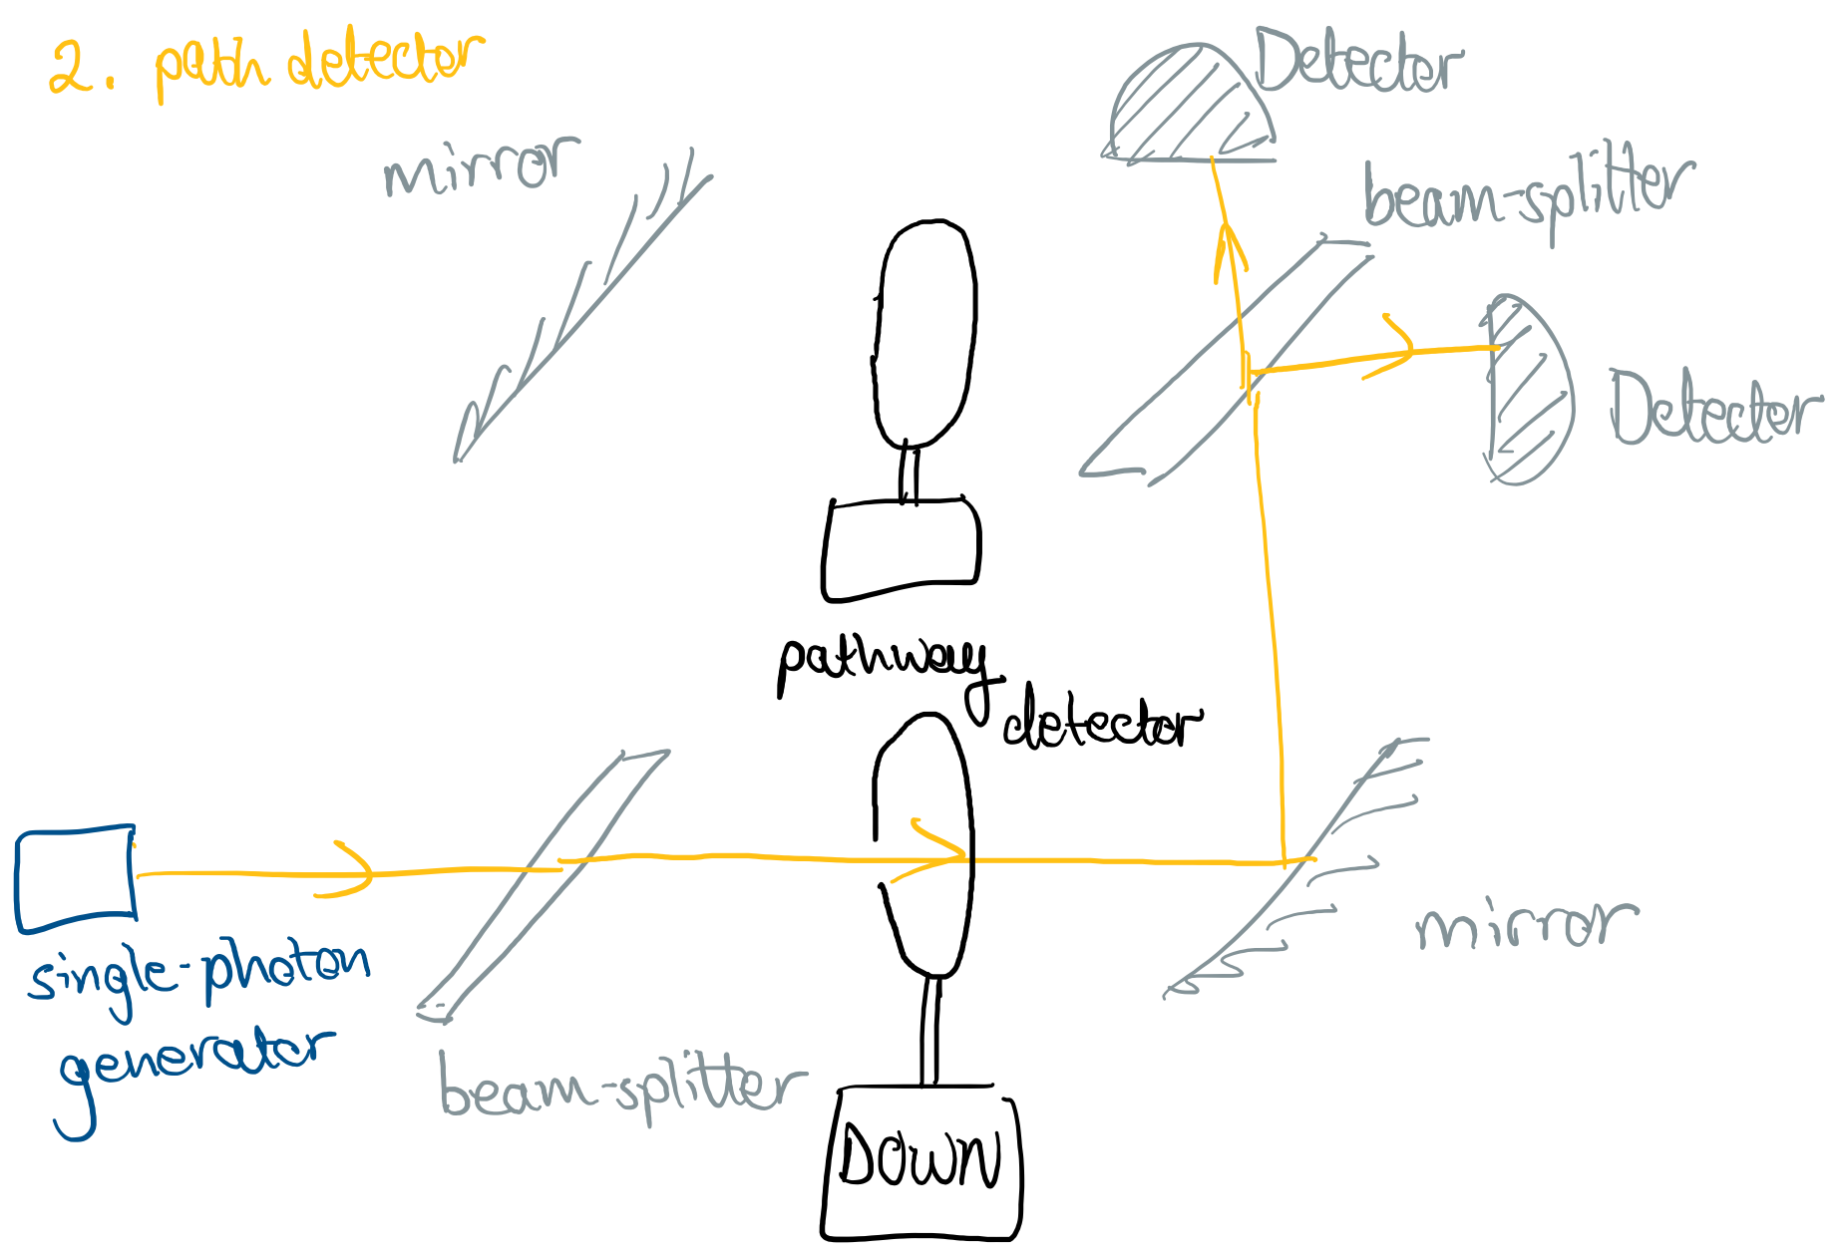
Add a detector

Slide 26
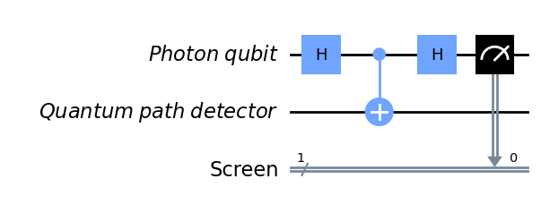
Single-qubit detector?!
No decoherence
(“wave”)
?
Decoherence
(“particle”)

Slide 27
Single-qubit detector?!
No decoherence
(“wave”)
Decoherence
(“particle”)

Slide 28
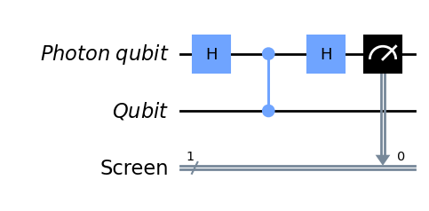
Single-qubit detector?!
No decoherence
(“wave”)
Decoherence
(“particle”)

Slide 29
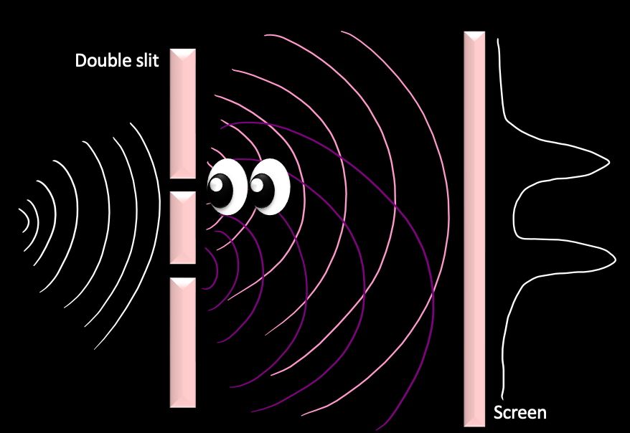
Double-slit summary

Slide 30
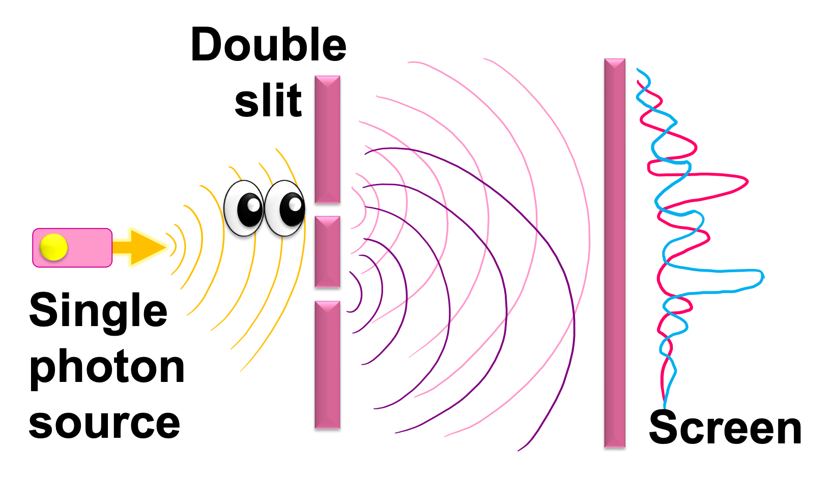
Take-home activities
Explain the double-slit thought experiment to someone else. Can you explain each possible outcome, and how a single-particle measurement explains the effect of the “observer” on the outcomes?
Play with building the simplified interferometer double-slit on the Quantum Flytrap Virtual Lab platform.
Code simulations of the thought experiments yourself using Qiskit in a Colab notebook.
Bonus: watch delayed-choice quantum eraser video!
Videos, blogs and code tutorials on my Quantum Paradoxes page:
https://www.mariaviolaris.com/quantum-paradoxes/
Delayed-choice quantum eraser

Slide 31
Content we didn’t get time for
Will be continued in Lecture 3!

Slide 32
Many-worlds vs Copenhagen test
Notes:
Now there is a controversy about whether the observer can really be treated as a quantum system or whether they should be treated as a classical system that causes irreversible collapse. Interestingly, a thought experiment proposed in 1985 by David Deutsch provides a way to experimentally distinguish the two cases where measurement causes irreversible collapse, and where measurement is reversible. I will refer you to my paper and an upcoming Qiskit video for the full explanation, but the overall idea is that we simulate an observer making a measurement, writing down that they definitely made a measurement, then try and reverse it all. Adding an irreversible measurement to collapse the qubit will lead to different outcomes at the end than a reversible measurement.
Another nice aspect of this thought experiment is that it was the first proposal for a universal quantum computer, though it was not called that at the time.
2 min

Slide 33
Many-worlds vs Copenhagen test
Notes:
Now there is a controversy about whether the observer can really be treated as a quantum system or whether they should be treated as a classical system that causes irreversible collapse. Interestingly, a thought experiment proposed in 1985 by David Deutsch provides a way to experimentally distinguish the two cases where measurement causes irreversible collapse, and where measurement is reversible. I will refer you to my paper and an upcoming Qiskit video for the full explanation, but the overall idea is that we simulate an observer making a measurement, writing down that they definitely made a measurement, then try and reverse it all. Adding an irreversible measurement to collapse the qubit will lead to different outcomes at the end than a reversible measurement.
Another nice aspect of this thought experiment is that it was the first proposal for a universal quantum computer, though it was not called that at the time.
2 min

Slide 34
Recipe for resolutions

Slide 35
Recipe for resolutions
1. Detectors / Observers → Quantum systems
Notes:
Detectors as quantum systems
Measurements as entangling CNOT gates
Environment as quantum system inducing decoherence

Slide 36
Recipe for resolutions
2. Measurements → Entangling CNOT gate
1. Detectors / Observers → Quantum systems
Notes:
Detectors as quantum systems
Measurements as entangling CNOT gates
Environment as quantum system inducing decoherence

Slide 37
Recipe for resolutions
2. Measurements → Entangling CNOT gate
1. Detectors / Observers → Quantum systems
3. Environment → Quantum system inducing decoherence
Notes:
Detectors as quantum systems
Measurements as entangling CNOT gates
Environment as quantum system inducing decoherence

