Slide 1
The Quantum Bomb Tester & Quantum Computing Basics
Maria Violaris, University of Oxford
Indiana University Bloomington Quantum Summer School
10th July 2024

Slide 2
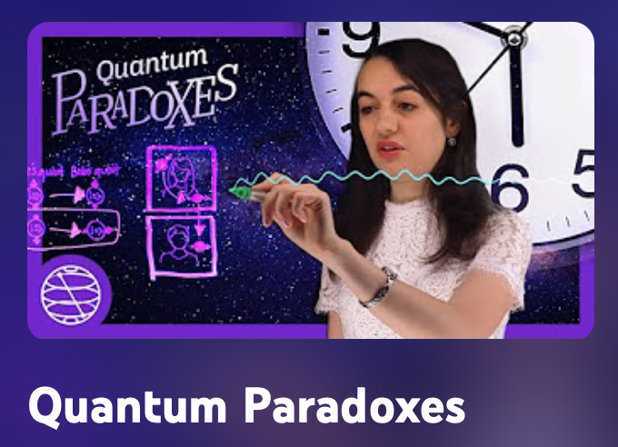
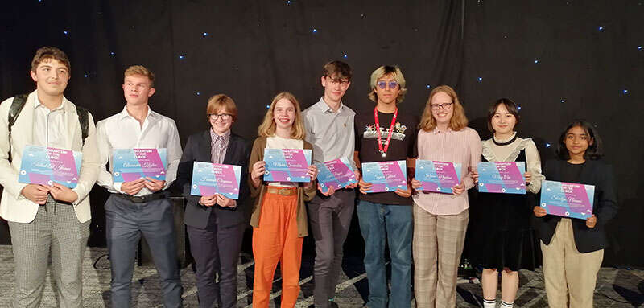
Hi!
maria@violaris.com
Maria Violaris
@maria__violaris
mariaviolaris.com
Maria Violaris
Industry
Maria Violaris
PhD
Engagement
Media
Host Quantum Foundations Podcast
Podcast interviews: Physics World, Quantum AI, Question Field, Constructor Theory
Notes:
Questions for the audience: High school?
Undergraduate?
Graduate study?
Working?
Heard of quantum computing? Heard of qubits?

Slide 3
Hi!
maria@violaris.com
Maria Violaris
@maria__violaris
mariaviolaris.com
Maria Violaris
Industry
Maria Violaris
Quantum
Paradox-Busting!
PhD
Engagement
Media
Host Quantum Foundations Podcast
Podcast interviews: Physics World, Quantum AI, Question Field, Constructor Theory
Notes:
Questions for the audience: High school?
Undergraduate?
Graduate study?
Working?
Heard of quantum computing? Heard of qubits?

Slide 4
What’s to come….
Lecture 1, Wednesday 10th July
The Quantum Bomb Tester and Quantum Computing Basics
Lecture 2, Wednesday 17th July
Collapse vs Many-Worlds: Demystifying Schrödinger’s Cat, the Double-Slit, and Quantum Observers
Lecture 3, Wednesday 24th July
Entangling Disciplines: How Quantum Computing meets Relativity, Maxwell’s Demon and Time-Travel

Slide 5
Summary
The quantum bomb tester: see a bomb without looking!
Up to 100% effective version with the “quantum Zeno effect”
Mapping the bomb tester to a quantum circuit

Slide 6
Quantum bomb tester

Slide 7
Quantum bomb tester
Detector 1
Mirror 1
Beam-splitter 2
Detector 2
Light-sensitive bomb?
Photon
Source
Beam-splitter 1
Mirror 2

Slide 8
Animation of basic bomb tester with no bomb

Slide 9
Animation of basic bomb tester with bomb, and bomb explodes

Slide 10
Animation of basic bomb tester with bomb, bomb doesn’t explode

Slide 11
Animation of basic bomb tester with bomb, bomb doesn’t explode, photon ends up at same detector as no bomb, giving inconclusive result

Slide 12
Animation of basic bomb tester with bomb, bomb doesn’t explode, photon ends up at detector that never goes off with no bomb, which tells us for sure that there is bomb

Slide 13
Quantum bomb tester
Detector 1
Mirror 1
Beam-splitter 2
Detector 2
Light-sensitive bomb?
Photon
Source
Beam-splitter 1
Mirror 2

Slide 14
Improved bomb tester with 6 beamsplitters. When there is a bomb, the photon is likely to stay in the same state, and end up at the vertical detector.

Slide 15
Improved bomb tester with 6 beamsplitters. When there is no bomb, the photon changes state to end up in the horizontal detector.

Slide 16
Weird implications & technology
Imaging delicate objects like cells using interaction-free measurement
Counterfactual quantum communication (communicate without sending anything physically)
Counterfactual quantum computing (compute without running the computation)
Evidence for Many-Worlds theory of quantum mechanics?

Slide 17
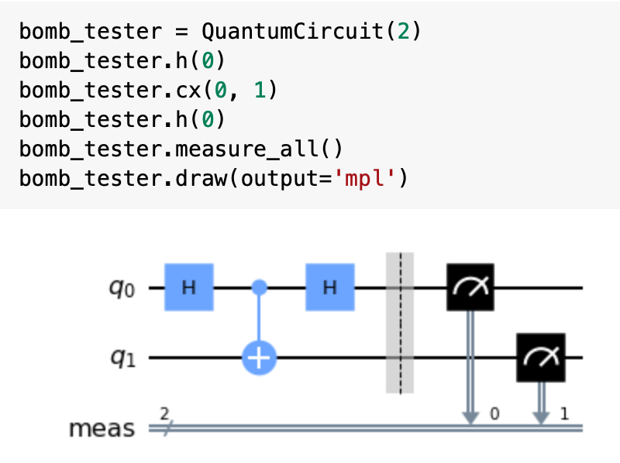
Photons → Quantum computers!
Detector 1
Mirror 1
Beam-splitter 2
Detector 2
Light-sensitive bomb?
Source
Photon
Beam-splitter 1
Mirror 2

Slide 18
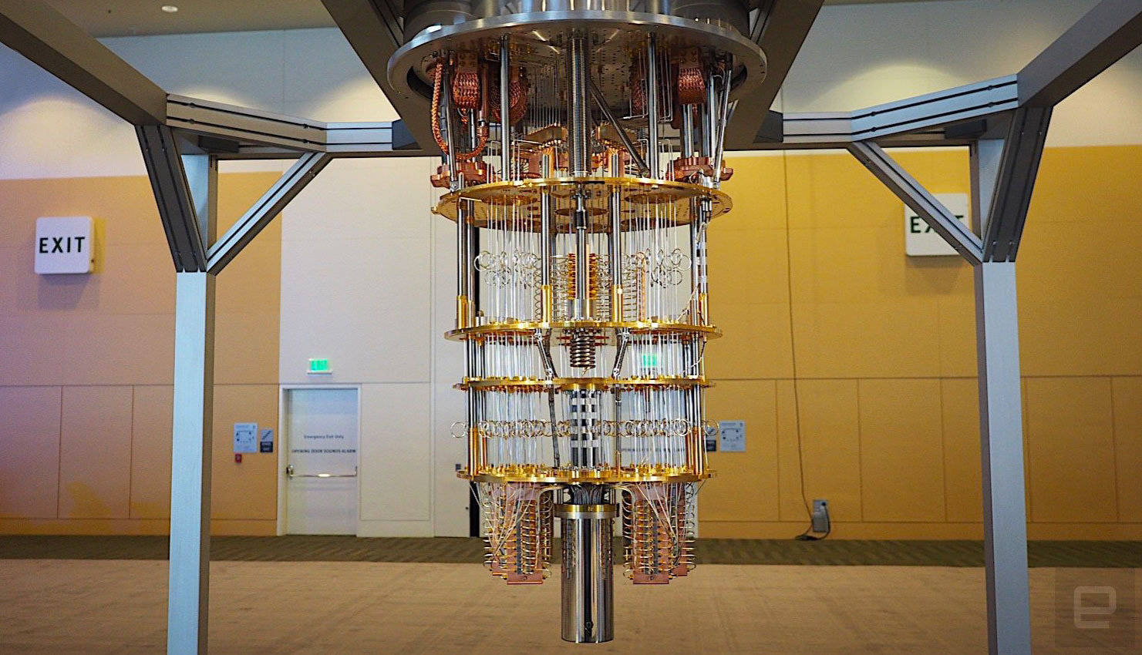
Quantum computing

Slide 19
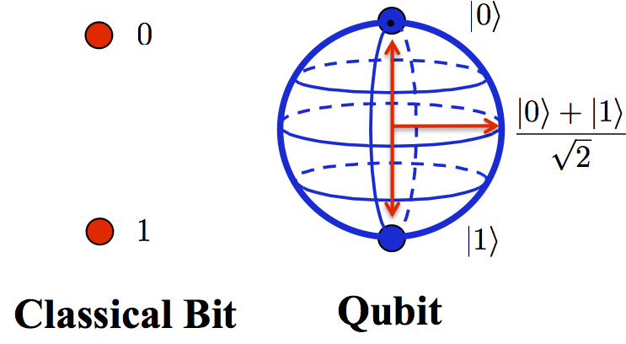
Qubits

Slide 20
Qubits
Heads
Spinning
Tails

Slide 21
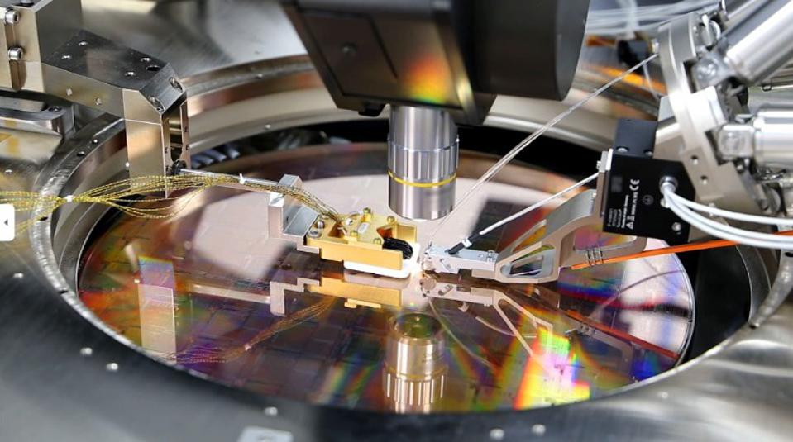
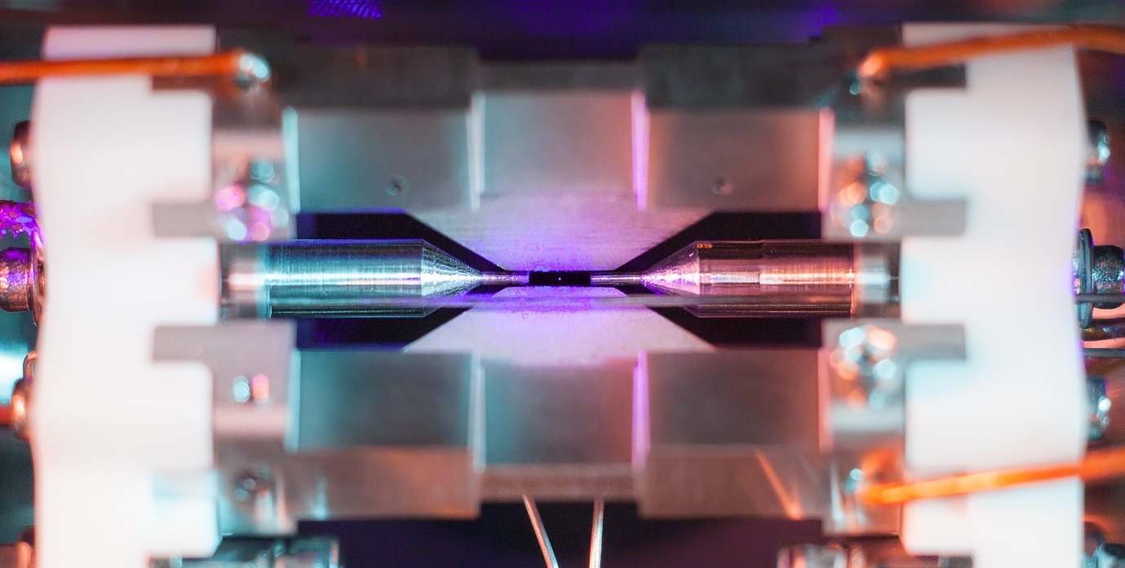
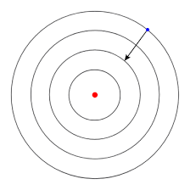
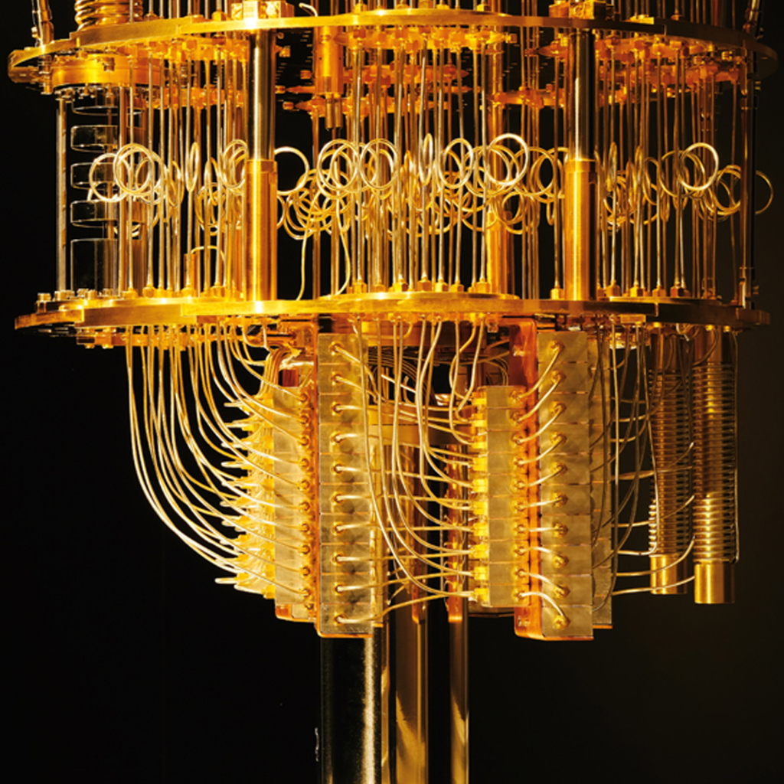
Qubits
Photons
Atoms
Superconductors
… and lots more!

Slide 22
Quantum circuits
Detector 1
Mirror 1
Beam-splitter 2
Detector 2
Light-sensitive bomb?
Source
Photon
Beam-splitter 1
Mirror 2
Qubits interact using quantum gates
Enter superpositions and become entangled
Constructively interfere to make the correct outcome have a high probability of being measured

Slide 23
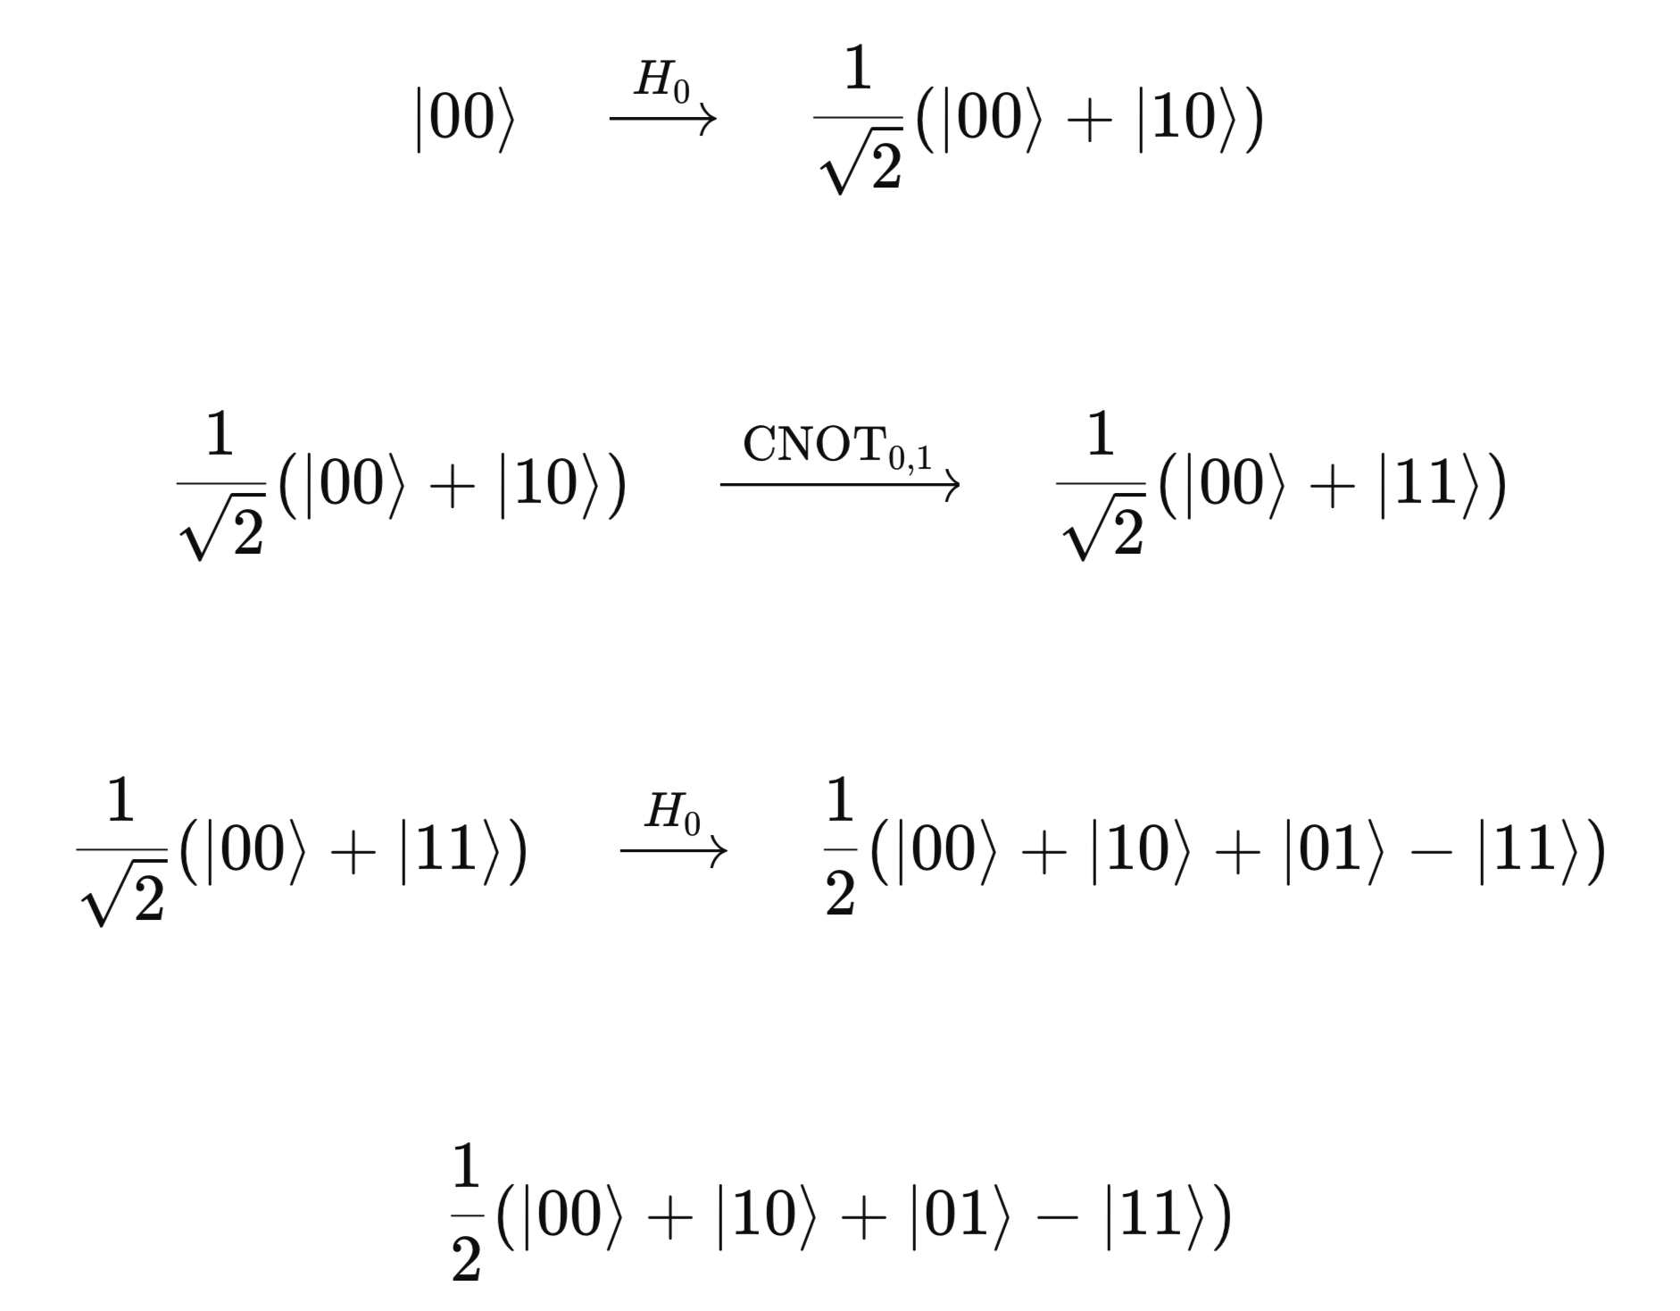
The Maths!
Detector 1
Mirror 1
Beam-splitter 2
Detector 2
Light-sensitive bomb?
Source
Photon
Beam-splitter 1
Mirror 2

Slide 24
Take-home activities
Explain the quantum bomb tester thought experiment to someone else. Can you draw out the interferometer diagram and explain the different possible outcomes?
Play with building the quantum bomb tester on the Quantum Flytrap Virtual Lab platform (Solution: https://lab.quantumflytrap.com/lab/elitzur-vaidman-bomb)
Code a quantum bomb tester simulation yourself using Qiskit in a Colab notebook. Identify the desired state where you’ve detected the bomb without exploding it! (Solution: https://github.com/maria-violaris/quantum-paradoxes/blob/main/quantum-minesweeper-code.ipynb)
Bonus: Play Quantum Minesweeper game & tell me your scores next week! (code is in my notebook tutorial).

Slide 25
Summary
Quantum bomb tester lets us see a bomb without looking!
Can be made up to 100% effective using the quantum Zeno effect
Turn it into a quantum circuit: beam-splitters → Hadamard, detection → CNOT gate and entanglement.

Slide 26
Any Questions?
Quantum bomb tester content
Video
Blog
Code tutorial
https://www.youtube.com/watch?v=fus1nJ6JaTk
https://medium.com/qiskit/building-quantum-bomb-testers-and-other-thought-experiments-with-quantum-computers-c160060fdde4
https://github.com/maria-violaris/quantum-paradoxes/blob/main/quantum-minesweeper-code.ipynb
Contact & Content
A Physics Lab Inside Your Head: Quantum Thought Experiments as an Educational Tool (paper)
maria@violaris.com
Maria Violaris
@maria__violaris
Quantum Paradoxes series on Qiskit YouTube channel
https://arxiv.org/pdf/2312.07840#:~:text=Now%2C%20quantum%20computers%20are%20putting,get%20creative%20with%20quantum%20computing
Maria Violaris
mariaviolaris.com
Maria Violaris

Slide 27
Resources: first steps
Videos
Two-part documentary presented by Jim Al-Khalili: "The mind bending story of quantum physics", "Exploring the world of quantum physics”
Quantum Enigmas animated video series introducing quantum computing using puzzles.
Quantum bomb tester videos: Seeing without looking short movie, Up and Atom explainer, Sabine Hossenfelder explainer, my “Quantum Minesweeper” video about coding a bomb tester on a quantum computer (gets technical)
Quantum on the Clock competition winners – 21 three-minute videos about quantum science and tech made by High School students.
Articles
Quantum City “Everyday Guide to Quantum Science”
Quantum articles on PLUS maths magazine: "Who killed Schrodinger's cat?”, "A brief history of quantum field theory”, "What is quantum computing?"
Physics World magazine
Quanta magazine
Books
Quantum in Pictures, The Science of Can and Can’t, Quantum Computing since Democritus (advanced), The Fabric of Reality, Decoding Reality

Slide 28
Resources: next steps
Interactive online learning resources
Qiskit resources for learning quantum computing: online textbook, YouTube course and videos
UK Quantum Technologies Programme resources aimed at 16 - 18 year olds.
Quantum Computing for the Very Curious
Online courses
“Qubit by Qubit” beginners quantum computing course for High School students and above, with scholarships for underrepresented participants.
Quantum Explorers for High School and above. Cohort-based, non-technical basics then builds up to applications. Updates on website soon, launches in July 2023.
Opportunities
IOP QQQ group Quantum on the Clock schools video competition. Hoping to run again! Updates on webpage and QQQ group Twitter.
Quantum Ambassadors programme to engage people working in quantum with schools.
Qiskit Advocates Programme. High School students can become one by contributing to quantum computing community, and schools can request Advocates as speakers related to quantum computing.
Annual “Quantum Shorts” competition, switches between stories and videos each year.

Slide 29
Other compilations of resources!
Quantum on the Clock compilation of resources
Quantum A to Z from Quantum Shorts competition

