Slide 1
Trie Indexes for Efficient XML Query Processing
Sofia Brenes, Yuqing Wu, Dirk Van Gucht, Pablo Santa Cruz
Indiana University, Bloomington
{sbrenesb, yuqwu, vgucht, psantacr}@cs.indiana.edu

Slide 2
XML and Queries – An Example
Query 1: //A/B/C
Query 2: //B/C
Query 3: //A/B[./D]/C
Query 4: //A[./B[./D]]/B/C

Slide 3
Index and XML Query Evaluation
Challenges → Structure
  Data: containment relationship
  Query:
    pattern matching
    (nested) predicates

Slide 4
Structural Indices for XML Data
Consider both value and structure
Index Features | Structural Indices
Pure structural summaries | DataGuide, T-index
Local bi-similarity | A(k), UD(k,i), D(k), M(k)
Workload-aware | D(k), M(k), M*(k)
Encoded sequence | ViST, Index Fabric
Index chooser | XIST

Slide 5
Expected Features for an XML Index
Reasonable size
Easy to construct and adjust
Query evaluation
  Index-only plan for most queries.

Slide 6
Outline
Introduction
Methodology
Partition induced by structural characteristics of XML
Partition induced by fragments of XPath Algebra
Coupling and Block Union Theorems
Trie Indices and Query Evaluation
Experimental Evaluation
Future Directions

Slide 7
Rewind – back to the world of RDB
RDBMS
Engineering
Techniques
RDBMS
Theory

Slide 8
Our approach
Study XML query language and its fragments
Study the indistinguishibility of components in an XML documents
Reason about existing XML indices
Design new XML indices.

Slide 9
Outline
Introduction
Methodology
Partition induced by structural characteristics of XML
Partition induced by fragments of XPath Algebra
Coupling and Block Union Theorems
Trie Indices and Query Evaluation
Experimental Evaluation
Future Directions

Slide 10
XML Data Model
Represent XML document D as a finite unordered node-labeled tree
D = (V, Ed, r, )
Nodes: V
Edges: Ed
Root: r
Labels:

Slide 11
Label Path
LP(m,n)
  LP(m,n) = (A,B,C)
LP(n, k)
  LP(n,0) = (C)
  LP(n, 1) = (B,C)
  LP(n,4) = (A,A,B,C)
  LP(n,7) = (A,A,B,C)
m
n

Slide 12
N [k] Equivalence
Given an XML document and value k

Slide 13
N [k] Partition
N [1] | (A) (A,A) (A,B) (B,B) (B,C) (B,D) | {A₁} {A₂} {B₁, B₂, B₃, B₄} {B₅} {C₁, C₂, C₃, C₄} {D₁}
Label Path
N [1][(A,B)] = {B₁, B₂, B₃, B₄}

Slide 14
P [k] Equivalence
Given an XML document and value k

Slide 15
P [k] Partition
P [1] | (A) (B) (C) (D) | {(A₁, A₁), (A₂, A₂)} {(B₁, B₁), (B₂, B₂), (B₃, B₃), (B₄, B₄), (B₅, B₅)} {(C₁, C₁), (C₂, C₂), (C₃, C₃), (C₄, C₄)} {(D₁, D₁)}
 | (A,A) (A,B) (B,B) (B,C) (B,D) | {(A₁, A₂)} {(A₁, B₁), (A₂, B₂), (A₂, B₃), (A₁, B₄)} {(B₄, B₅)} {(B₁, C₁), (B₂, C₂), (B₃, C₃), (B₅, C₄)} {(B₂, D₁)}
P [1][(A,A)] = {(A₁, A₂)}

Slide 16
P [k] Partition
P [2] | (A) (B) (C) (D) | {(A₁, A₁), (A₂, A₂)} {(B₁, B₁), (B₂, B₂), (B₃, B₃), (B₄, B₄), (B₅, B₅)} {(C₁, C₁), (C₂, C₂), (C₃, C₃), (C₄, C₄)} {(D₁, D₁)}
 | (A,A) (A,B) (B,B) (B,C) (B,D) | {(A₁, A₂)} {(A₁, B₁), (A₂, B₂), (A₂, B₃), (A₁, B₄)} {(B₄, B₅)} {(B₁, C₁), (B₂, C₂), (B₃, C₃), (B₅, C₄)} {(B₂, D₁)}
 | (A,A,B) (A,B,B) (A,B,C) (A,B,D) (B,B,C) | {(A₁, B₂), (A₁, B₃)} {(A₁, B₅)} {(A₁, C₁), (A₂, C₂), (A₂, C₃)} {(A₂, D₁)} {(B₄, C₄)}
P [2][(A,B,C)] = {(A₁, C₁), (A₂, C₂), (A₂, C₃)}

Slide 17
Outline
Introduction
Methodology
Partition induced by structural characteristics of XML
Partition induced by fragments of XPath Algebra
Coupling and Block Union Theorems
Trie Indices and Query Evaluation
Experimental Evaluation
Future Directions

Slide 18
XPath Algebra
Path semantics
Node semantics

Slide 19
Fragments of XPath Algebra
D algebra XPath algebra - ↑, π₁
D [ ] algebra XPath algebra - ↑
D [k] algebra D algebra up to length k
D [ ][k] algebra D [ ] algebra up to length k

Slide 20
D [k] Equivalence
Given an XML document and value k and (m₁, n₁), (m₂, n₂) in DownPairs(D)
For any E in D [k]

Slide 21
Outline
Introduction
Methodology
Partition induced by structural characteristics of XML
Partition induced by fragments of XPath Algebra
Coupling and Block Union Theorems
Trie Indices and Query Evaluation
Experimental Evaluation
Future Directions

Slide 22
Coupling Theorem
Let D be a document and k is an integer.
  The P[k]-partition of D and the D[k]- partition of D are the same under the path semantics
  The N[k]-partition of D and the D[k]-partition of D are the same under the node semantics

Slide 23
k-Label-Path Set
The set of label-paths of length k in an XML document that satisfies an XPath expression in algebra D.

Slide 24
Label-Union Theorem
Let D be a document, k an integer, and E is an D[k] expression. Then there exists a class of partition blocks of the P[k]-partition (N[k]-partition) of D such that

Slide 25
Query Evaluation Using
Label-Union Theorem
Query 2: //B/C
LPS(E,2) = {(A,B,C), (B,B,C)}
N [2] | (A) (A,A) (A,B) (A,A,B) (A,B,B) (A,B,C) (B,B,C) (A,B,D) | {A₁,} {A₂} {B₁, B₄} {B₂, B₃,} {B₅} {C₁, C₂, C₃} {C₄} {D₁}

Slide 26
Outline
Introduction
Methodology
Partition induced by structural characteristics of XML
Partition induced by fragments of XPath Algebra
Coupling and Block Union Theorems
Trie Indices and Query Evaluation
Experimental Evaluation
Future Directions

Slide 27
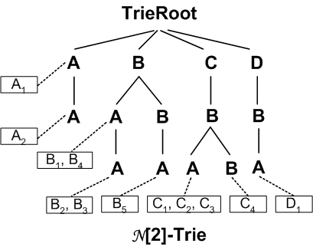
N[k]-Trie Index
Keep track of the N [k]-partitions
Use the reverse label path as key
N [2] | (A) (A,A) (A,B) (A,A,B) (A,B,B) (A,B,C) (B,B,C) (A,B,D) | {A₁,} {A₂} {B₁, B₄} {B₂, B₃,} {B₅} {C₁, C₂, C₃} {C₄} {D₁}

Slide 28
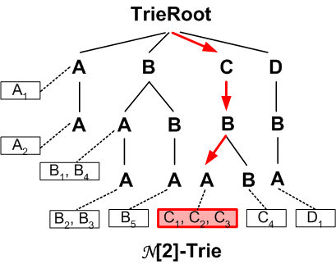
Query Evaluation with N [k]-Trie Index
Query 1: //A/B/C
LPS(E,2) = {(A,B,C)}
N [2] | (A) (A,A) (A,B) (A,A,B) (A,B,B) (A,B,C) (B,B,C) (A,B,D) | {A₁,} {A₂} {B₁, B₄} {B₂, B₃,} {B₅} {C₁, C₂, C₃} {C₄} {D₁}

Slide 29
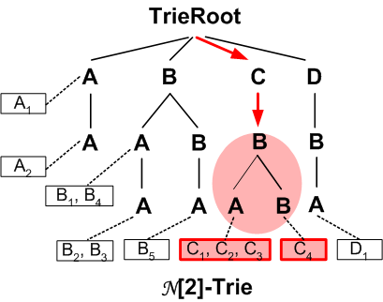
Query Evaluation with N [k]-Trie Index
Query 2: //B/C
LPS(E,2) = {(A,B,C), (B,B,C)}
N [2] | (A) (A,A) (A,B) (A,A,B) (A,B,B) (A,B,C) (B,B,C) (A,B,D) | {A₁,} {A₂} {B₁, B₄} {B₂, B₃,} {B₅} {C₁, C₂, C₃} {C₄} {D₁}

Slide 30
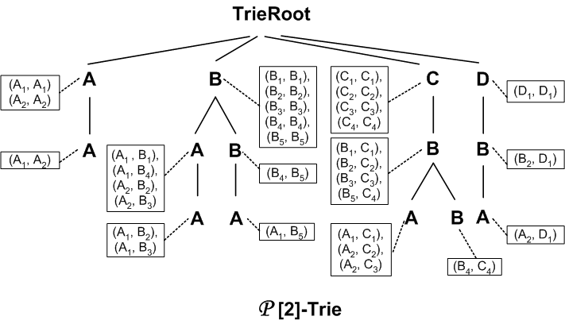
P[k]-Trie Index
Keep track of the P[k]-partitions
Use the reverse label path as key
P [2] | (A) (B) (C) (D) | {(A₁, A₁), (A₂, A₂)} {(B₁, B₁), (B₂, B₂), (B₃, B₃), (B₄, B₄), (B₅, B₅)} {(C₁, C₁), (C₂, C₂), (C₃, C₃), (C₄, C₄)} {(D₁, D₁)}
 | (A,A) (A,B) (B,B) (B,C) (B,D) | {(A₁, A₂)} {(A₁, B₁), (A₂, B₂), (A₂, B₃), (A₁, B₄)} {(B₄, B₅)} {(B₁, C₁), (B₂, C₂), (B₃, C₃), (B₅, C₄)} {(B₂, D₁)}
 | (A,A,B) (A,B,B) (A,B,C) (A,B,D) (B,B,C) | {(A₁, B₂), (A₁, B₃)} {(A₁, B₅)} {(A₁, C₁), (A₂, C₂), (A₂, C₃)} {(A₂, D₁)} {(B₄, C₄)}

Slide 31
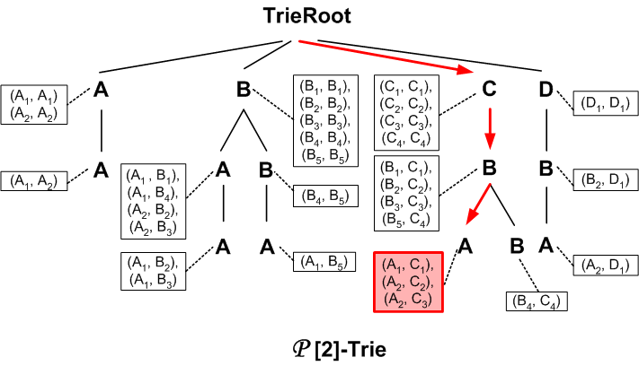
Query Evaluation with P[k]-Trie Index
Query 1: //A/B/C

Slide 32
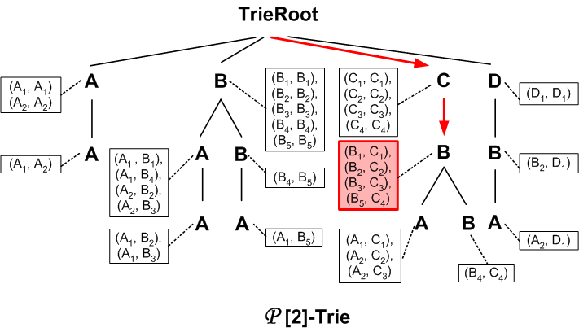
Query Evaluation with P[k]-Trie Index
Query 2: //B/C

Slide 33

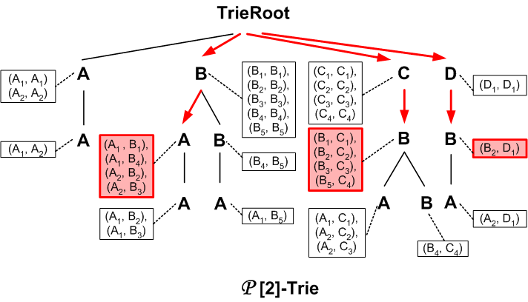
Query Evaluation with P[k]-Trie Index
Query 3: //A/B[./D]/C

Slide 34

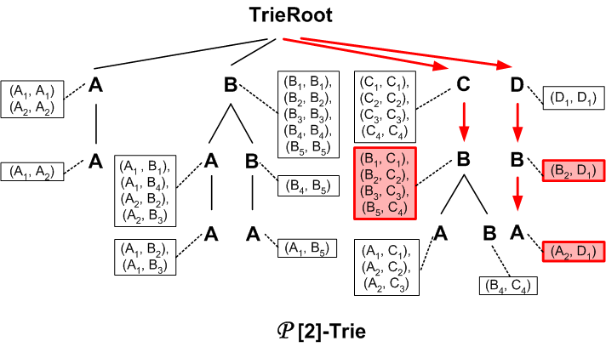
Query Evaluation with P[k]-Trie Index
Query 3: //A/B[./D]/C

Slide 35
Outline
Introduction
Methodology
Partition induced by structural characteristics of XML
Partition induced by fragments of XPath Algebra
Coupling and Block Union Theorems
Trie Indices and Query Evaluation
Experimental Evaluation
Future Directions

Slide 36
Experimental Setup
Indices prototyped in TIMBER system
Report results on DBLP data
  127M bytes
  3.3M nodes

Slide 37
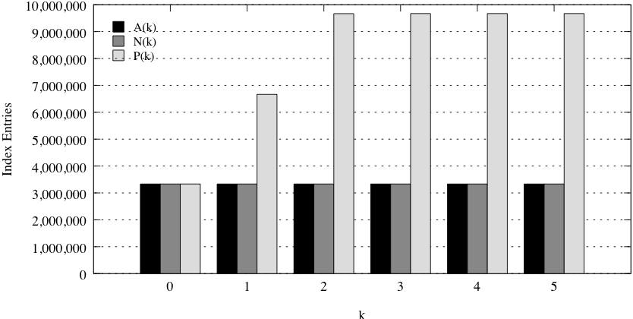
Index Sizes

Slide 38
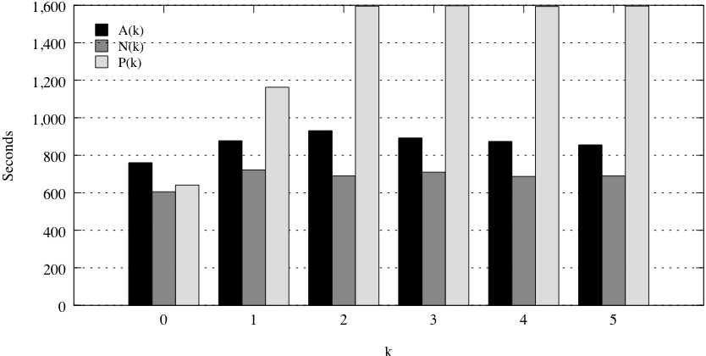
Index Creation Time

Slide 39
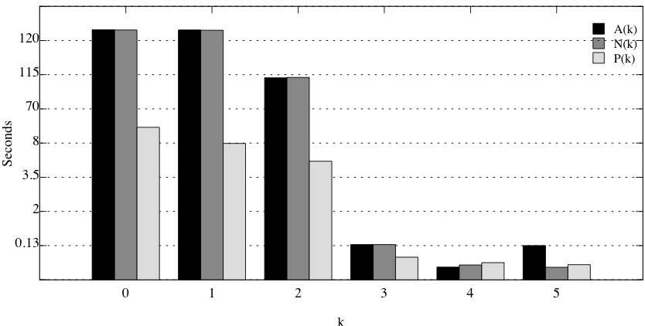
Query Evaluation
//dblp/inproceedings/title/i/sub

Slide 40
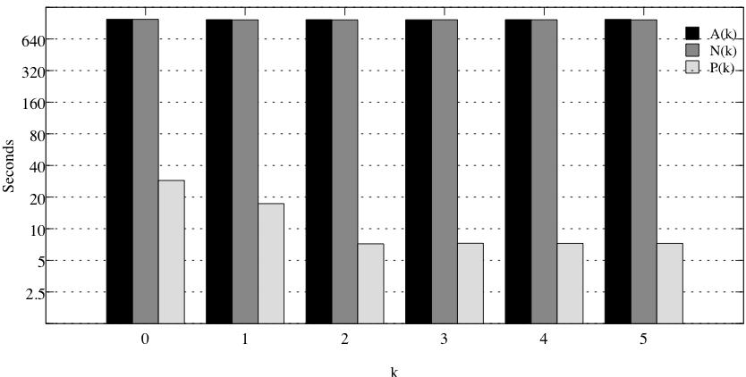
Query Evaluation
//dblp/inproceedings[./title[./i]/sub]/ee

Slide 41
Outline
Introduction
Methodology
Partition induced by structural characteristics of XML
Partition induced by fragments of XPath Algebra
Coupling and Block Union Theorems
Trie Indices and Query Evaluation
Experimental Evaluation
Conclustion

Slide 42
Conclusion
P [k]-Trie index is able to facilitate index-only plan for most queries → consistently and significantly outperform N[k]-Trie and A(k)-index.
A modest k value is sufficient for providing significant performance improvements.

Slide 43
Thanks!!
Questions?

Slide 44
Research Direction
Further study of query decomposition and inversion algorithms
Study workload driven index creation
Develop other appropriate index structures

